Slide 1

Strong Foundations
The State of State Postsecondary Data Systems
2012 Update on Postsecondary Data Sharing with
K-12 and Labor
26th Annual Management Information Systems Conference
Washington, D.C.
February 15, 2013
Hans Peter L’Orange and Tanya I. Garcia
Notes:
The main report and all associated resources are available online on the SHEEO website: http://www.sheeo.org/resources/publications/strong-foundations-state-state-postsecondary-data-systems-2012-update-data.
Citation
Tanya I. Garcia and Hans Peter L’Orange. Strong Foundations: The State of State Postsecondary Data Systems: 2012 Update on Data Sharing with K-12 and Labor. December 2010. Boulder: State Higher Education Executive Officers Association.
Back Matter Info
The following abbreviations are used in the maps for states with more than one state postsecondary agency/entity:
California
California Community Colleges (CCC)
California Postsecondary Education Commission (CPEC)
The California State University and Colleges (CSU)
University of California System (UCS)
Florida
Florida Department of Education (DOE)
State University System of Florida Board of Governors (BOG)
Minnesota
Minnesota Office of Higher Education (MOHE)
Minnesota State Colleges and Universities (MNSCU)
New York
City University of New York (CUNY)
New York State Education Department Office of Higher Education (NYSED)
The State University of New York (SUNY)
North Carolina
North Carolina Community College System (NCCCS)
University of North Carolina (UNC)
Oregon
Oregon Department of Community Colleges and Workforce Development (ODCC)
Oregon University System (OUS)
Pennsylvania
Pennsylvania Department of Education Office of Postsecondary and Higher Education (PDE)
Pennsylvania State System of Higher Education (PASSHE)
Vermont
University of Vermont (UVM)
Vermont State Colleges (VSC)
Washington
Washington Office of Financial Management (OFM)
Washington State Board for Community & Technical Colleges (SBCTC)
Washington Student Achievement Council (WSAC)
Wyoming
University of Wyoming (UWYO)
Wyoming Community College Commission (WCCC)

Slide 2
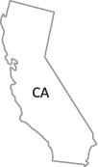








Background and scope
Focus of update is on data sharing activities
58* respondents from 44 states and the District of Columbia
Includes 10 states with more than one state postsecondary agency/entity
2
3
2
2
3
3
2
2
2
2
Notes:
Back in 2010, SHEEO released the first Strong Foundations report that identified and described the various characteristics of state postsecondary data systems, including the types of data collected, uses of data, reports generated, and data sharing practices.
The study focused on state higher education coordinating and governing boards with student unit record systems, or SURs for short.
SURs are data systems that collect data for each student attending colleges and universities in each state, but it does not mean that all students from all colleges are included in these systems.
Moreover, there is variation from state to state and within states as to the types of student data collected.
This 2012 update focuses exclusively on the data sharing practices of these state postsecondary agencies/entities. Due to certain limitations, we were unable to conduct a full update of the original report, but this is our hope for the future.
What do we mean by data sharing activities? This includes the relationships the state postsecondary entities have with other partners in the state, whether as part of a state P-20 data warehouse, as a one-way exchange with one or more state agencies, or as a two-way exchange with one or more state agencies.
*This update replicates the 2009 study respondents with one exception. The California Postsecondary Education Commission no longer exists, as funding for this agency was discontinued in November 2011.
As was the case in 2009, this update includes more than one postsecondary agency/entity in 10 states in order to capture a more accurate picture of state postsecondary data collection in these states.

Slide 3

First main finding
End result:
State postsecondary entities are better positioned to follow students from
cradle to career
(Microsoft Word Clip Art Images)
Notes:
We arrived at two main conclusions as a result of this update, neither of them terribly surprising.
As was the case three years ago, the most common data sharing agreements exist between the state postsecondary agency/entity and the state education (K-12) and labor/workforce agencies.
Many states are now able to supplement the postsecondary data from institutions with K-12 and/or labor data.
The end result is the ability to follow students from cradle to career.

Slide 4
Second main finding
Federal investment in
SLDS
K-12 and PS partners
Coordinated, multi-sector data sharing
In at least 30 of 39 states with coordinated data sharing, the influence of SLDS grants cannot be understated in the creation of state P-20 data warehouses or federated data models
Notes:
The second main conclusion:
While state postsecondary agencies/entities are no strangers to data sharing with other state partners, the SLDS grant application requirement for state K-12 agencies to partner with their postsecondary and labor counterparts has accelerated and expanded data sharing across the country.
A very conservative comparison of the states that have received SLDS grants in the last three years with the state postsecondary agencies/entities featured in this report with new data sharing relationships suggests that the grants seem to have directly influenced the increase in coordinated, multi-sector data sharing in at least 30 of these 39 states.
You can read more about this influence in the report.

Slide 5
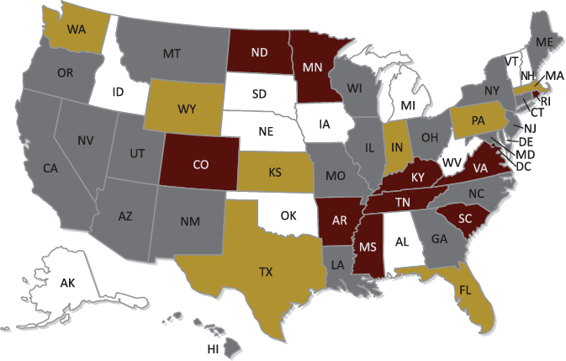
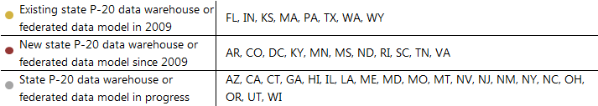
Figure 1: Coordinated, multi-sector data sharing, 2009-present
Source: Tanya I. Garcia and Hans Peter L’Orange. Strong Foundations: The State of State Postsecondary Data Systems: 2012 Update on Data Sharing with K-12 and Labor. December 2010. Boulder: State Higher Education Executive Officers Association. Available online.
Notes:
Sharing data via inclusion in state P-20 data warehouses or federated data models has recently emerged as one of the options available to state postsecondary agencies/entities wishing to increase their data sharing capacity with other state agencies/entities.
Based on feedback from the study respondents, I am now referring to this phenomenon as “coordinated, multi-sector data sharing,” a much broader term that includes both state P20 data warehouses as well as federated data models. What distinguishes the former from the latter is that in the latter, there is no central repository for storing data; rather the data gets pulled from the partners’ data systems each time the data are matched.
Some of you may know that state postsecondary SURs have been around since the late seventies, whereas state K-12 agencies, have, for the most part, been developing their SURs since 2005, when the first round of SLDS grants were awarded. So this type of sharing was simply not possible until recently.
This is Figure 1 from the report, which shows states with multi-sector data sharing where the state postsecondary agency/entity plays a role.
In 2009, the eight states in yellow had a state P-20 data warehouse or federated data model. Today, the number has grown to 19 states (including D.C.) that have established such structures (in yellow and red); 20 additional states (shown in gray) are in the process.
Since the state K-12 agencies in Alaska, Idaho, and Iowa have been awarded SLDS grants in the past three years in partnership with their postsecondary and labor/workforce counterparts, the total number of states with coordinated, multi-sector data sharing that include postsecondary is actually 42, including D.C.
The 2009 study excluded the state postsecondary agencies/entities in Delaware, Idaho, Iowa, Nebraska, New Hampshire, and Puerto Rico because they did not have SURs at the time. Michigan does not have a state postsecondary agency/entity. Of these states, Idaho, Iowa, and Michigan have received SLDS grants that include the postsecondary sector. Delaware, Nebraska, New Hampshire, and Puerto Rico received FY2012 SLDS grants to develop their state K-12 data systems.
It was beyond the scope of this update to detail which of these data sharing relationships originated as individual agreements, as part of the state’s effort to build a P-20 data warehouse or federated data model, or both.

Slide 6
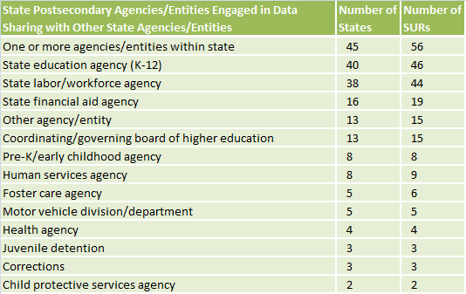
Extent of postsecondary data sharing across the board
Notes:
The previous slide showed a specific data sharing trend, and this slide, Table 1 from the report, shows a more general picture of data sharing, regardless of how it is carried out. There was an error in the original Table 1 in the report, which has been corrected here and on our site.
Many individual data sharing agreements trace their roots to data reporting requirements associated with state laws. As such, it should not be assumed that the existence and pending development of state P-20 data warehouses or federated data models will replace existing individual data sharing agreements.
Compared with 42 states in 2009, all 45 states featured in this update are engaged in some form of data sharing with other state agencies/entities.
80% of participating agencies/entities have between one and four data sharing agreements with other state agencies/entities, and in the next slide we feature the 20% that have between five and 11 such relationships.

Slide 7




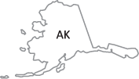
Postsecondary data sharing with multiple state agencies/entities
Board of Governors
11
Office of Financial Management
University System
10
5
NY State Ed Dept Office of Higher Ed
University System
Board of Regents
University System
6
University of AK Statewide System
8
Department of Education
Notes:
In which states does the state postsecondary agency/entity have data sharing agreements with between five and 11 other state agencies/entities?
Washington has the most with 11 (Washington Office of Financial Management)
Rhode Island is next with 10, and to clarify, it currently has seven, with three in progress (Rhode Island Board of Governors for Higher Education)
Next is Florida with eight (Florida Department of Education)
Followed by Alaska with six (University of Alaska Statewide System)
And finally Georgia, New York, Kansas, North Dakota, and Oregon with five
To clarify, Kansas has four with one in progress
University System of Georgia
Kansas Board of Regents (four with one IP)
New York State Education Department Office of Higher Education
North Dakota University System
Oregon University System
Some examples of the other agencies include financial aid, preK, foster care, health, motor vehicle, juvenile detention, and corrections.

Slide 8
Extent of postsecondary data sharing across the board
Notes:
Going back to Table 1, I now want to focus on the most common data sharing agreements the state postsecondary entities engage in: that with the state K-12 and labor agencies. This trend was evident back in 2009 and remains the case today.

Slide 9
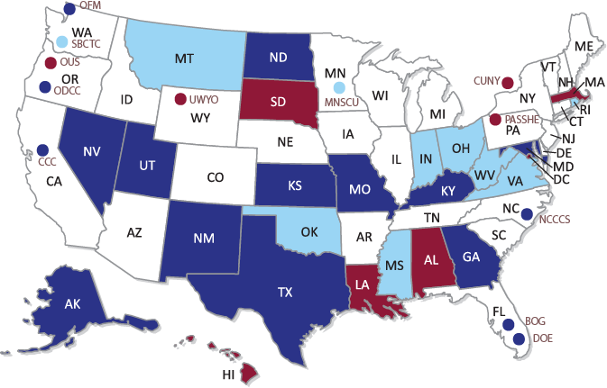
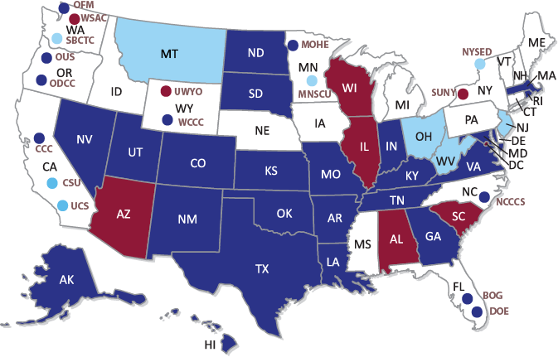

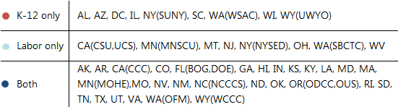
Data sharing with K-12, labor, or both agencies
2009…that was then
2012…this is now
Source: Tanya I. Garcia and Hans Peter L’Orange. Strong Foundations: The State of State Postsecondary Data Systems: 2012 Update on Data Sharing with K-12 and Labor. December 2010. Boulder: State Higher Education Executive Officers Association. Available online.
Notes:
Before we begin with these figures, several respondents issued corrections to the information provided in 2009; any 2009 numbers in this report have been adjusted where appropriate and as requested…
The figure on the left shows the situation in 2009 with regard to states with postsecondary data sharing agreements with the state K-12 and labor/workforce agencies.
The figure on the right shows this phenomenon as of 2012.
Look at how much more purple there is today. These are respectively Figures 2 and 3 from the report.
As I stated earlier, keep in mind that these arrangements may or may not take place via the state P-20 data warehouses or federated data models.
I’d like to point out that back in 2009, the Pennsylvania State System of Higher Education (PASSHE) was a contributor to the state P-20 data warehouse managed by the Pennsylvania Department of Education (PDE) until passage of House Bill 1352 in June 2011. This bill limited the sharing of PASSHE data with PDE to aggregate data only. The bill prohibited PDE from collecting any identifying information of students unless they were specifically required to do so under federal statute or regulation. House Bill 1901, passed in June 2012, now allows PASSHE to voluntarily participate in the state P20 data warehouse as long as students are allowed to opt out of data collection activities.
Also, the maps show that the Minnesota State Colleges and Universities (MNSCU) continues to have a data sharing arrangement with the state labor/workforce agency. But since MNSCU is a data contributor to the state’s P-20 data warehouse, and the Minnesota Office of Higher Education has a data sharing agreement with the state education (K-12) agency, MNSCU also will have access to K-12 data from this agency as a partner.

Slide 10
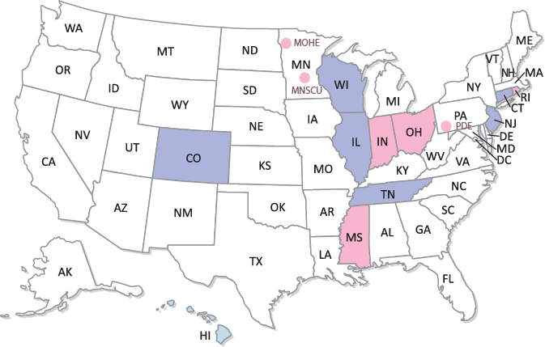
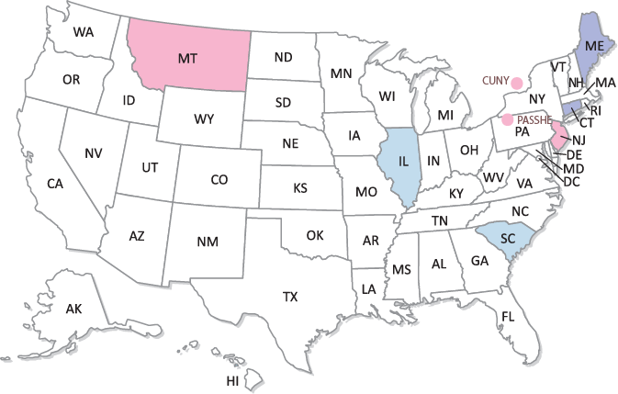


Data sharing in progress with K-12, labor, or both agencies
2009…that was then
2012…this is now
Source: Tanya I. Garcia and Hans Peter L’Orange. Strong Foundations: The State of State Postsecondary Data Systems: 2012 Update on Data Sharing with K-12 and Labor. December 2010. Boulder: State Higher Education Executive Officers Association. Available online.
Notes:
And in terms of the agreements that are in progress:
The figure on the left shows the situation in 2009 with regard to the postsecondary data sharing agreements that were in progress with the state K-12 and labor/workforce agencies.
The figure on the right shows this phenomenon as of 2012.
These are respectively Figures 4 and 5 from the report.
You can see that in 2009 the Illinois Board of Higher Education was in the process of sharing data with both the K-12 and labor agencies, and today the agreement with K-12 is up and running.

Slide 11
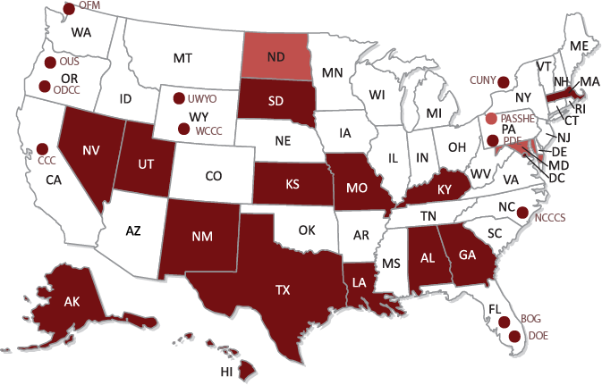
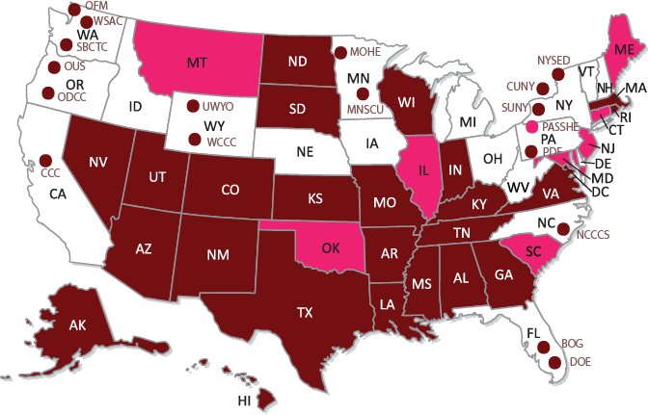
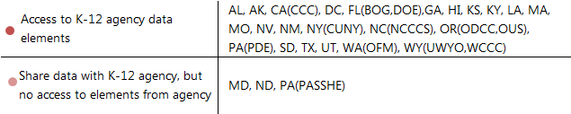
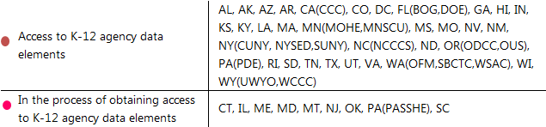
States with access to elements from the K-12 agency
2009…that was then
2012…this is now
Source: Tanya I. Garcia and Hans Peter L’Orange. Strong Foundations: The State of State Postsecondary Data Systems: 2012 Update on Data Sharing with K-12 and Labor. December 2010. Boulder: State Higher Education Executive Officers Association. Available online.
Notes:
The vast majority of the state postsecondary agencies/entities with data sharing agreements with state K-12 agencies also have access to these data elements.
The figure on the left shows the situation in 2009 with regard to postsecondary access to K-12 data elements by virtue of the data sharing agreements with the state K-12 agency.
In 2009, Maryland, North Dakota, and Pennsylvania (Pennsylvania State System for Higher Education, PASSHE) had data sharing agreements with their respective state K-12 agency, but it was a one-way exchange that did not include postsecondary access to K-12 data elements.
The figure on the right shows this phenomenon as of 2012.
These are respectively Figures 6 and 7 from the report.
Please note that the legends are not the same: as of this update, states with agreements with the K-12 agency either have access to these elements or are in the process of obtaining access.
Also worth noting is that state postsecondary entities in California (The California State University and Colleges, University of California System), North Carolina (University of North Carolina), Ohio, Pennsylvania (Pennsylvania State System of Higher Education), Vermont (Vermont State Colleges), and West Virginia are among the states that obtain K-12 elements via the institutions of higher education (or IHEs) that report data to the state postsecondary agencies/entities. High school attended, high school graduation date, and high school grade point average are among the K-12 elements typically collected by IHEs and then shared with their respective state postsecondary agencies/entities. Appendix C in the report has more detailed information.

Slide 12
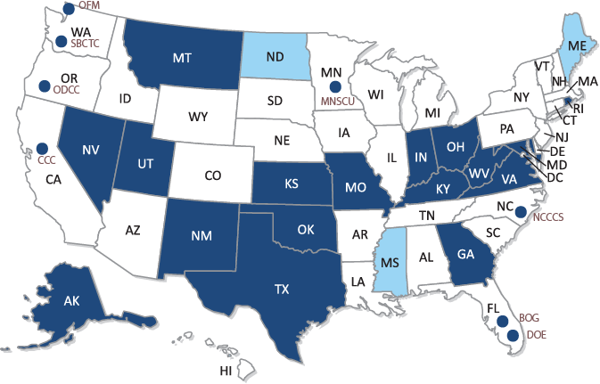
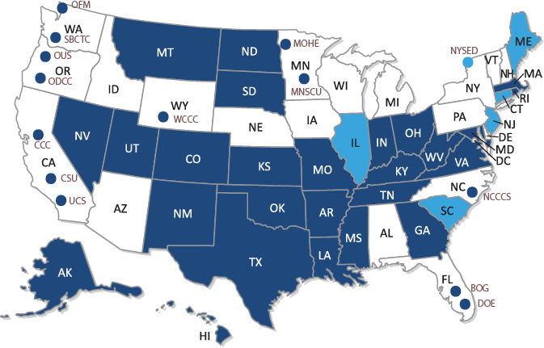
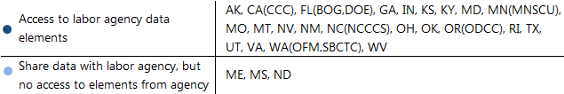
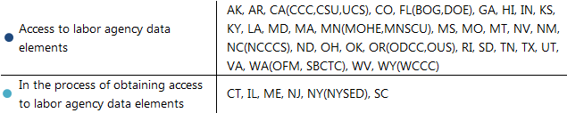
States with access to elements from the labor agency
2009…that was then
2012…this is now
Source: Tanya I. Garcia and Hans Peter L’Orange. Strong Foundations: The State of State Postsecondary Data Systems: 2012 Update on Data Sharing with K-12 and Labor. December 2010. Boulder: State Higher Education Executive Officers Association. Available online.
Notes:
The vast majority of the state postsecondary agencies/entities with data sharing agreements with the labor/workforce agencies also have access to these data elements.
The figure on the left shows the situation in 2009 with regard to postsecondary access to labor data elements by virtue of the data sharing agreements with the state labor/workforce agency.
In 2009, Maine, Mississippi, and North Dakota had data sharing agreements with their respective state labor/workforce agency, but it was a one-way exchange that did not include postsecondary access to labor data elements.
The figure on the right shows this phenomenon as of 2012.
These are respectively Figures 8 and 9 from the report.
As you can see, all those with these data sharing arrangements either have access to labor elements or are in the process of gaining access.
Please note that the legends are not the same: as of this update, states with agreements with the labor/workforce agency either have access to these elements or are in the process of obtaining access.

Slide 13
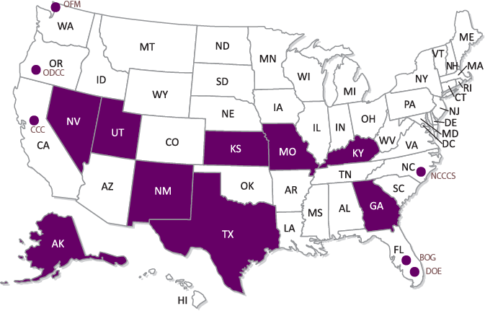
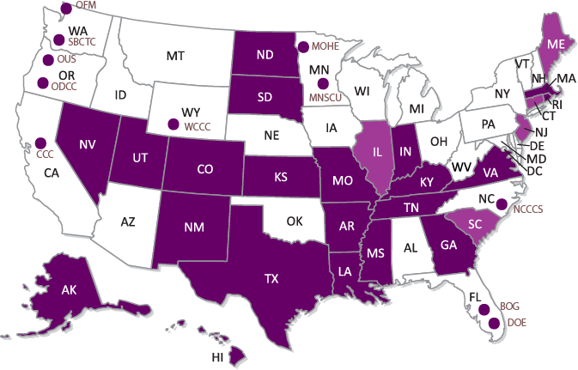
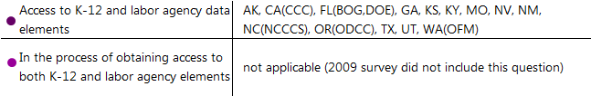
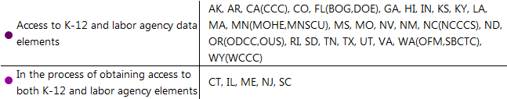
States with access to elements from both K-12 and labor agencies
2009…that was then
2012…this is now
Source: Tanya I. Garcia and Hans Peter L’Orange. Strong Foundations: The State of State Postsecondary Data Systems: 2012 Update on Data Sharing with K-12 and Labor. December 2010. Boulder: State Higher Education Executive Officers Association. Available online.
Notes:
And since some of you are probably wondering who has access to both…
The figure on the left shows the situation in 2009 with regard to postsecondary access to both K-12 and labor agency data elements by virtue of the data sharing agreements with these agencies.
The figure on the right shows this phenomenon as of 2012.
The number of states where state postsecondary agencies/entities have gained access to both K-12 and labor data elements from those respective state agencies has doubled in the past three years.
These are respectively Figures 10 and 11 from the report.
Please note again that the legends are not the same: as of this update, states with agreements with both agencies either have access to these elements or are in the process of obtaining access.

Slide 14
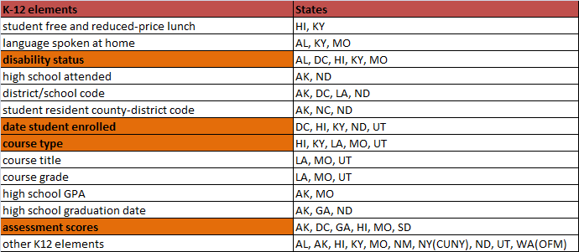
15 of 24 states increased their already existing access to K-12 elements
Source: Tanya I. Garcia and Hans Peter L’Orange. Strong Foundations: The State of State Postsecondary Data Systems: 2012 Update on Data Sharing with K-12 and Labor. December 2010. Boulder: State Higher Education Executive Officers Association. Available online.
Notes:
As I was putting together the slides for this presentation, I was curious which states added K-12 elements and therefore expanded their access to these elements in the last three years.
These are the states who already had access to K-12 elements from the state K-12 agency in 2009.
The most commonly added elements are disability status, date student enrolled (in high school), course type, and assessment scores.

Slide 15
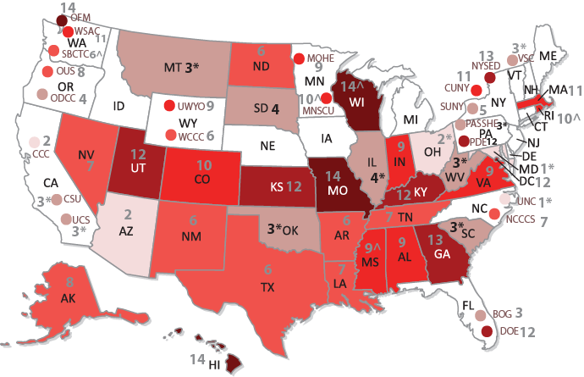
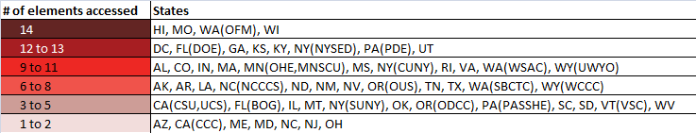
Access to K-12 elements by the numbers
* via institutions of higher education (IHE) only ^ via K-12 agency and IHE
Notes:
But what happened overall across the nation in terms of access to K-12 elements in the last three years? We collected more detailed information on the extent of access to 14 K-12 elements. This map represents current access to elements, and does not include the states that are in the process of gaining access.
When you put together the states with existing and new access to K-12 elements, these are the numbers. The agencies/entities with access to these elements via the institutions of higher education have a star next to the number. Those with access to both K-12 agency and institution of higher education K-12 elements have a “carrot” next to the number. The ones with access solely via the K-12 agency appear as plain numbers.
I’ve circled the states with the highest number of access to the elements we examined, between 12 and 14.
WA, UT, HI, KS, MO, WI, KY, GA, FL, DC, PA, and NY

Slide 16
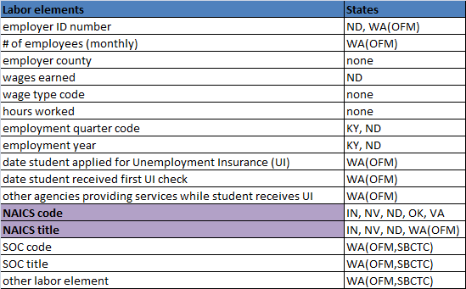
7 of 24 states increased their already existing access to labor elements
Source: Tanya I. Garcia and Hans Peter L’Orange. Strong Foundations: The State of State Postsecondary Data Systems: 2012 Update on Data Sharing with K-12 and Labor. December 2010. Boulder: State Higher Education Executive Officers Association. Available online.
Notes:
Similarly, I was curious which states added labor elements and, therefore, expanded their access to these elements in the last three years.
These are the states who already had access to labor elements from the state labor agency in 2009.
The most commonly added elements are the North American Industry Classification System (or NAICS) code and title.

Slide 17
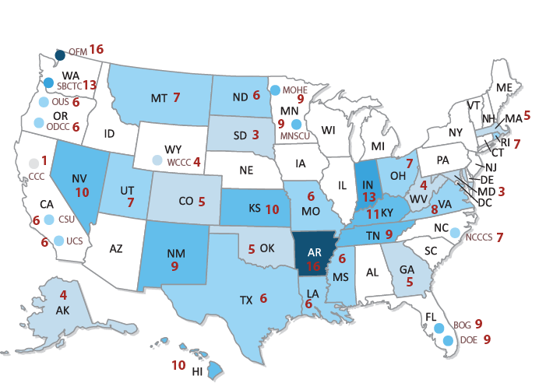
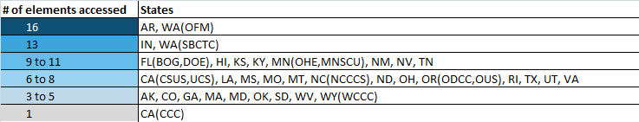
Access to labor elements by the numbers
Notes:
And what happened overall across the nation in terms of access to labor elements in the last three years? We collected more detailed information on the extent of access to 16 labor elements.
When you put together the states with existing and new access to labor elements, these are the numbers.
I’ve circled the states with the highest number of access to the elements we examined.
WA, AR, IN
And let me just note that the California Community Colleges does a lot with the one labor element it has access to, which is wages earned.

Slide 18
Q & A
Any questions, comments or feedback
would be greatly appreciated!

Slide 19
Where to go for the report and other materials
http://www.sheeo.org/resources/publications/strong-foundations-state-state-postsecondary-data-systems-2012-update-data
You’ll find:
Report
January 17 Webinar slides and audio
Individual responses
Downloadable data (maps, tables, etc.)

Slide 20
Thank you very much!
Tanya I. Garcia, tgarcia@sheeo.org
Hans Peter L’Orange, hans@sheeo.org
Visit our new website if you haven’t already!
www.sheeo.org

