Slide 1
Establishing, documenting, and institutionalizing K-12 data governance policies and processes
Thursday, February 14, 2013
Christina Tydeman, HI Department of Education
Kathy Gosa, KS Department of Education
Bill Huennekens, WA Office of Superintendent of Public Instruction

Slide 2
Overview
First Hour
Participant Self-Assessment
Hawaii Presentation
Kansas Presentation
Washington Presentation
Second Hour
Roundtable discussion 1
Roundtable discussion 2
Wrap-up

Slide 3
Practice Run Question
Are you excited to learn more about K-12 data governance?
Yes
Absolutely
Of Course
All of the above

Slide 4
K-12 Data Governance Survey
Does your organization have identified/specified goals or business problems to be addressed by your data governance program?
A. Yes B. In Progress C. No
Do you have executive sponsorship for the data governance initiative?
A. Yes B. No
Does a policy, legislation, or other requirement for data governance exist?
A. Yes B. No
Has your organization defined and established specific data governance roles and responsibilities?
A. Yes B. In Progress C. No

Slide 5
K-12 Data Governance Survey
Do these roles include data stewardship and data ownership responsibilities?
A. Yes B. In Progress C. No
How is the data governance coordinator role being filled?
Dedicated position
Additional duty assigned to other existing role
No coordinator role
Are data governance responsibilities included in staff’s position descriptions?
A. Yes B. No

Slide 6
K-12 Data Governance Survey
Have you established a data governance organizational structure or blueprint?
Yes B. In Progress C. No
Have you established an agency-wide process for data collection, data release, and resolving critical data issues?
A. Yes B. In Progress C. No
Is there a process for monitoring the progress and holding stakeholders accountable for fulfilling their data governance responsibilities and following the established protocols?
A. Yes B. In Progress C. No

Slide 7
K-12 Data Governance Survey
11. Does your organization have specified data governance processes/work plan?
A. Yes B. In Progress C. No
12. If so, which of the following topics are included:
Critical data issues
Data quality
Metadata management
Data security
Master data management
Data release
13. Have you defined metrics to measure and evaluate the data governance program?
Measurement of the program improves the program and provides information to use to tell the data governance story in your organization.
A. Yes B. In Progress C. No

Slide 8
Hawaii

Slide 9
Hawaii
Data Governance Structure
Who Answers for the Data?
Data Stewards – What should be done
IT Partners – What can be done
Stewardship of data vs. stewardship of systems
Data Issues Resolution Process
Single Point of Entry/Information website
Managed by DGO; owned by HIDOE
Multiple paths to resolution

Slide 10
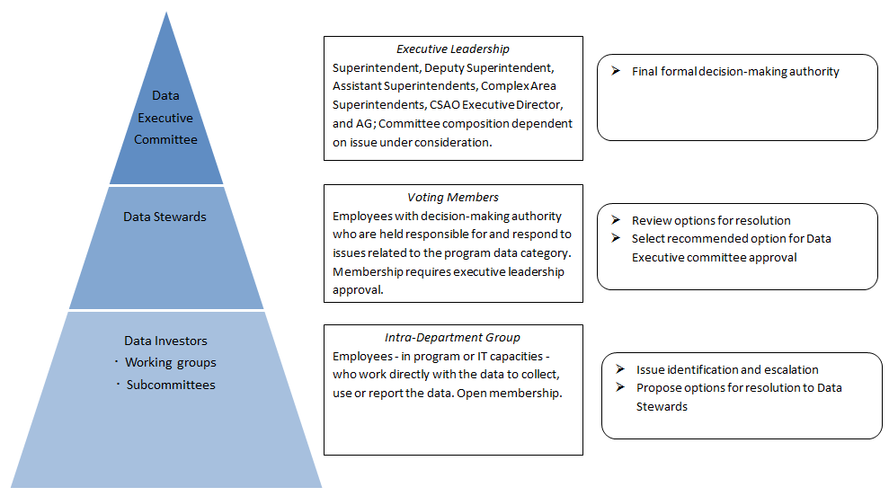
Data Governance Structure

Slide 11
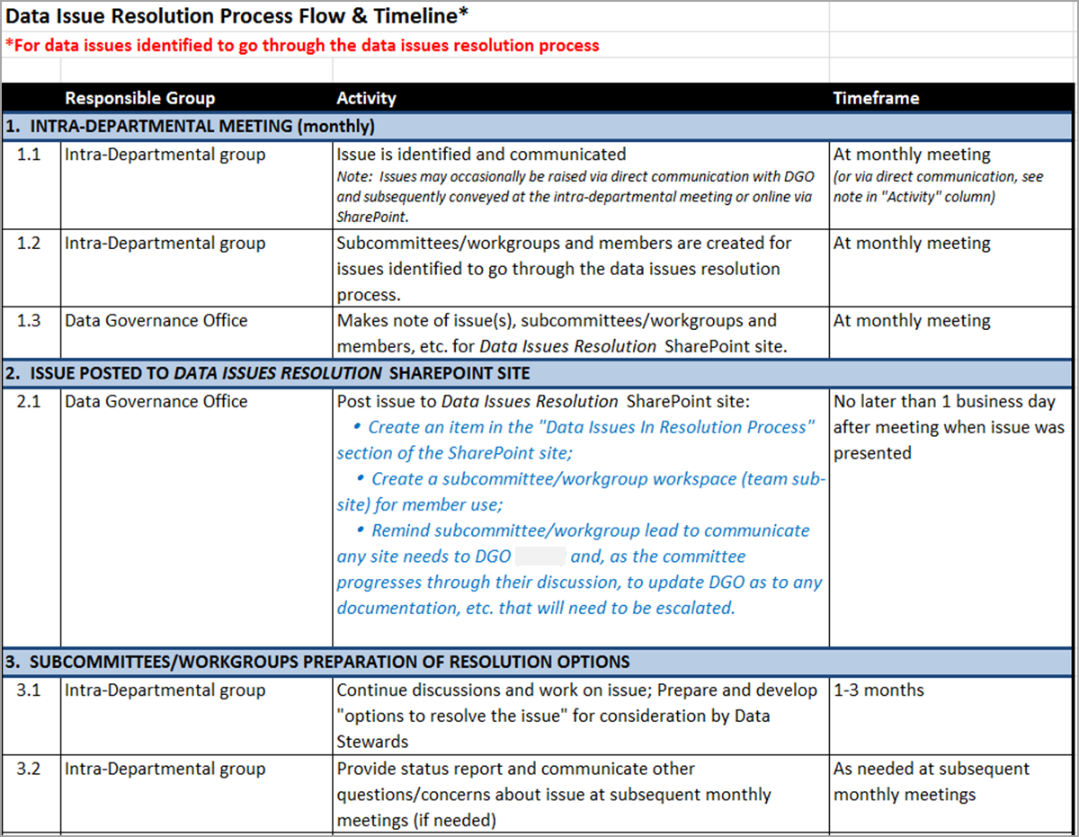
Process Flow

Slide 12
Clarify Roles and Responsibilities

Slide 13
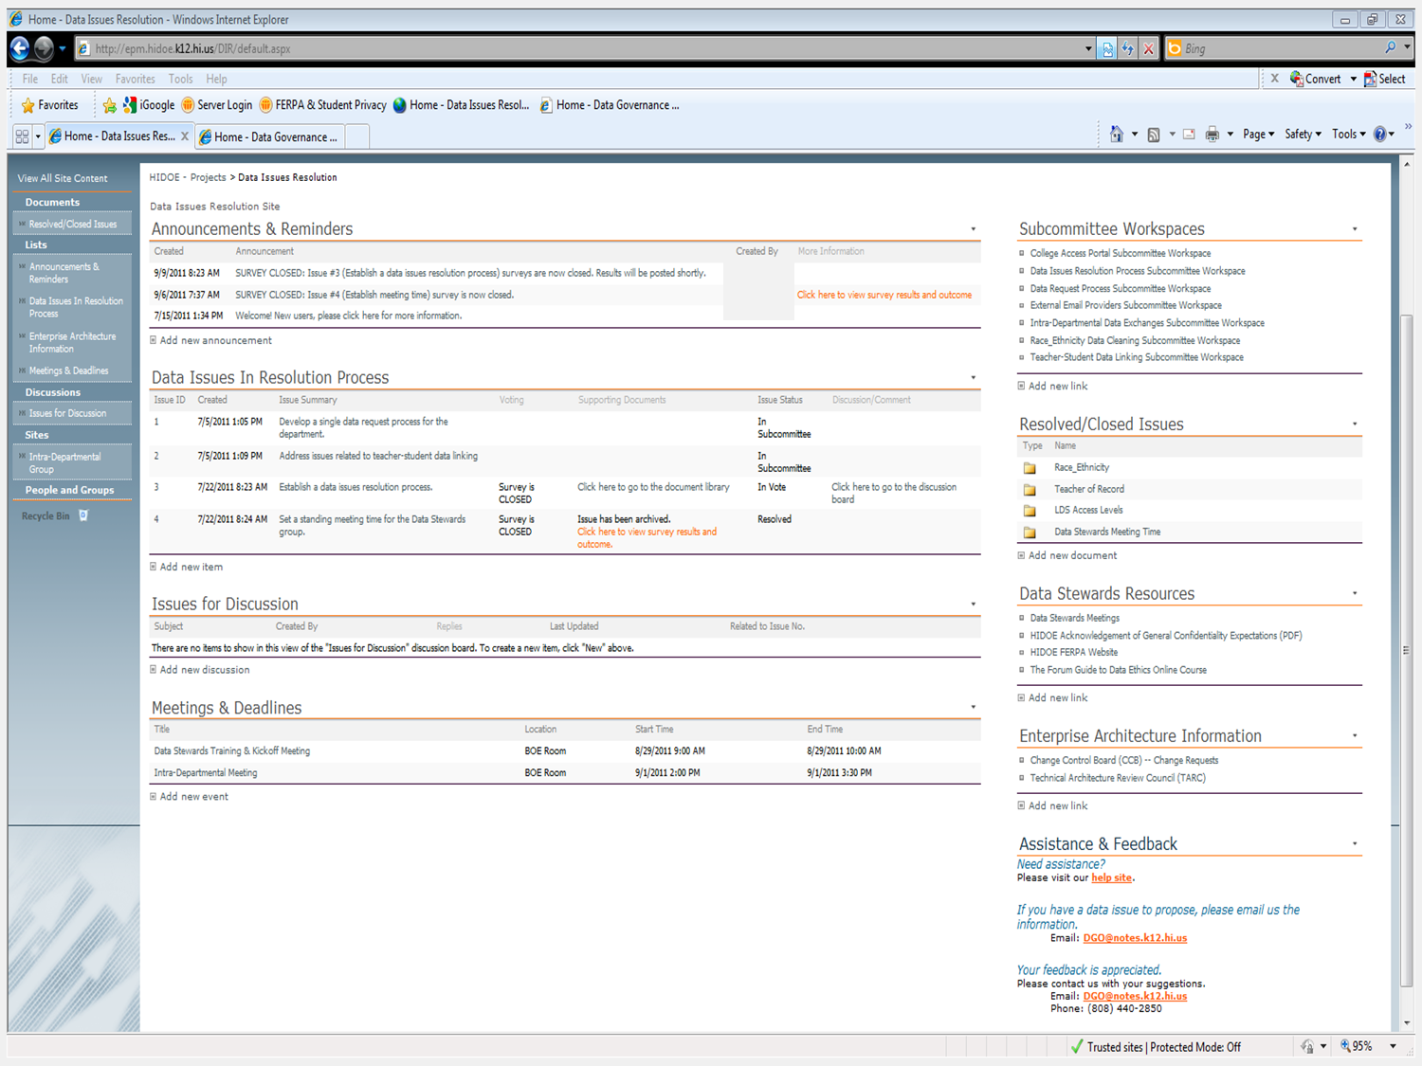
Notes:
Main page of the site.
Note: This is an old screenshot since the content from the current site would not fit into the window.

Slide 14
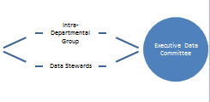
Paths of Subcommittee Proposals
Identify data issue
Subcommittee
Data Stewards
Intra- Department Group
Executive Data Committee
Joint Subcommittee
Two Subcommittees
External data requests Subcommittee
Internal data requests
Data requests
Proposals
External guidelines
Internal guidelines
Web 2.0 Subcommittee
Sponsors
Survey Proposal
Process Proposal
Data Stewards
Intra-Departmental Group
Executive Data Committee

Slide 15
Hawaii, cont.
Turning the Titanic Toward Sustainability
Recruit an Executive Sponsor
Data Governance Office (staff and presence)
SLDS, Research, Grants, Privacy/Confidentiality, Records retention
Seek participation at all levels (SEA/LEA)
Reduce the burden and facilitate cross-office collaboration
Lessons Learned
Patience and Persistence
Revisit and Revise the Process
Communications – Amp them up!
Training, Training, Training

Slide 16
Kansas

Slide 17
Kansas
Data Governance Structure
Setting Expectations
Escalation Process
Executive
Leadership
Executive
Leadership
Data
Governance Board
Data
Governance Board
Data Request Review Board
Data Request
Review Board
Data Steward Workgroup
Data Manager / Coordinator
Data Stewards
& Programmers

Slide 18
Kansas
Data Governance Board
Director level decision-makers (including Data Owners) from each department / program area
Mission: “…establish and enforce policies and practices related to agency data management”
Guiding Principles
Ethics and security will be a part of every decision the group makes
Members have the authority and commitment to make policy recommendations and decisions
Meet at least monthly
Actionable agendas

Slide 19
Kansas
Data Steward Workgroup
Reports to the DGB and meets monthly
Focused on communication, collaboration, data quality
Build capacity for ownership and accountability of data
Eliminate the silo effect of working with data
Data Stewards
Identified by Data Owners
Responsible for program area data
Identify and manage metadata
Identify and resolve data quality issues
Communicate new and changed data requirements
Determine business, security and retention needs of data
Provide input to data analysis and reporting

Slide 20
Kansas
Data Request Review Board
Subgroup of the DGB
Voting members represent the three agency divisions
Mission “… to implement processes for the provision of accurate, timely data and information to our internal and external customers while protecting personally identifiable student information and other confidential information.”
Provides consistent treatment of data requests
Considers, prioritizes and assigns requests for data
Meets monthly in person; ad-hoc virtually
Review status of routine requests
Approval of denials, charges, and non-routine requests
All requests for PII must be presented to DRRB

Slide 21
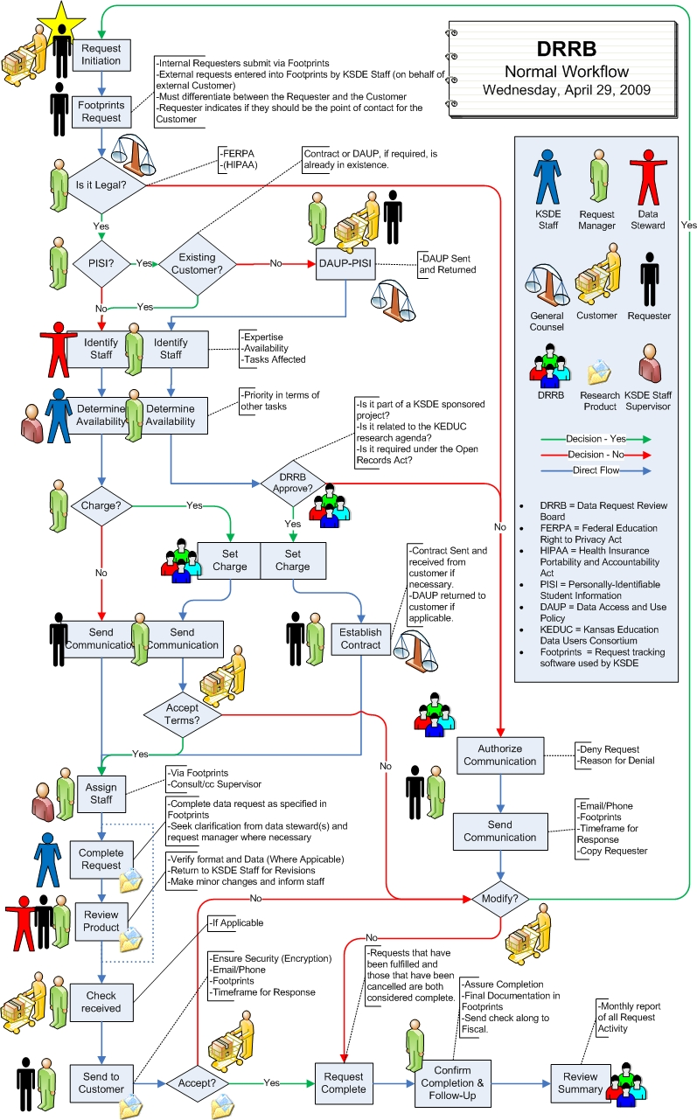

Slide 22
Kansas
All data are subject to Data Governance Principles:
Data ownership
Data stewardship
Security
Lifecycle and Change Management
Data Quality Management
Master data management
Collection edits
Data audits
Data Quality Certification Program

Slide 23
Kansas
Critical Components/Lessons Learned
Automated tracking process for Data Requests
Roles/responsibilities included as part of the job specification
Cultural change – requires time and leadership support
Requires a flexible framework

Slide 24
Washington

Slide 25
The Approach to Data Governance in WA
The forward of the Implementation Guidelines for K–12 Data Governance System (Our Data Governance Manual) outlines the approach to Data Governance in WA state:
“The essential notion behind establishing a data governance system is that decisions are only as good as the data on which they are based. As OPSI transforms data into information to facilitate wise decision-making, users and managers of K–12 data need a clear understanding of data definitions, data and process ownership and authority, accountability, security, and reporting needs and requirements, as well as the processes and timelines around each.”
See http://www.k12.wa.us/K12DataGovernance/pubdocs/DataGovernanceManual.pdf, page 6

Slide 26
Data Governance Structures

Slide 27
Roles and Decision-Making Authority
Data Governance Group
Prioritize education policy and research questions
Determine new reporting needs and ideas
Eliminate redundant reporting requirements
Evaluate the advantages and disadvantages of adding new data elements and make recommendation to Superintendent
Data Leadership Team
Advisory and Communication

Slide 28
Roles and Decision-Making Authority
Data Management Committee
Improve data quality
Increase accountability for data accuracy
Eliminate redundancy in data collection
Improve understanding of data within OSPI and among districts
Facilitate transformation of data into information for wise decision-making
Increase use of data to make program and policy decisions
Improve data reporting capability and timeliness of reporting

Slide 29
Roles and Decision-Making Authority
Final Tier – Work Groups, Business\IT work Sessions
Make recommendation to solve specific problems and day to day operation of systems
Stakeholder Tier
Ensure that we are engaging our stakeholders in the process

Slide 30
Roles and Responsibilities
Data Owner (Looking to Change the title)
Senior manager who serves on the top tier groups in our structure
Sets policies, appoints data stewards, represents Department data interests and authority to resolve data issues
Data Steward
Subject matter expert for data in a certain business area

Slide 31
Data Governance Processes
Collaborative decision-making
Adoption of data manuals
Proactive engagement
Commenting on EDFacts Collections
Efficiencies
Identify duplicate collection – Learning Assistance Program

Slide 32
Lessons Learned in WA
Formalize processes – should have started immediately
Pay attention to the pendulum swing
Stress that data is not just an enterprise asset but a public asset

Slide 33
Contacts & Additional Resources
Contact information:
Christina Tydeman, christina_tydeman@notes.k12.hi.us
Kathy Gosa, kgosa@ksde.org
Bill Huennekens, Bill.Huennekens@k12.wa.us
Corey Chatis, corey.chatis@sst-slds.org
For more information on data governance:
HI Data Governance: http://datagovernance.k12.hi.us
KS Data Governance: http://www.ksde.org/Default.aspx?tabid=83
WA Data Governance: http://www.k12.wa.us/K12DataGovernance/default.aspx

