Slide 1
Virginia Department of Education Division Competition 25th Annual MIS Conference February 16th 2012

Slide 2
VDOE Division Competition
ARRA
ARRA
ARRA
American Recovery and Reinvestment Act of 2009
Goals: Stimulate economy and invest in education for long-term economic health
$17.5M multi-year grant for Virginia to develop and operate a Longitudinal Data System
Longitudinal Data Project
$2M in grants to Virginia school divisions
Estimates of student growth
Multi-agency reporting portal
e-Transcripts in higher education
Completion of SFSF reporting requirements

Slide 3
ARRA Reform Areas
Making progress toward rigorous college- and career-ready
standards and high-quality assessments that
are valid and reliable for all students.
Establishing pre-K to college and career data systems
that track progress and foster continuous improvement.
Making improvements in teacher effectiveness and in the
equitable distribution of qualified teachers for all students.
Providing intensive support and effective interventions
for the lowest-performing schools.

Slide 4
Competition Objectives and Division Challenges
Competition Objectives
Division Challenge
Encourage and Finance
Division Data Projects
Advance Goals of the Statewide
Longitudinal System
Support Goals of the Four ARRA
Education Reform Areas
Improve Education Data Statewide
Burden to collect data for cash strapped divisions
Strengthen/Revise Existing Data System
Align System Design With Four ARRA Education Reform Areas

Slide 5
Key Steps and Results
Key Program Steps
Result
Statewide stakeholders developed and agreed evaluation criteria
Held multiple information webinars & Q&A conference calls
Developed simple competition rules and application templates
Engaged external evaluators and subject matter experts in the evaluation process
Divisions had ownership of and engagement in the process
Ensure awareness across the Commonwealth
Comparatively low barrier to entry competition in terms of time and $ investment
State resources completely neutral in the process

Slide 7
Project Examples
Solving a technology problem
Training in D3M
Improving system implementation
Mapping elements to data exchange
Purchase of software
Implementation of horizontal SIF
Innovative ways to address common issues
Improving access to and recording of data
Improving local assessment system
Using data to make decisions
SIF identifiers
Virtual programs
Cleaning up data
Anything Web-based
Professional development
Using data in the classroom

Slide 8
Eligibility Criteria

Slide 9
Evaluation Criteria

Slide 10
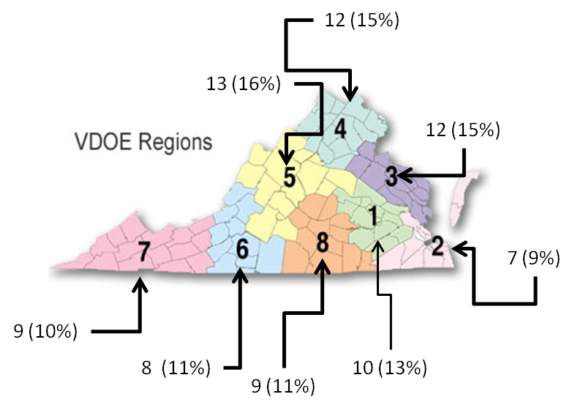
Distribution of Proposal Submissions by VDOE Regions

Slide 11
Distribution of Proposal Submissions by VDOE Regions
REGION | REGION NAME | # DIVISIONS IN REGION SUBMITTING PROPOSALS | TOTAL # DIVISIONS IN REGION
1 | Central | 10 | 15
2 | Tidewater | 7 | 15
3 | Northern Neck | 12 | 17
4 | Northern VA | 12 | 19
5 | Valley | 13 | 20
6 | Western VA | 8 | 15
7 | Southwest | 9 | 19
8 | Southside | 9 | 12

Slide 12
Evaluation Process and Calculation of Project Scores
25% | ARRA reform areas
25% | Feasibility and technical merit
15% | Collaboration and/or reusability
15% | Rationality of Budget
10% | Stakeholder Involvement/Agreement
10% | Evaluation Plan
Score | Guidance
0 | No information/non compliance
1 | Weak
2 | Below Average
3 | Average
4 | Above Average
5 | Excellent
OVERALL SCORE =
(ARRA Score) *.25 + (Feasibility/Technical Score) * .25 + (Collaboration/Reusability Score) * .15
+ (Budget Score) *.15 + (Evaluation Score) * .10 + (Stakeholder Score) * .10

Slide 13
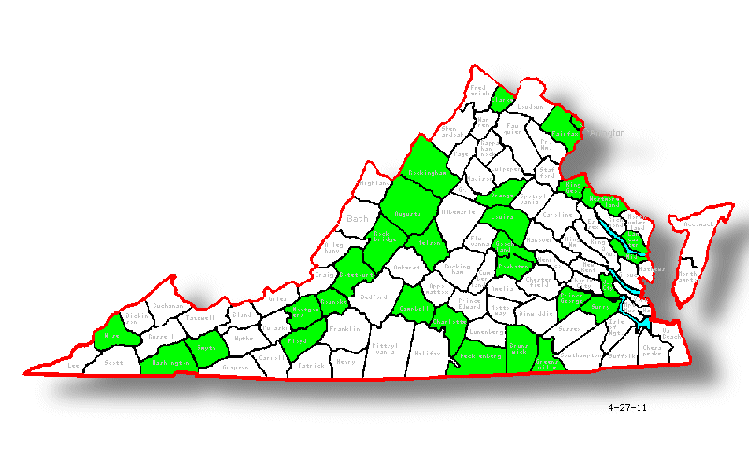
Distribution of Funded Proposals by Division
Charlottesville
Alexandria City
Buena Vista City
Richmond City
Roanoke City
Hampton City
Norfolk
Williamsburg
Bristol City
Colonial Heights City
Petersburg City
Chesapeake City

Slide 14
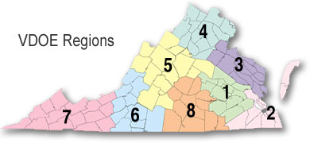
Distribution of Funding
5 (12%)
8 (20%)
4 (10%)
4 (10%)
4 (10%)
5 (12%)
7 (17%)
4 (10%)

Slide 15
Division Challenges by Type
Categorization of Division Challenges
Type 1: Hire Staff | Type 2: Upgrade or Consolidate | Type 3: New System/ Different Product | Type 4: Convert from Manual | Type 5: Division Designed | Type 6: Other
1 | 33 | 4 | 6 | 0 | 2

Slide 16
Winning Divisions
Division | Project
Clarke County Public Schools | IEP Data Enhancement System
Arlington Public Schools/Wise County Public Schools | Creating a Data System and Data Culture in Virginia
Charlottesville City Public Schools | Anywhere, Anytime, Over Time: Longitudinal Data to the Teacher Desktop
Roanoke City Public Schools | Portal to Performance (P2P)
Bristol VA Public Schools | Bristol Virginia Public Schools Longitudinal Data System Grant Proposal
Floyd County Public Schools | Enhancements to Current Student Information System – Infinite System
Smyth County Public Schools | The Student Teacher Archive for Research and Teaching (START)
Washington County Public Schools | Student & Teacher Educational Warehouse
Consortium of Botetourt County Public Schools , Buena Vista City Schools, King George County Schools, Lancaster County Public Schools, Middlesex County Public Schools, Montgomery County Public Schools, Orange County Public Schools, Roanoke County Public Schools, Rockbridge County Schools, Surry County Public Schools, Westmoreland County Public Schools | Longitudinal Data Warehouse for a Consortium of Virginia School Districts
Nelson County Public Schools | Evaluation Systems Linking Student Data to Teacher and Principal Evaluations for Improvements in Teacher Effectiveness and the Equitable Distribution of Qualified Teachers for All Students
Rockingham County Public Schools | Open Source PowerSchool Extension Using SIF
Goochland County Public Schools | Goochland County Public Schools – 3DM Tools for AYP Subgroup Acceleration

Slide 17
Project Benefits
41 division projects funded (including collaboration).
Partnerships created between divisions (some lasting beyond the competition project).
VDOE gained insight into the needs of divisions in order to develop resources/training.
Divisions able to leverage requirements for discounts with vendors.
Communication between divisions increased (for long-term sharing of best practices/problem solving).

Slide 18
Contact
Bethann Canada
804.225.2951
Bethann.Canada@doe.Virginia.gov
Paul McGowan
703.689.3070
Paul.McGowan@cit.org

