Slide 1
2012 MIS Conference

Slide 2
The Butterfly Effect and the Iowa Transcript Center
Jay Pennington
Carla Schimelfenig
Iowa Department of Education
Jessica Bleak
Pearson

Slide 3
The Butterfly Effect
In chaos theory, the butterfly effect is the sensitive dependence on initial conditions, where a small change at one place in a nonlinear system can result in large differences to a later state. (Wikipedia)

Slide 4
The Butterfly Effect
Initial Conditions
Legislative initiative in 2008 with funding
State universities and community colleges were actively involved in the development of the transcript
One set of data to fulfill student record and transcript needs
SIS vendor would create a SIF XML file extract

Slide 5
History
Contract awarded July 2009
NCES Summer Data Conference presentation July 2010
First SIS vendor released extract December 2010
Currently, more than 70% public school districts are registered

Slide 6
How ITC is Different
Higher Education participation
Disaster mitigation
ARRA SFSF reporting requirement
Foster care placements
Nonpublic school participation
Iowa College Aid Commission

Slide 7
University Participation
Universities and community colleges were at the table during the planning stages.
What data did they want
How would they utilize the data
Data flow high schools to ITC in SIF XML and transported to the SPEEDE Server with output in PESC XML or SPEEDE EDI (preferred data format for Iowa’s universities).

Slide 8
RAI
Prior to 2009, any Iowa resident who graduated in the upper half of his/her graduating class was admitted to a state university.
New measure was developed to include more information with less variability.
# Courses taken in core areas (English, Math, Science, Social Studies, Foreign Language)
Class rank
GPA
ACT score

Slide 10
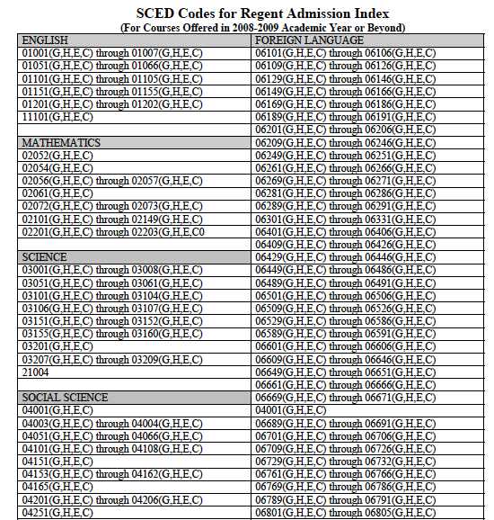

Slide 11
http://www.regents.iowa.gov/RAI

Slide 12
Community College Participation
Transcripts are not a requirement; they are a ‘nice to have’
Community colleges are under the guidance of the Dept of Education
Included in the scope of the project – receive but also can send to other Iowa institutions for free
13 of 15 use Datatel. Now working on the development of a PESC or EDI export for consumption to ITC
ITC becomes the translation engine and transport to the SPEEDE Server

Slide 13
Disaster Mitigation
May 2008 – Aplington-Parkersburg HS was destroyed by a tornado one week after graduation.
June 2008 – Cedar Rapids Elementary School flooded.
June 2008 - Grant Wood AEA houses PowerSchool for 31 public districts, 34 nonpublic schools, and 7 nonpublic school systems.
Servers were moved to the 3rd floor while the 1st floor was overtaken by flood waters
PowerSchool was off-line for nearly a week during end-of-year reporting
ITC provides a permanent repository for student information

Slide 14
ARRA SFSF Reporting – HS final course grades
Decision was made in 2010 to not add final course grade to the student-level collection.
Collect final course grades through the transcript center.
With SIF implementation, data will be sent to the state before being sent to the transcript center.

Slide 15
Foster Care & Residential Placements
Iowa law requires schools to send student records within five days of a student being placed in the foster care system.
No counterpart that requires agencies (Dept. of Human Services or Juvenile Court) to notify the prior school of a change in placement.

Slide 16
Foster Care & Residential Placements
Will be adding accounts for DHS workers and JCOs to initiate the request for records from school to placement.
No authority to view student records
Alternative Ed consultant at the IA Dept. of Ed will manage user accounts.
Schools will then be able to transfer student records through ITC to education centers at the facilities.
Drawback – moving student record from placement to home school upon return if placement facility does not have an approved SIS.

Slide 17
Accredited Nonpublic Participation
Desire to participate
Desire for regents universities to have all Iowa student transcripts sent through the transcript center
Must have an approved SIS
Must send student-level data same as public school districts
All high school courses have been appropriately coded with SCED codes
Provides same level of detailed information to be used for accreditation reviews (offer and teach)

Slide 18
Iowa College Aid Commission
Iowa law required schools to send transcripts to the commission for students who were applying for certain scholarships
Iowa College Aid Commission is a trading partner
8th grade, I Have a Plan Iowa

Slide 19
Next Steps
Integration of new Iowa Education Portal and SIF
Iowa Education Portal - SSO
ITC already runs through the portal
Developing the organizational structure now
Will import users in March
SIF
Infinite Campus will be releasing their Iowa SIF agent late March
Move SIF Vertical Reporting Framework behind the new portal

Slide 20
Next Steps
Re-engage public high schools in discussion
What’s missing
Common agreement
Engage elementary schools
Don’t see a need
Desire to build an electronic cum folder

Slide 21
Next Steps
Data Considerations
Elementary, middle, and high schools have different data. What should be included at each level?
Can we use the course completion information to provide information to perform audit adjustments? Supplementary weighting on course completion versus course enrollment.

Slide 22
Lessons Learned
If you are asking SIS vendors for SIF XML and you’ve already indicated you will be moving toward SIF, they don’t want to/won’t do both.
While postsecondary institutions are the consumers of the transcript, high schools do not want to give up their local flavor.
Initial vision for student record and transcript exchange began in the late 1990’s. This takes time.

