Slide 1
Public Domain Clearinghouse
2012 MIS Conference
Jeff Sellers
SLDS State Support Team
Dan Domagala
Colorado Department of Education
Jim McMahon
Louisiana Department of Education
Photo credit: iStockPhoto.com

Slide 2
Overview
Initiated by states
How to avoid “reinventing the wheel”
Create a clearinghouse of public domain tools & documents
Platform for all states to post, learn about, and adopt non-proprietary SLDS-related products
Benefits both contributing and receiving states

Slide 3
CDE Data Dictionary Tool
Demonstration
Dan Domagala
Colorado Department of Education

Slide 4
Data Dictionary Approach
WHAT data are requested
(data element definitions)
HOW do we gather this data
(collections and rules)
WHY do we capture this data
(warrant)
Definitions of the data CDE collects
(NOT access to the data)

Slide 5
Organizing Data Elements
Relationships
To Collections (CDE inbox)
To Reports (CDE outbox)
To other Data Elements
Rules
Datatype Constraints
Mandatory vs. Optional
Allowable values
Groupings
Alphabetical
Subject or Domain (i.e. Student, Staff, or School)
Calculated or Aggregated Elements

Slide 7
Live Demonstration
https://cdeapps.cde.state.co.us/DataDictionary/

Slide 9
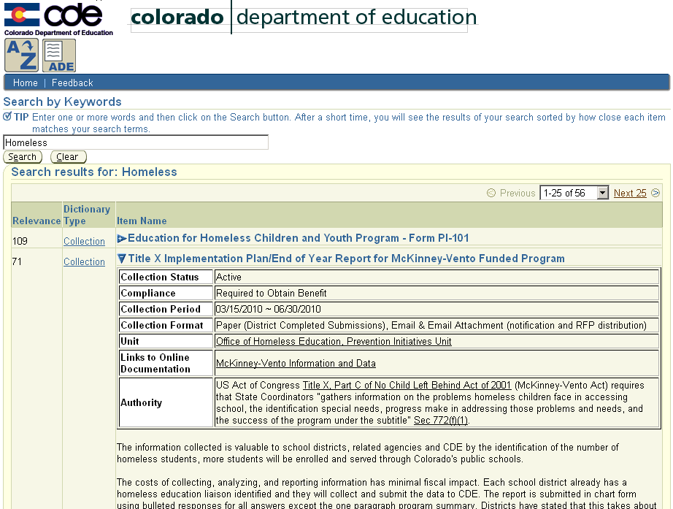

Slide 10
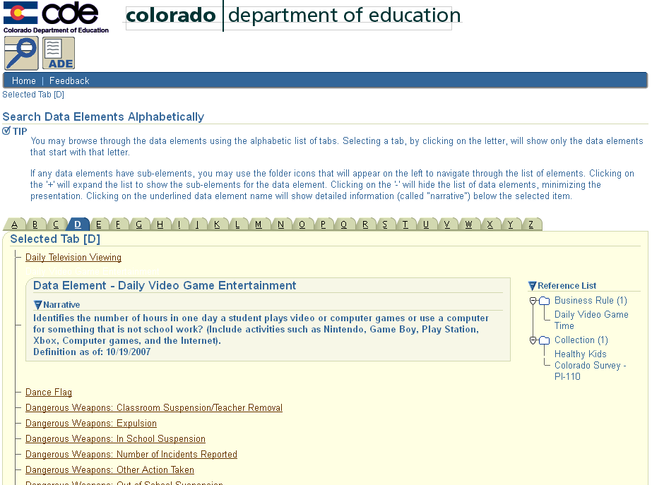

Slide 11
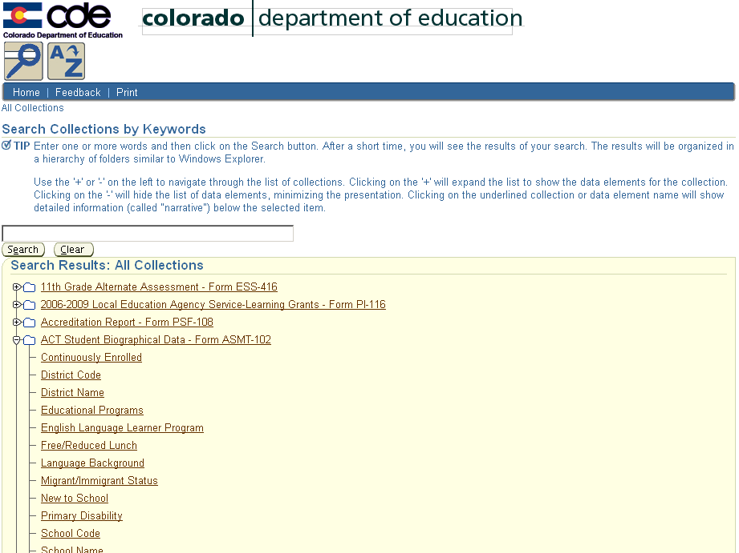

Slide 12
Questions?
Thank You!
Dan Domagala
Chief Information Officer
Domagala_D@cde.state.co.us
303.866.6961
Colorado Department of Education
http://cde.state.co.us/
https://cdeapps.cde.state.co.us/DataDictionary/

Slide 13
LDOE Curriculum Verification and Results Reporting Portal (CVR)
Demonstration
Jim McMahon
Louisiana Department of Education

Slide 14
Notes:
This is the first page of the CVR…curriculum verification & results reporting portal. (https://leads13.doe.louisiana.gov/cvr)
The text in black is always there, but we can (and do) edit the red to reflect important information.

Slide 15
Notes:
Registration for CVR follows basic protocols, and the user guide (available in both PPT and text form) walks the user through each step. Login and password are user-selected, and the data is NOT stored; we reset the account if need be, and the users reregister.

Slide 16
Notes:
While we do allow users to sign up with either the last four digits of SSN, or their entire SSN, we also provide a means of registering for those who are uncomfortable using the SSN….we sent them a form, they fill it out, send it back, and we do the registration for them.

Slide 17
Notes:
Teachers have the ability to verify the rosters of students for each of their classes.
If a student needs to be removed, for any of the possible reasons (moved, on list in error, etc.) the teacher simply clicks the “remove from list” button. They can also add students (from within district, only) who were erroneously omitted.

Slide 18
Notes:
If classes are erroneously assigned to teachers, they can simply remove the class in its entirety….and can add the correct classes as needed. IF a class DOES get added, the teacher would need to add in all of the students for each one. (For instance….it lists all ELA classes, and ‘I’ teach Math, I’d remove all the ELA classes, and add in the appropriate Math courses, and then go through the ‘add student’ function from the previous slide.)

Slide 19
Notes:
Teachers (and leaders) are able to see the changes that were made to the rosters.
This slide shows that, in the highlighted Science class, there were 5 students; one of whom was marked ‘not in class’, to be removed from the roster. If a student had been added, that child’s information would appear in green.

Slide 20
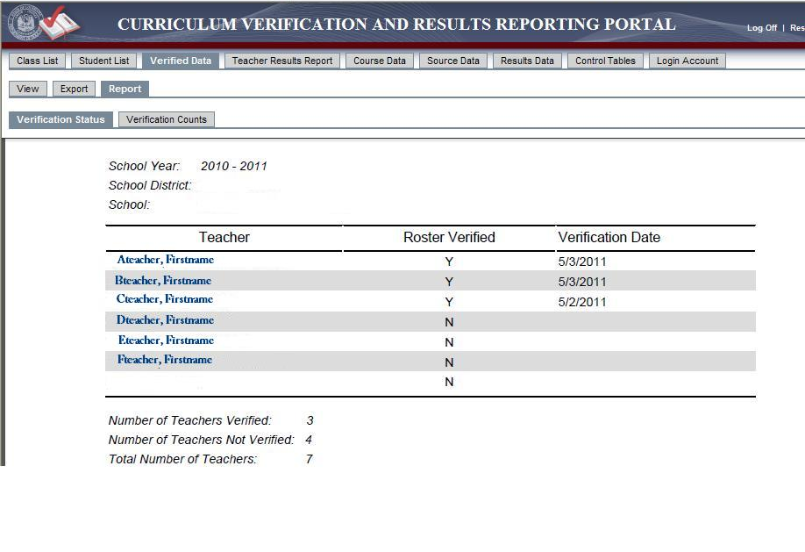
Notes:
Principals (and supers) can see the report, by school, of each individual teacher, and if they have verified their roster or not. At the end of the verification process, teachers are required to click on a button that indicates “I have reviewed my rosters and made any appropriate changes”, and once that is submitted, this report will reflect the date that takes place. (that’s what the ‘verification date’ is). Principals are also required to attest to the same.

Slide 21
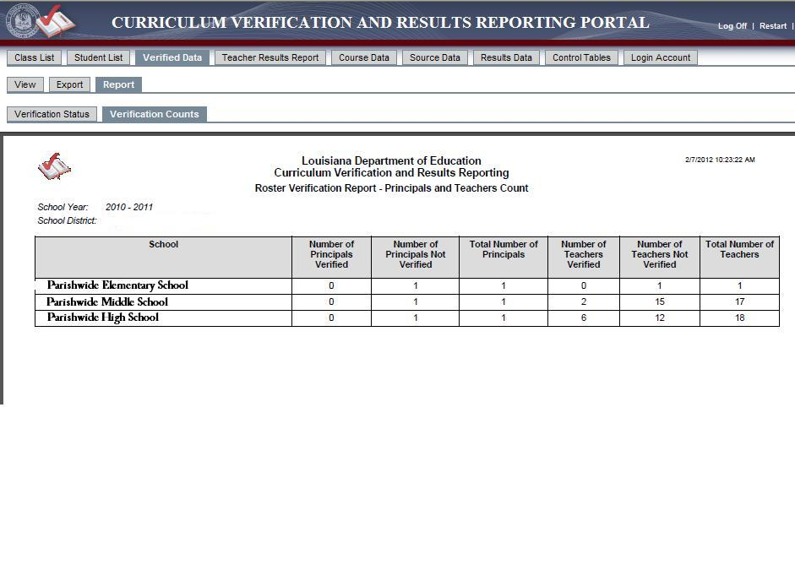
Notes:
There is also a report that shows district-wide the numbers of teachers (and principals) who should verify, and the numbers that have/have not. This is strictly numbers of…the previous report would show the names of the teachers…as we see in our elementary school, only one teacher should verify, and they have not; our middle school has 17 who should, 2 of whom have; and our high school indicates that 6 of their 18 teachers have completed the process.

Slide 22
Notes:
This first page of the Student Teacher Achievement result score report is BRAND new…this shot was snagged from staging.
The first thing is the text that has a teacher’s effectiveness rating….the percentile of teachers REGARDLESS of content, and the corresponding Scale Score Rating, and the standards for that rating scale was set by BESE.
This teacher is ‘effective:proficient’ (there are 3 levels of “effective”, along with ‘ineffective’ and ‘highly effective’)…is doing as good or better than 67% of teachers statewide, no matter who is teaching what…and that puts the SSR at a 3.2

Slide 23
Notes:
On the reports that show the breakdown by content taught (remember, the first report is combined/composite/overall)….here, the percentile is CONTENT-SPECIFIC…..67%...better/as good as 67% of English teachers….58% of Reading teachers….75% of Social Studies teachers.
The Student Teacher Achievement Result numbers (those + and – in the middle) are the difference above or below ‘typical’ that this teacher’s students earned on their testing…the actual score….on average.

Slide 24
Notes:
There is a school-wide report available, showing each teacher, the AR, and the corresponding percentiles. Clicking the headers will allow sorting in various ways..

Slide 25
Notes:
All of these drill-downs are available for teachers, provided they have at least 5 students in a category…
Achievement Groups; Students with/without disabilities; Free/Paid lunch status, and ELP.

Slide 26
Notes:
On our end, checking/resetting/verifying registration…..this isn’t something that schools would have….

Slide 27
Notes:
And we can go through by district as well as statewide.

Slide 28
GOALS
Lighten development burden
Quicker turnaround on SLDS efforts
Lighten financial burden
Less expense to develop SLDS
Collaboration
Share improvements to PDC tools
Expectation
All states will contribute tools to the PDC

Slide 29
ORGANIZATION

Slide 30
Demonstrate Download Process
www.grads360.org

Slide 31
NEW TOOLS
Newest Tools:
CO Record Integration Tracking System
NV EDEN Reporting System
LA Roster Verification Tool
Future Tools:
KS Student Course Collection specifications
P20 Data Dictionary
P20 Data Model

Slide 32
CURRENT TOOLS
AR (Identity Management)
CO Data Dictionary Tool
CO Growth Model
GA Tunneling Tool
KS Course Code Management System
KS Data Quality Curriculum
NE Data Reporting System
NH Student Data Collection System
OR DATA Project
OR EDEN Data Model

Slide 33
DOCUMENTS
LDS Share v2 – New Look!
>200 Documents
Project Management & Data Governance
Data Access & Use
Agreements, MOUs & RFPs
LDS Warehouse Construction
System Implementation & Maintenance
Data Exchange & Interoperability

Slide 34
Notes:
http://eddev.kforcegov.com/Programs/SLDS/LDSShare/SLDS.html

Slide 35
REQUESTING ACCESS
www.grads360.org

Slide 36
WHAT WE NEED FROM YOU!
Supply feedback/suggestions for improvements to the PDC
Submit tools
Suggest ideas for tools
Suggest products from the field
Continue submitting documents to the LDS Share

Slide 37
Public Domain Clearinghouse
www.grads360.org

Slide 38
Public Domain Clearinghouse
www.grads360.org

