Slide 1
First Look at the Program for International Student Assessment (PISA) 2015 Results
Peggy G. Carr, Ph.D.
Acting Commissioner
National Center for Education Statistics (NCES)
Washington, DC
December 2016

Slide 2
Who Participates in PISA?
In 2015, 70 participating education systems
Additionally, Massachusetts, North Carolina, and Puerto Rico participated
Participating Country
Regional Results Only
Participating Region

Slide 3
What Does PISA Measure?
PISA Assesses 15-year-old students’:
Applied knowledge—or literacy—rather than achievement
Cumulative knowledge gained both in and out of school
How well can students nearing the end of compulsory schooling apply their knowledge to real-life situations?

Slide 4
What Does PISA Measure?
Three subject areas: Science Literacy, Reading Literacy, Mathematics Literacy
All three assessed each cycle; one is focal subject
As of 2015, administered on computers in most countries
2000
2003
2006
2009
2012
2015
Science
Math
Science
Reading
Reading
Math
Science
Reading
Math
Science
Reading
Math
Science
Science
Reading
Math
Reading
Math
PISA Administration Cycle

Slide 5
U.S. PISA Findings

Slide 6
General Pattern of U.S. Results
Science Literacy
Reading Literacy
Math Literacy
Short-Term: No measurable change in U.S. average score since 2012
Long-Term: No measurable change in U.S. average score since 2006 (earliest comparable timeframe)
Short-Term: No measurable change in U.S. average score since 2012
Long-Term: No measurable change in U.S. average score since 2000
Short-Term: U.S. average
score lower than in 2012
Long-Term: U.S. average score lower than in 2009; not measurably different than in 2003 and 2006

Slide 7
Science Literacy

Slide 8
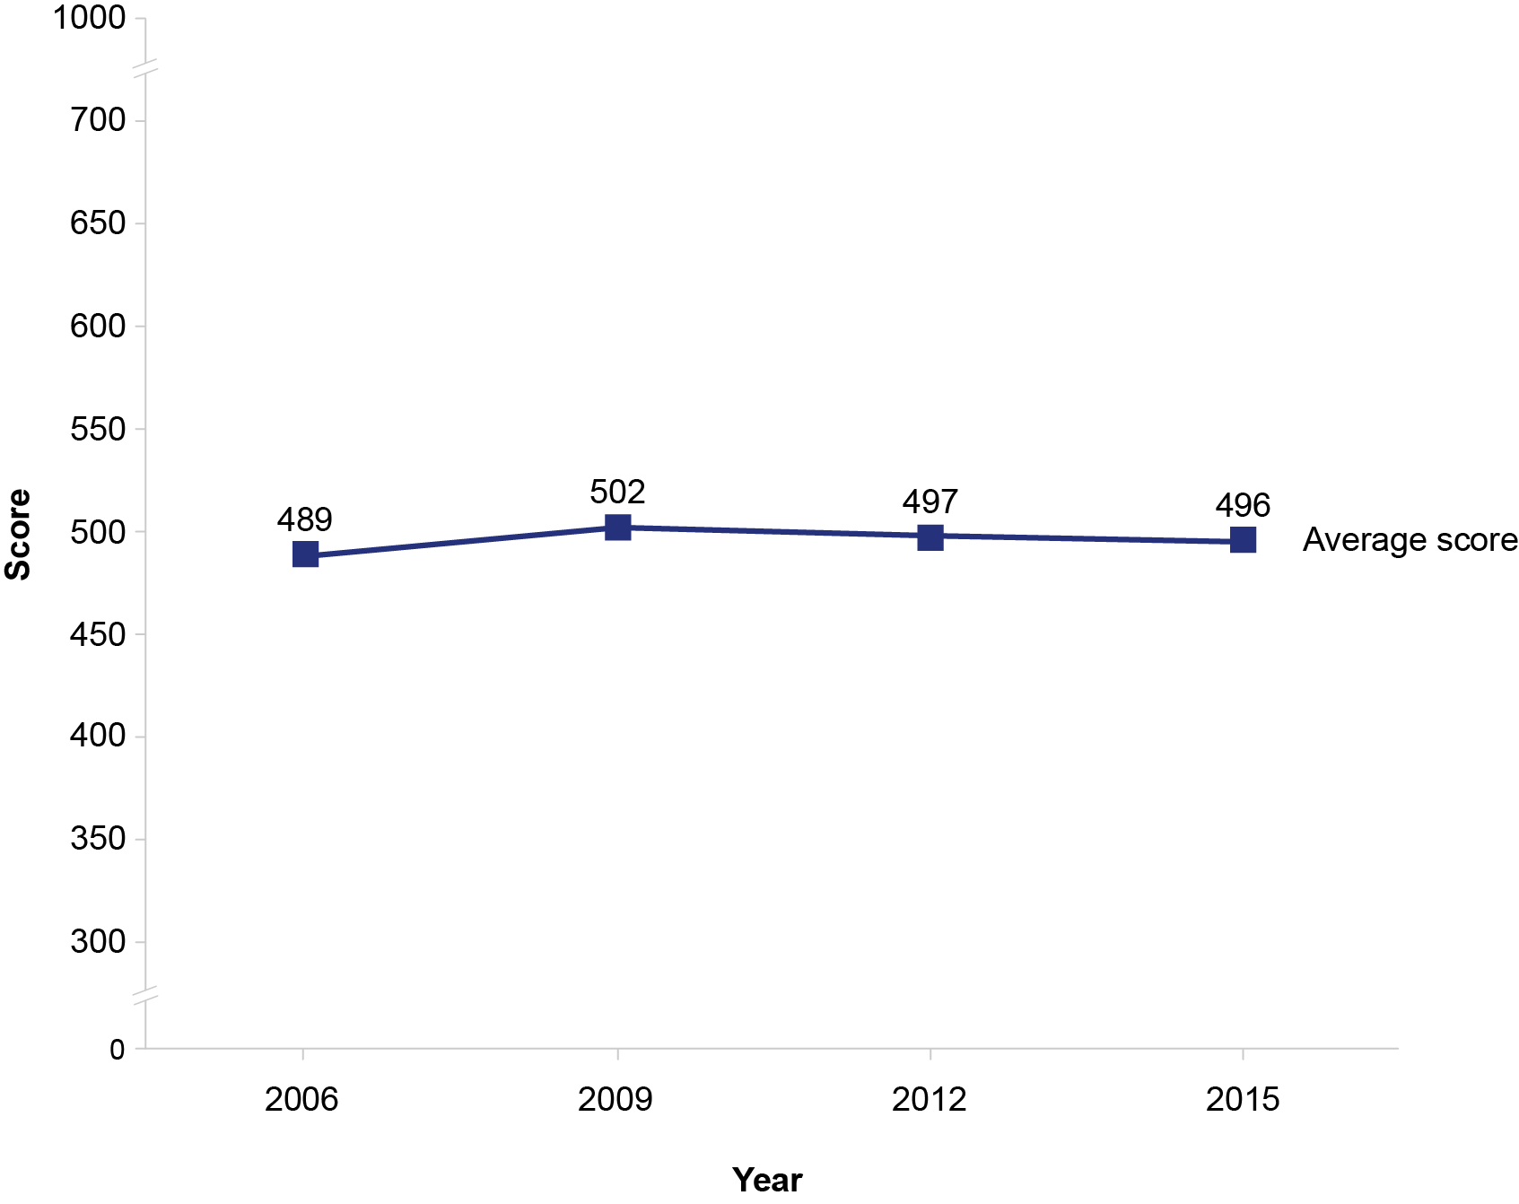
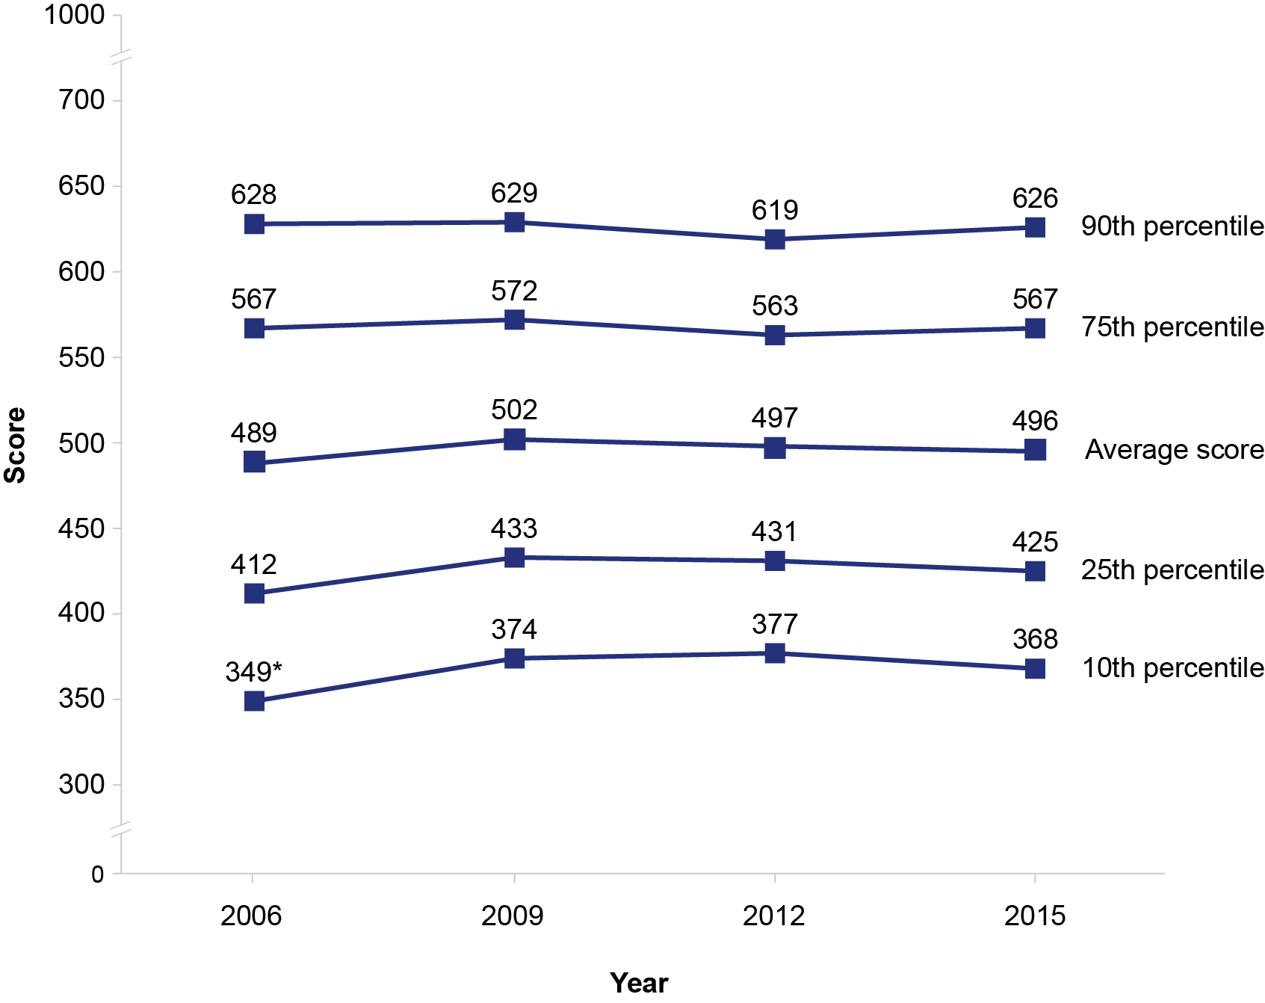
Science Literacy: U.S. PISA Trends in Average Scores & Percentiles
No change in U.S. average scores between 2015 and previous years
Increase at 10th percentile from 2006
* Significantly different from 2015 score

Slide 9
Science Literacy: PISA 2015 U.S. Average Score
Average Score Higher than U.S. Average
Singapore | 556
Japan | 538
Estonia | 534
Chinese Taipei | 532
Finland | 531
Macau (China) | 529
Canada | 528
Vietnam | 525
Hong Kong (China) | 523
B-S-J-G (China) | 518
Korea, Republic of | 516
New Zealand | 513
Slovenia | 513
Australia | 510
United Kingdom | 509
Germany | 509
Netherlands | 509
Switzerland | 506
Average Score Not Measurably Different than U.S. Average
Ireland | 503
Belgium | 502
Denmark | 502
Poland | 501
Portugal | 501
Norway | 498
United States | 496
Austria | 495
France | 495
OECD Average | 493
Sweden | 493
Czech Republic | 493
Spain | 493
Latvia | 490
U.S. 15-year-old students’ average score not different than OECD average
U.S. States and Territories
Massachusetts | 529
North Carolina | 502
Puerto Rico | 403
Key
Average score higher than U.S. average
Average score is lower than U.S. average
Note: Italics indicate non-OECD countries and education systems.

Slide 10
Science Literacy: PISA 2015 U.S. Subnational System Scores
Massachusetts
1
system scored higher
10
systems not different
North Carolina
13
systems scored higher
Puerto Rico
59
systems scored lower
17
systems not different
40
systems scored lower
58
systems scored higher
6
systems not different
6
systems scored lower

Slide 11
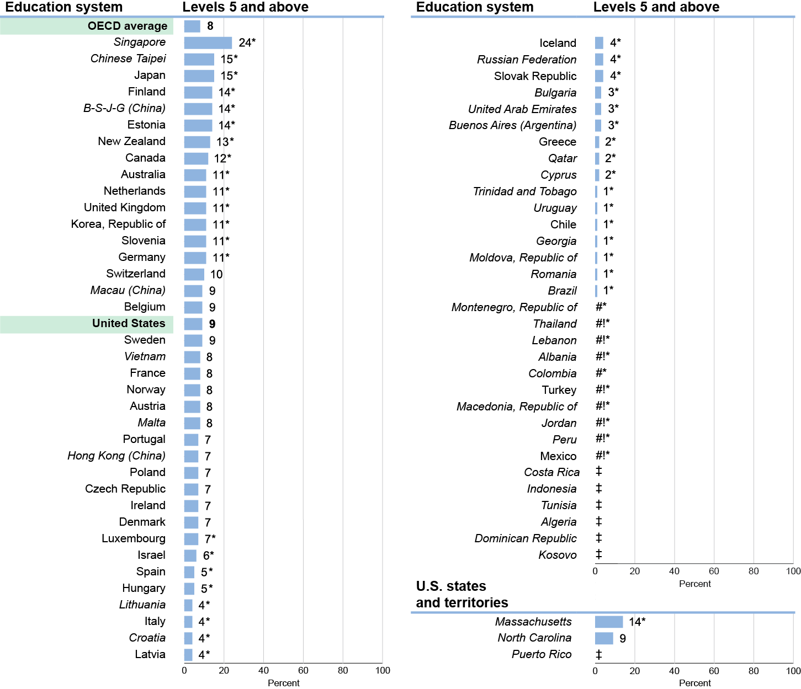
Science Literacy: PISA 2015 Top Performers
9 percent of U.S. 15-year-old students scored at Proficiency Levels 5 and above
* Significantly different from the U.S. percentage.
# Rounds to zero.
! Interpret data with caution. Estimate is unstable due to high coefficient of variation (>30 percent and <=50 percent).
‡ Reporting standards not met due to coefficient of variation over 50 percent.
Note: Italics indicate non-OECD countries and education systems.

Slide 12
Science Literacy: PISA 2015 Top Performers
Education Systems with Higher Average Score in Science Literacy than U.S.
Singapore
Chinese Taipei
Japan
Finland
B-S-J-G (China)
Estonia
New Zealand
Canada
Australia
Netherlands
United Kingdom
Korea, Republic of
Slovenia
Germany
Switzerland
Macau (China)
United States
Vietnam
OECD Average
Hong Kong (China)
*
*
*
*
U.S. percentage of top performers not different than OECD average
*
*
*
*
*
*
*
*
*
*
United States
OECD Average
9
* Significantly different from U.S.
8
Note: Italics indicate non-OECD countries and education systems.

Slide 13
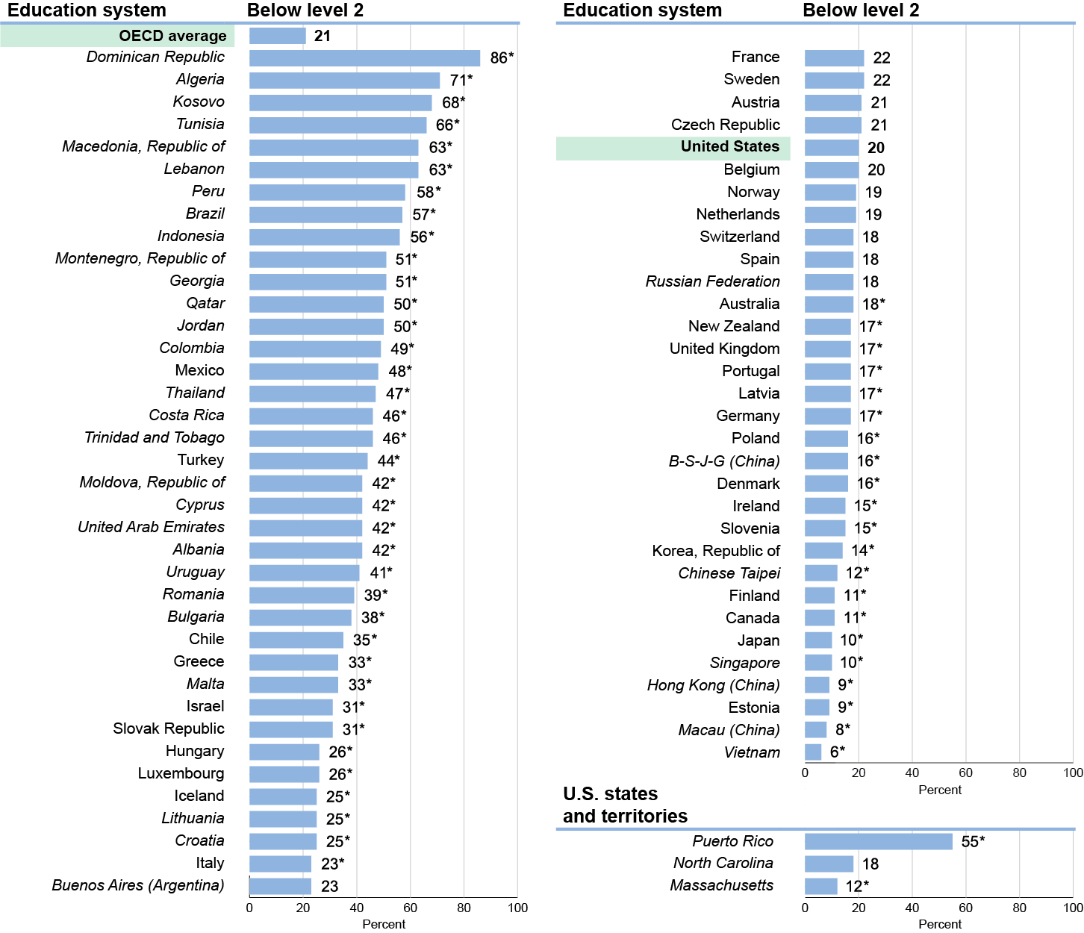
Science Literacy: PISA 2015 Low Performers
20 percent of U.S. 15-year-old students scored below Proficiency Level 2
* Significantly different from the U.S. percentage.
# Rounds to zero.
! Interpret data with caution. Estimate is unstable due to high coefficient of variation (>30 percent and <=50 percent).
‡ Reporting standards not met due to coefficient of variation over 50 percent.
Note: Italics indicate non-OECD countries and education systems.

Slide 14
Science Literacy: PISA 2015 Low Performers
Education Systems with Higher Average Score in Science Literacy than U.S.
OECD Average
United States
Netherlands
Switzerland
Australia
New Zealand
United Kingdom
Germany
B-S-J-G (China)
Slovenia
Korea, Republic of
Chinese Taipei
Finland
Canada
Japan
Singapore
Hong Kong (China)
Estonia
Macau (China)
Vietnam
OECD Average
United States
21
20
*
*
*
*
*
*
U.S. percentage of low performers not different than OECD average
*
*
*
*
*
* Significantly different from U.S.
*
*
*
*
*
Note: Italics indicate non-OECD countries and education systems.

Slide 15
Reading Literacy

Slide 16
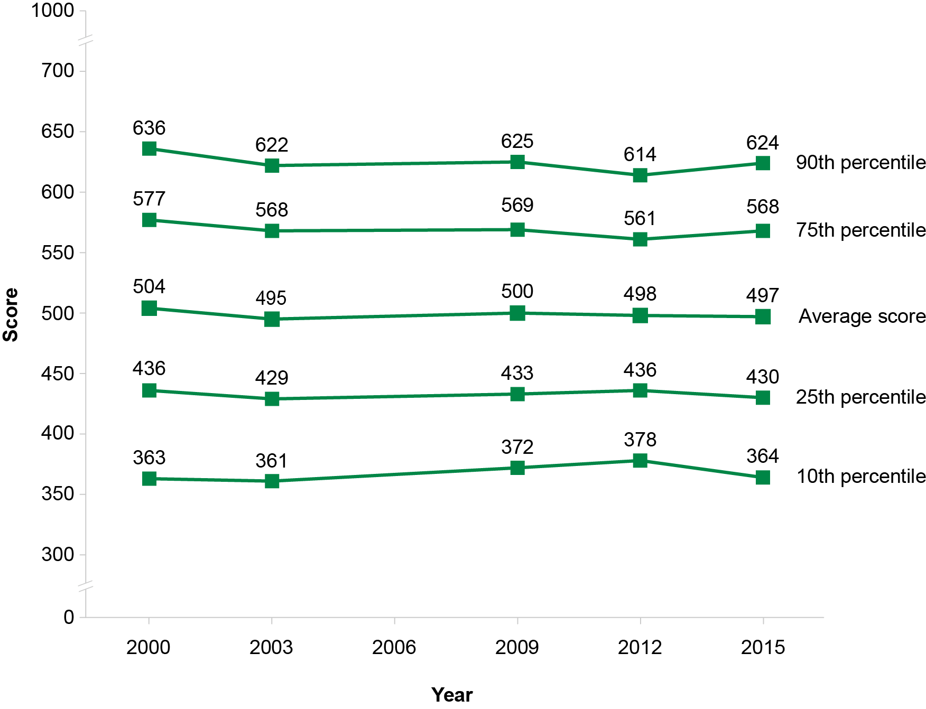
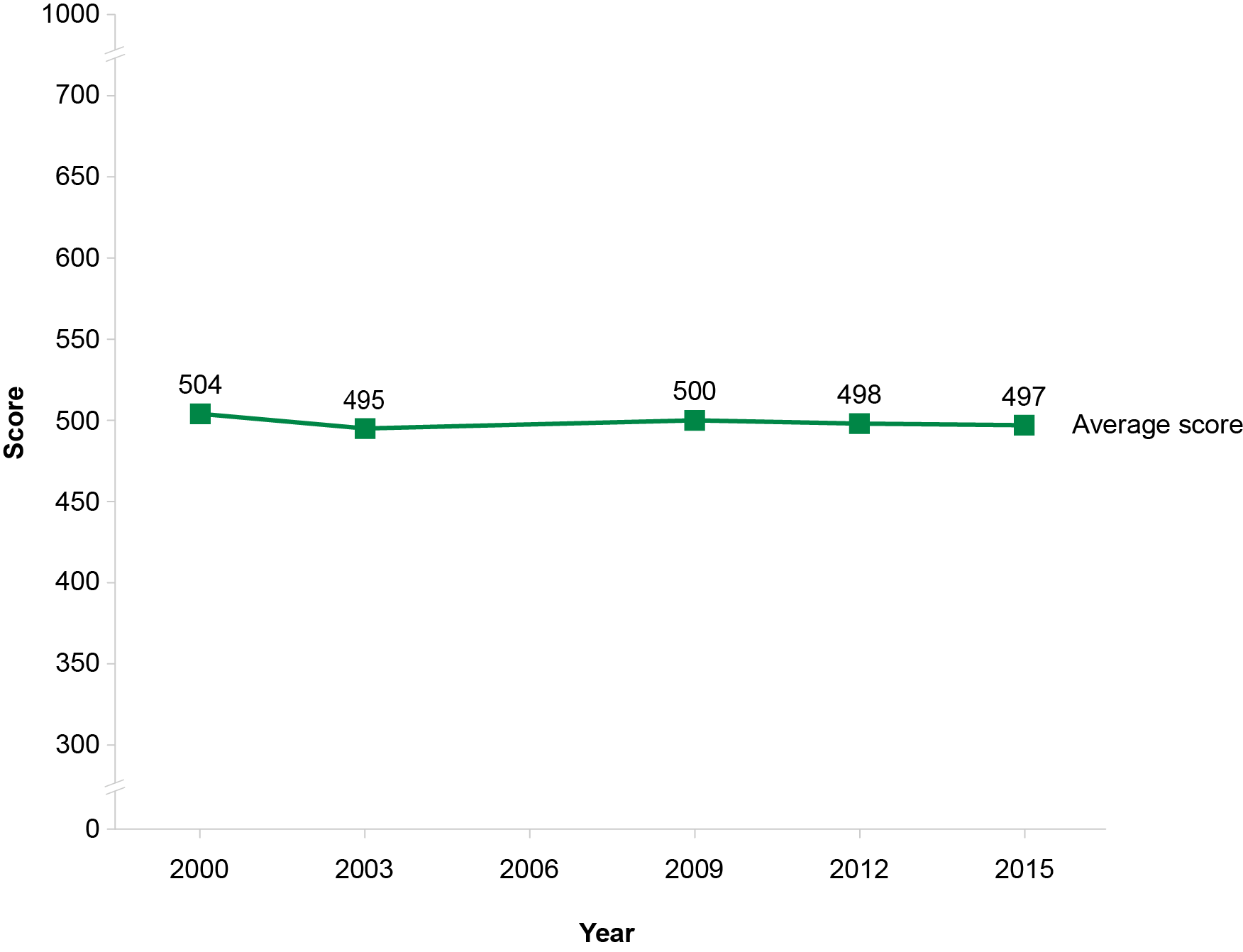
Reading Literacy: U.S. PISA Trends in Average Scores & Percentiles
No change in U.S. average scores between 2000 and 2015
No change in percentiles
Note: PISA 2006 reading literacy results for the U.S. were not reported due to an error in printing the test booklets.

Slide 17
Reading Literacy: PISA 2015 U.S. Average Score
Average Score Higher than U.S. Average
Singapore | 535
Hong Kong (China) | 527
Canada | 527
Finland | 526
Ireland | 521
Estonia | 519
Korea, Republic of | 517
Japan | 516
Norway | 513
New Zealand | 509
Germany | 509
Macau (China) | 509
Poland | 506
Slovenia | 505
Average Score Not Measurably Different than U.S. Average
Netherlands | 503
Australia | 503
Sweden | 500
Denmark | 500
France | 499
Belgium | 499
Portugal | 498
United Kingdom | 498
Chinese Taipei | 497
United States | 497
Spain | 496
Russian Federation | 495
B-S-J-G (China) | 494
OECD Average | 493
Switzerland | 492
U.S. 15-year-old students’ average score not different than OECD average
U.S. States and Territories
Massachusetts | 527
North Carolina | 500
Puerto Rico | 410
Key
Average score higher than U.S. average
Average score is lower than U.S. average
Note: Italics indicate non-OECD countries and education systems.

Slide 18
Reading Literacy: PISA 2015 U.S. Subnational System Scores
Massachusetts
0
systems scored higher
8
systems not different
North Carolina
13
systems scored higher
Puerto Rico
62
systems scored lower
17
systems not different
40
systems scored lower
58
systems scored higher
6
systems not different
6
systems scored lower

Slide 19
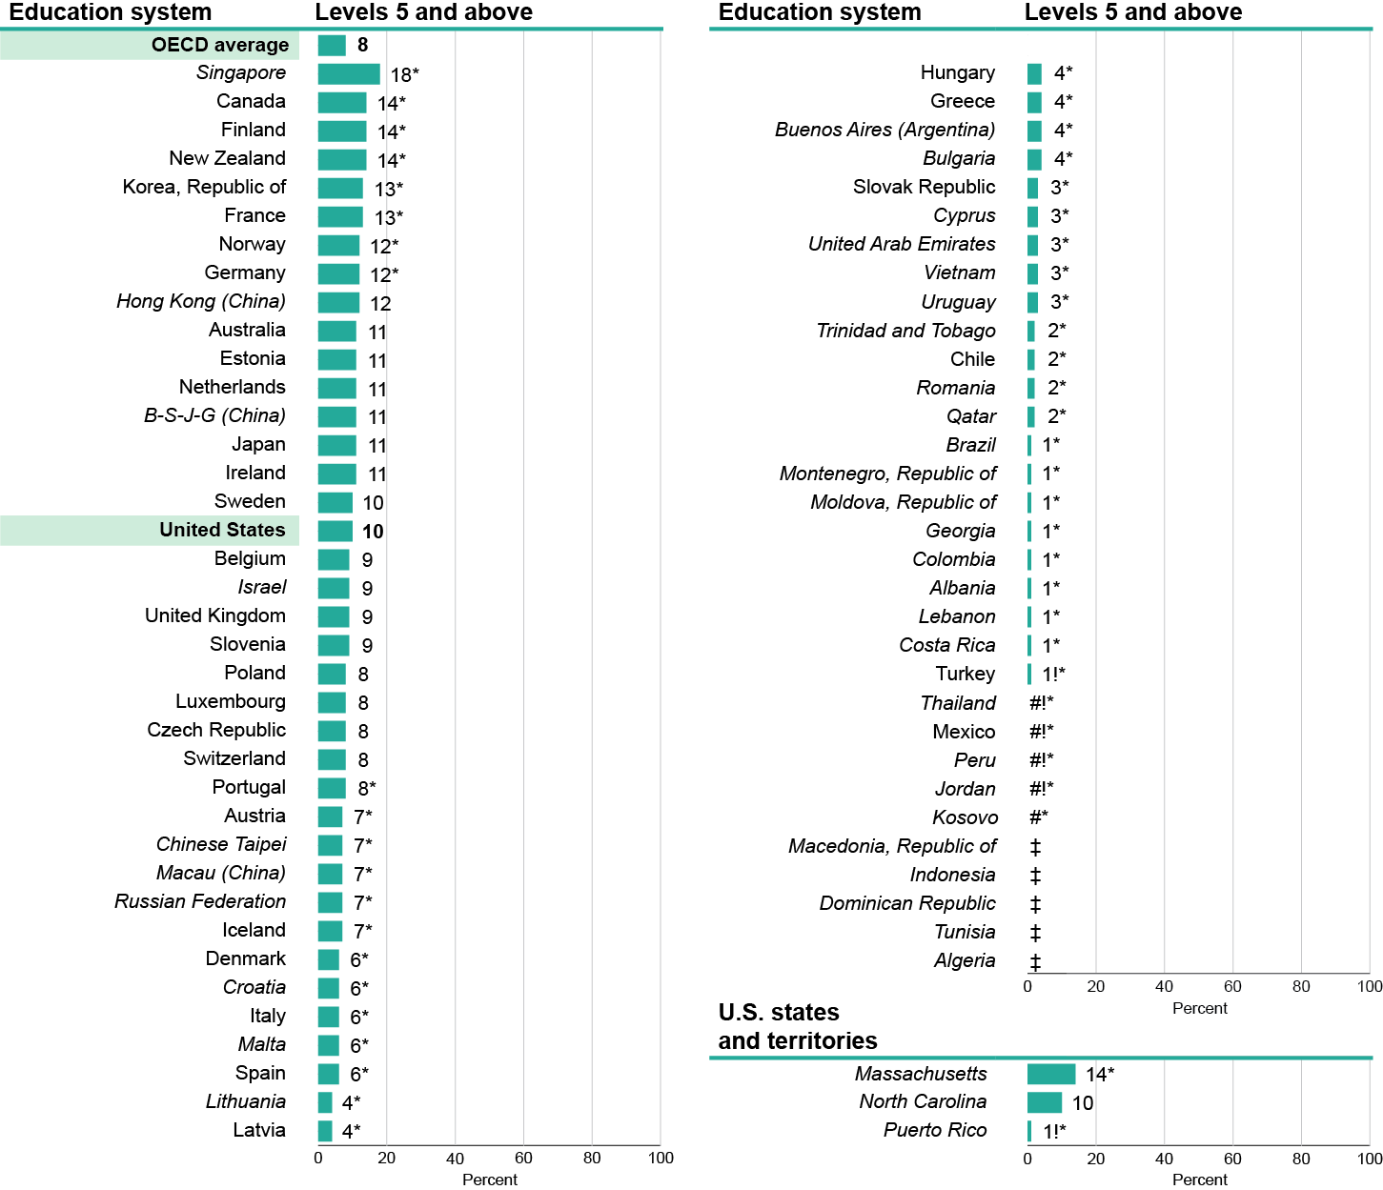
Reading Literacy: PISA 2015 Top Performers
10 percent of U.S. 15-year-old students scored at Proficiency Levels 5 and above
* Significantly different from the U.S. percentage.
# Rounds to zero.
! Interpret data with caution. Estimate is unstable due to high coefficient of variation (>30 percent and <=50 percent).
‡ Reporting standards not met due to coefficient of variation over 50 percent.
Note: Italics indicate non-OECD countries and education systems.

Slide 20
Reading Literacy: PISA 2015 Top Performers
Education Systems with Higher Average Score in Reading Literacy than U.S.
Singapore
Canada
Finland
New Zealand
Korea, Republic of
Norway
Germany
Hong Kong (China)
Estonia
Japan
Ireland
United States
Slovenia
OECD Average
Poland
Macau (China)
*
*
U.S. percentage of top performers not different than OECD average
*
*
*
*
*
United States
OECD Average
10
8
* Significantly different from U.S.
Note: Italics indicate non-OECD countries and education systems.

Slide 21
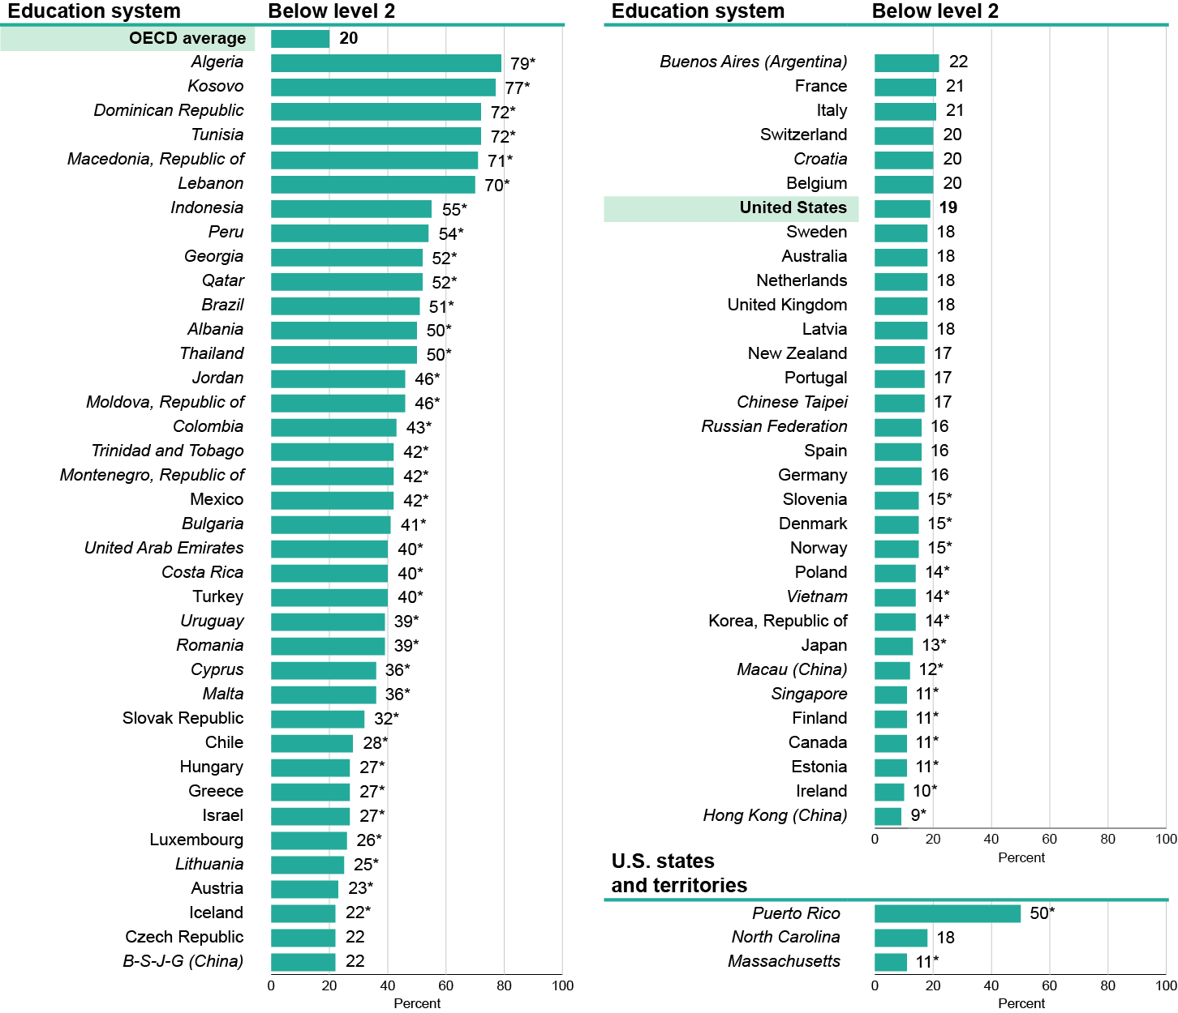
Reading Literacy: PISA 2015 Low Performers
19 percent of U.S. 15-year-old students scored below Proficiency Level 2
* Significantly different from the U.S. percentage.
# Rounds to zero.
! Interpret data with caution. Estimate is unstable due to high coefficient of variation (>30 percent and <=50 percent).
‡ Reporting standards not met due to coefficient of variation over 50 percent.
Note: Italics indicate non-OECD countries and education systems.

Slide 22
Reading Literacy: PISA 2015 Low Performers
Education Systems with Higher Average Score in Reading Literacy than U.S.
OECD Average
United States
New Zealand
Germany
Slovenia
Norway
Poland
Korea, Republic of
Japan
Macau (China)
Singapore
Finland
Canada
Estonia
Ireland
Hong Kong (China)
OECD Average
United States
20
19
*
*
*
*
U.S. percentage of low performers not different than OECD average
*
*
*
*
* Significantly different from U.S.
*
*
*
*
Note: Italics indicate non-OECD countries and education systems.

Slide 23
Mathematics Literacy

Slide 24
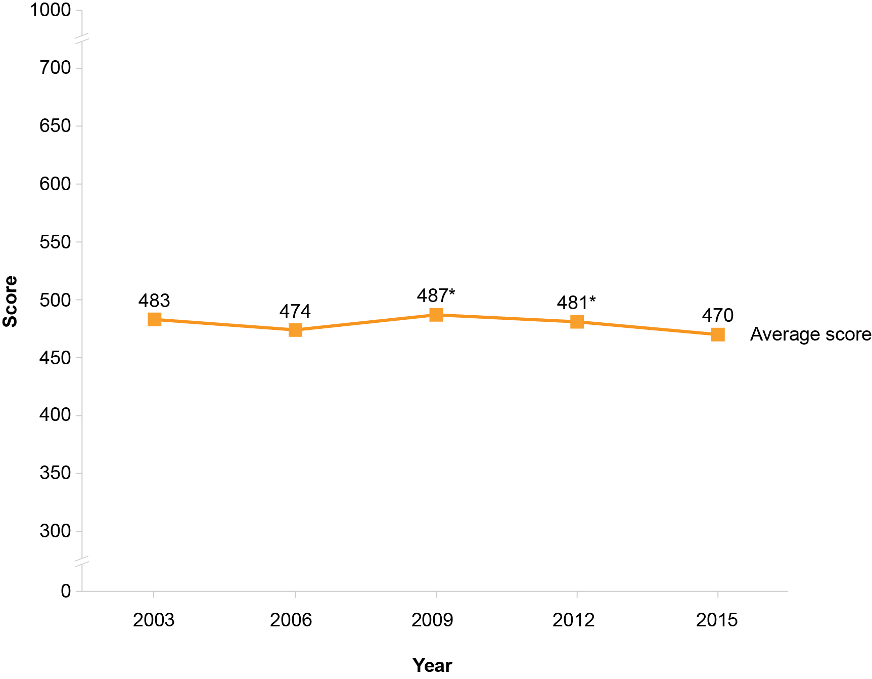
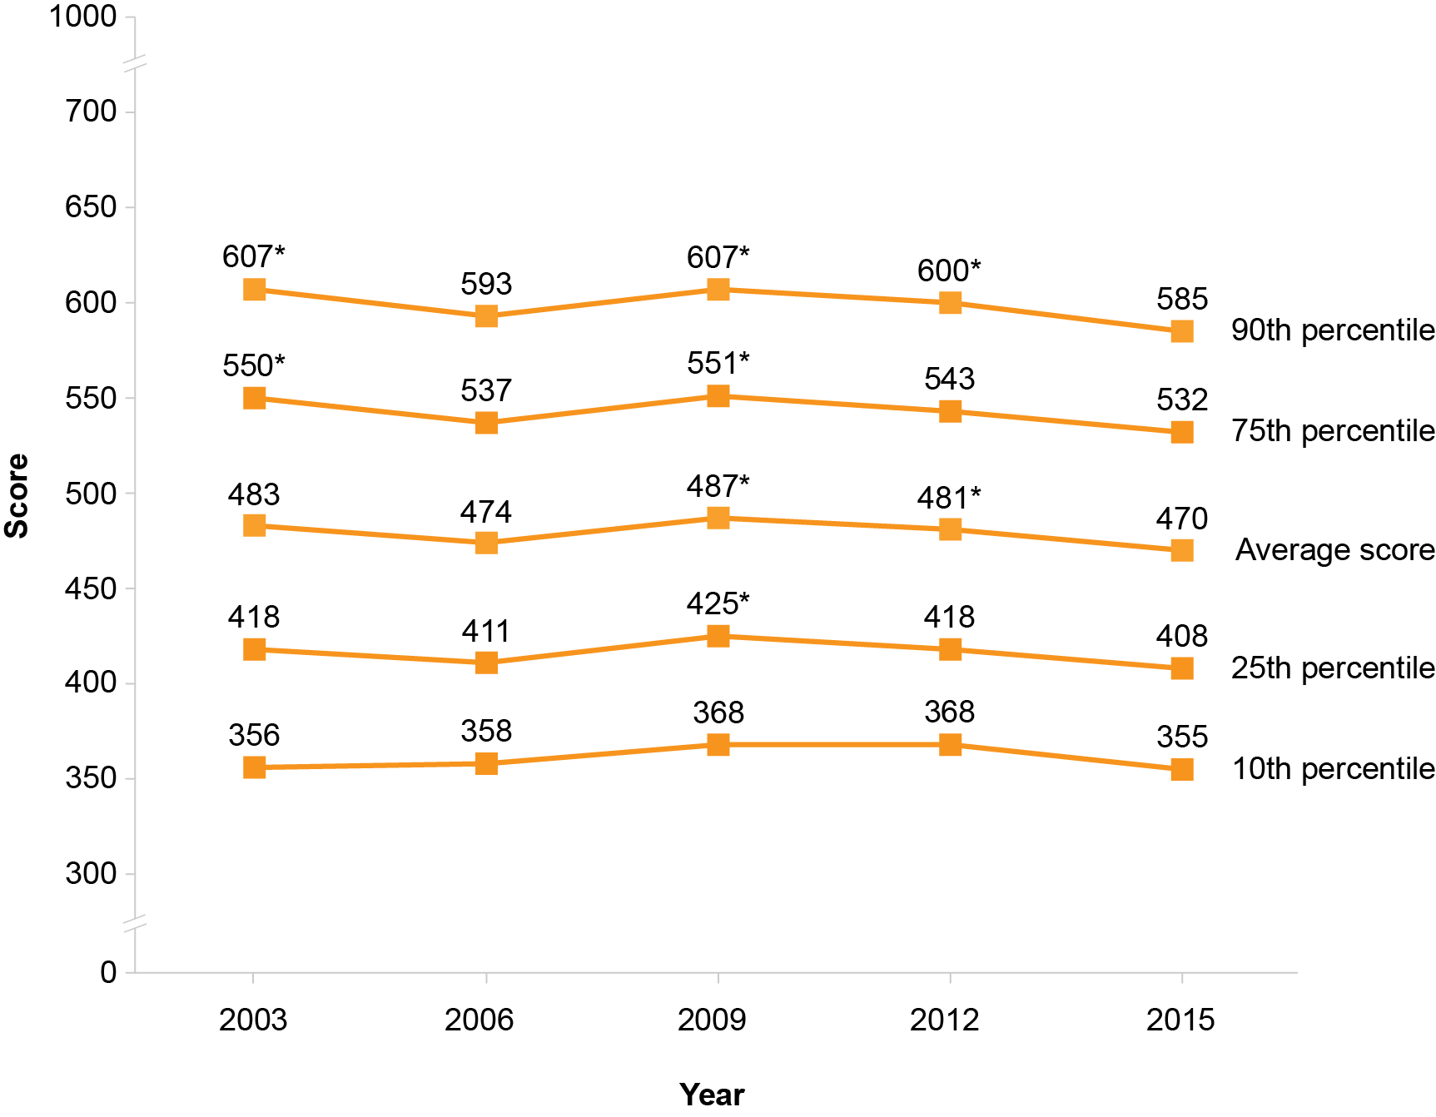
Math Literacy: U.S. PISA Trends in Average Scores & Percentiles
U.S. average scores lower in 2015 than in 2009 and 2012
Scores at the 90th, 75th, and 25th percentiles declined since 2009
* Significantly different from 2015 score

Slide 25
Math Literacy: PISA 2015 U.S. Average Score
Average Score Higher than U.S. Average
Singapore | 564 | Austria | 497
Hong Kong (China) | 548 | New Zealand | 495
Macau (China) | 544 | Vietnam | 495
Chinese Taipei | 542 | Russian Federation | 494
Japan | 532 | Sweden | 494
B-S-J-G (China) | 531 | Australia | 494
Korea, Republic of | 524 | France | 493
Switzerland | 521 | United Kingdom | 492
Estonia | 520 | Czech Republic | 492
Canada | 516 | Portugal | 492
Netherlands | 512 | OECD Average | 490
Denmark | 511 | Italy | 490
Finland | 511 | Iceland | 488
Slovenia | 510 | Spain | 486
Belgium | 507 | Luxembourg | 486
Germany | 506 | Latvia | 482
Poland | 504 | Malta | 479
Ireland | 504 | Lithuania | 478
Norway | 502
U.S. 15-year-old students’ average score below OECD average
Average Score Not Measurably Different than U.S. Average
Hungary | 477
Slovak Republic | 475
Israel | 470
United States | 470
Croatia | 464
Buenos Aires (Argentina) | 456
U.S. States and Territories
Massachusetts | 500
North Carolina | 471
Puerto Rico | 378
Key
Average score higher than U.S. average
Average score is lower than U.S. average
Note: Italics indicate non-OECD countries and education systems.

Slide 26
Math Literacy: PISA 2015 U.S. Subnational System Scores
Massachusetts
11
systems scored higher
19
systems not different
North Carolina
34
systems scored higher
Puerto Rico
40
systems scored lower
8
systems not different
28
systems scored lower
60
systems scored higher
7
systems not different
3
systems scored lower

Slide 27
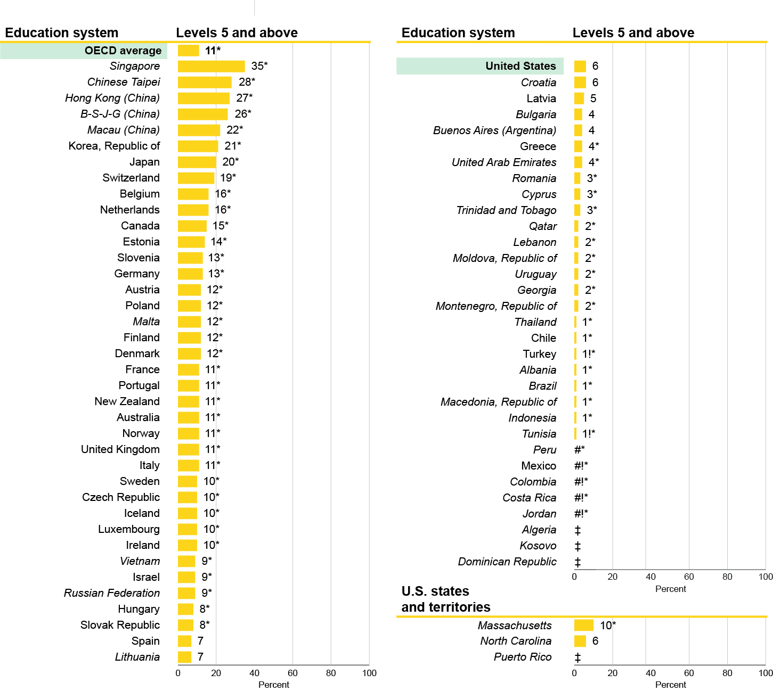
Math Literacy: PISA 2015 Top Performers
6 percent of U.S. 15-year-old students scored at Proficiency Levels 5 and above
* Significantly different from the U.S. percentage.
# Rounds to zero.
! Interpret data with caution. Estimate is unstable due to high coefficient of variation (>30 percent and <=50 percent).
‡ Reporting standards not met due to coefficient of variation over 50 percent.
Note: Italics indicate non-OECD countries and education systems.

Slide 28
Math Literacy: PISA 2015 Top Performers
Education Systems with Higher Average Score in Math Literacy than U.S.
Singapore
Chinese Taipei
Hong Kong (China)
B-S-J-G (China)
Macau (China)
Korea, Republic of
Japan
Switzerland
Belgium
Netherlands
Canada
Estonia
Slovenia
Germany
Austria
Poland
Malta
Finland
Denmark
France
Portugal
New Zealand
Australia
OECD Average
Norway
United Kingdom
Italy
Sweden
Czech Republic
Iceland
Luxembourg
Ireland
Vietnam
Russian Federation
Spain
Lithuania
United States
Latvia
*
*
*
*
*
U.S. percentage of top performers lower than OECD average
*
*
*
*
*
*
*
*
*
*
*
*
*
*
*
*
*
*
*
OECD Average
United States
*
11*
*
*
*
6
*
*
*
*
* Significantly different from U.S.
*
*
Note: Italics indicate non-OECD countries and education systems.

Slide 29
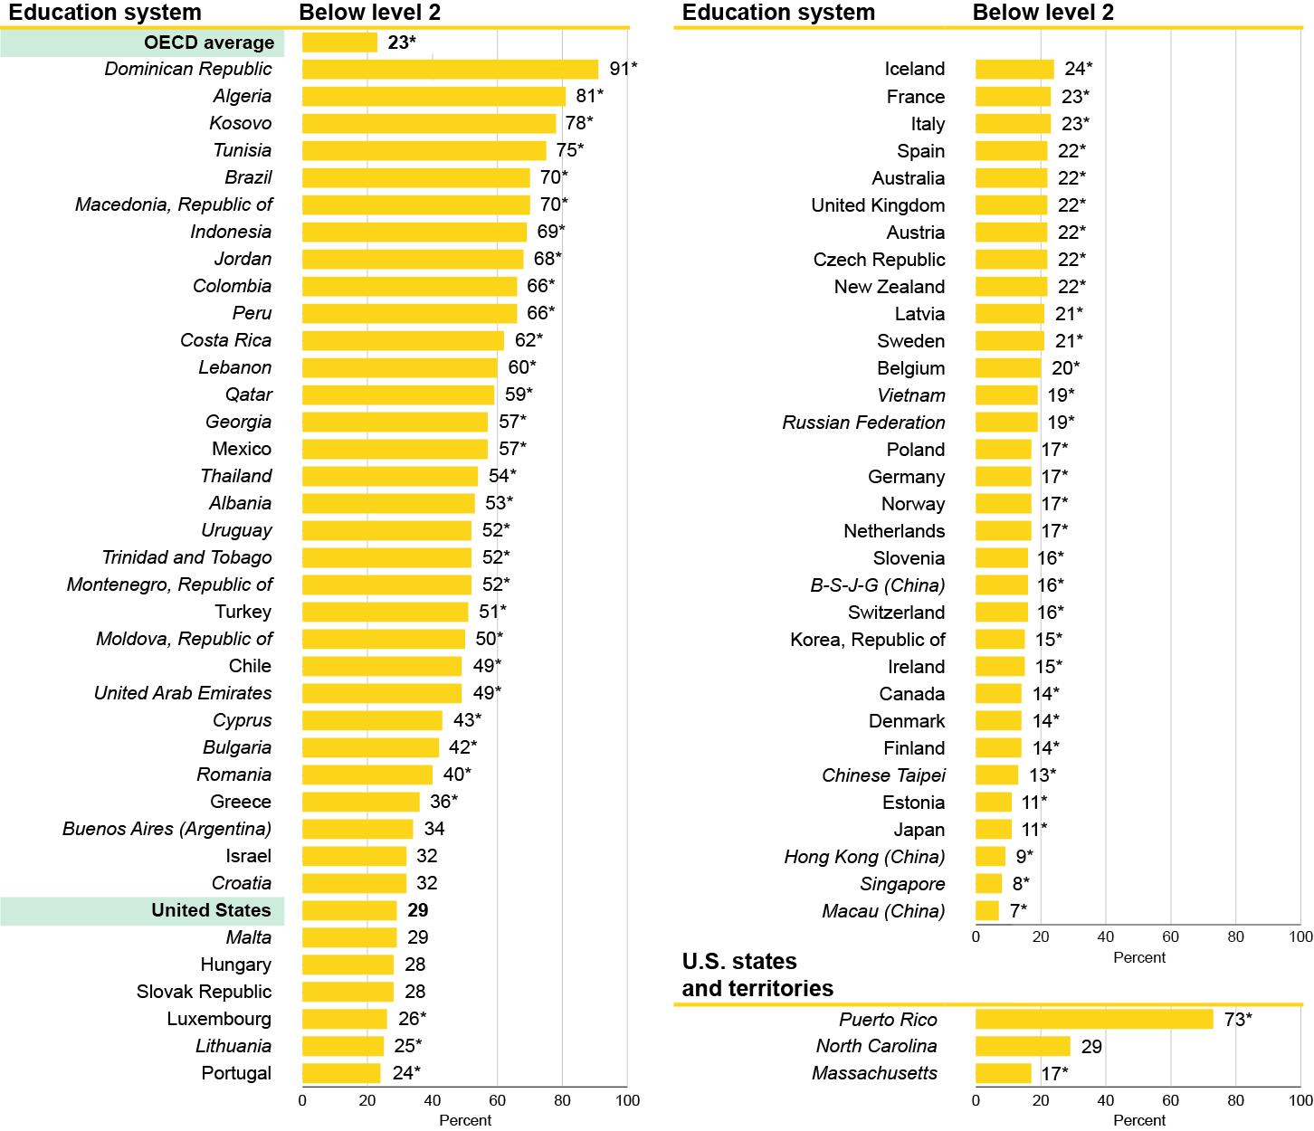
Math Literacy: PISA 2015 Low Performers
29 percent of U.S. 15-year-old students scored at below Proficiency Level 2
* Significantly different from the U.S. percentage.
# Rounds to zero.
! Interpret data with caution. Estimate is unstable due to high coefficient of variation (>30 percent and <=50 percent).
‡ Reporting standards not met due to coefficient of variation over 50 percent.
Note: Italics indicate non-OECD countries and education systems.

Slide 30
Math Literacy: PISA 2015 Low Performers
Education Systems with Higher Average Score in Math Literacy than U.S.
United States
Malta
Luxembourg
Lithuania
Portugal
Iceland
France
OECD Average
Italy
Spain
Australia
United Kingdom
Austria
Czech Republic
New Zealand
Latvia
Sweden
Belgium
Vietnam
Russian Federation
Poland
Germany
Norway
Netherlands
Slovenia
B-S-J-G (China)
Switzerland
Korea, Republic of
Ireland
Canada
Denmark
Finland
Chinese Taipei
Estonia
Japan
Hong Kong (China)
Singapore
Macau (China)
*
*
*
United States
OECD Average
29
*
*
*
23*
*
*
*
*
*
*
*
*
*
U.S. percentage of low performers higher than OECD average
*
*
*
*
*
*
*
*
*
*
*
* Significantly different from U.S.
*
*
*
*
*
*
*
*
*
*
Note: Italics indicate non-OECD countries and education systems.

Slide 31
PISA 2015 U.S. Score Gaps by Gender
U.S. males outperformed females in science and math
U.S. females outperformed males in reading
Science
Reading
Math
United States
OECD average
United States
OECD average
United States
OECD average
7*
4*
Male average score
Female average score
*Score gap is significant

Slide 32
Summary of U.S. 2015 PISA Results
Science
Reading
Math
No change in
average score from 2012
No change in
average score from 2012
Average score lower
than in 2012
9%
20%
10%
19%
6%
29%
top performers in 2015
(Levels 5 and above)
low performers in 2015
(Level 2 and below)
top performers in 2015
(Levels 5 and above)
low performers in 2015
(Level 2 and below)
top performers in 2015
(Levels 5 and above)
low performers in 2015
(Level 2 and below)

Slide 33
U.S. 2015 PISA Results in an International Context
Science
Reading
Math
No change in
average score from 2012
No change in
average score from 2012
Average score lower
than in 2012
U.S. Ranking*
U.S. Ranking*
U.S. Ranking*
21
18
18
15
28
35
2012
2015
2012
2015
2012
2015
5 that were now
3 that were now
6 that were now
5 that were now
7 that were now
3 that were now
*Rankings are based on the 60 education systems that participated in both PISA 2012 and PISA 2015 and are determined by calculating the highest possible rank (number of education systems performing higher plus one).

Slide 34
For More Information
PISA at NCES:
http://nces.ed.gov/surveys/pisa/
Contact:
Patrick Gonzales
NCES
415-920-9229
Patrick.Gonzales@ed.gov

