Slide 1
State Support Team
A group of SLDS experts who support states & territories (regardless of grant status) around developing, managing, using, and sustaining SLDSs. Provide services across sectors and many topics.
Individual Assistance:
check-in calls & on-site visits
review project plans & other docs
provide resources, training, and examples
connect states with peers
help determine state needs
Multi-state assistance:
Best Practices Conference
resource sharing repository
publications
topical webinars
communities of practice
listserv
Common Topics: data governance, stakeholder engagement, project management, data use, sustainability
Learn more about the SST

Slide 2
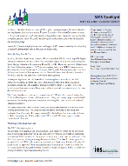
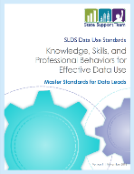
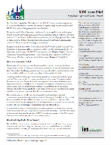
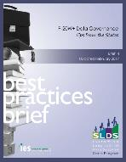
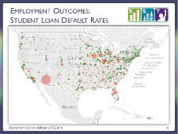
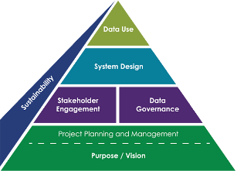
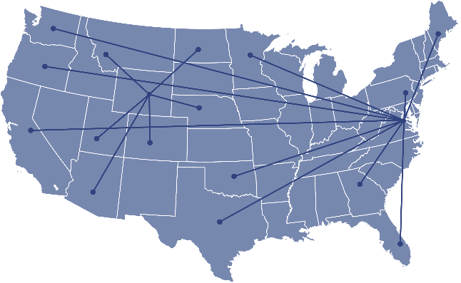
SLDS Technical Assistance
Pubs & Resources
Capture best practices from the field: briefs, guides, tools, templates, state- contributed resources and examples, state spotlights, etc.
Webinars
Online presentations to showcase state work or offer tips on pressing topics.
Communities of practice
Organized around seven essential building blocks of an effective data system, on which SST focus work and states collaborate.
Multi-State engagements
Best Practices Conference
Personnel Exchange Network
Regional Meetings
Learn more about SLDS Technical Assistance

