Slide 1
Using DMV Records to Access Social Security Numbers (SSNs)
Monday, October 29, 2012
Rico Barrera, Idaho Department of Labor

Slide 2
Overview
Using DMV Records to Access SSNs: Idaho’s Experience
Dialogue: Questions and Answers

Slide 3
Using DMV Records
to Access SSNs:
Idaho’s Experience

Slide 4
In the beginning…
First round of WDQI
“Wouldn’t it be great if we could get all this data from all these places?”
Reaching out to DMV
Previous Informal Data Exchanges a
Providing LMI on Economic Distressed Areas (EDAs)
In-Out Migration Data

Slide 5
Key to getting there
Sell it
Interact with your counterparts
Start with correspondence, move to email /phone then propose a meeting.
Focus on the benefits to the state and its residents
“...strive to create jobs, increase earnings, economic well-being and ultimately the quality of life.”

Slide 6
Trials and tribulations
The MOU Process
Specify its purpose and authority
Identify each parties’ duty and obligation
Designate the positions involved
Safeguards and costs (if any)
Ensure legal review
Don’t hold your breath

Slide 7
Trials and tribulations
What helped?
State DMV statute that allows for data sharing
Personal information may be disclosed strictly limited to...use by any government agency…in carrying out its functions, or any private person or entity acting on behalf of a federal, state, or local agency in carrying out its functions.
What didn’t help?
Politics – Internal & External

Slide 8
How does it work?
What did we ask for/get?
Social Security number (SSN)
Name
Last Name(s)
Any additional AKAs (multiple names, last names)
Date of Birth (DOB)
Gender
Last-record update date

Slide 9
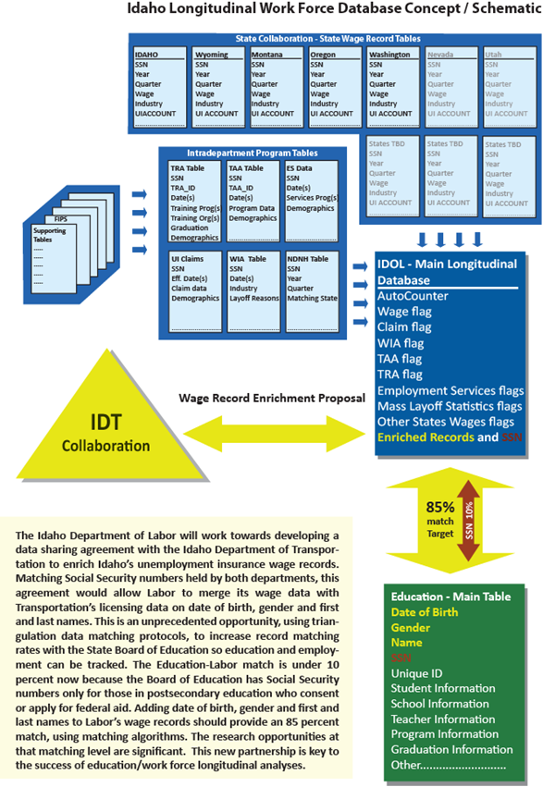
How does it work?

Slide 10
How does it work?
Match-Success Rate
90% success
750,000 Wage records – 1.5 mil DMV records
85% success rate anticipated in matching with Education records

Slide 11
Dialogue:
Questions
and Answers

Slide 12
Contacts & Additional Resources
Contact information:
Rico Barrera, Ricardo.Barrera@labor.idaho.gov
Keith Brown, keith.brown@sst-slds.org

