Slide 1
Documenting and Quantifying Return on Investment
Tuesday, October 30, 2012
Brian Rawson, Texas Education Agency
Kurt Kiefer, Wisconsin Department of Public Instruction
Neal Gibson, Arkansas Department of Education

Slide 2
Overview
Approaches to ROI
  Arkansas
  Texas
  Wisconsin
Questions & Answers

Slide 3
Arkansas’s
Return on Investment

Slide 4

arc.arkansas.gov

Slide 5
Duplicate Enrollment

Slide 6
quicklooks.arkansas.gov

Slide 7
Economic Success Measures

Slide 8
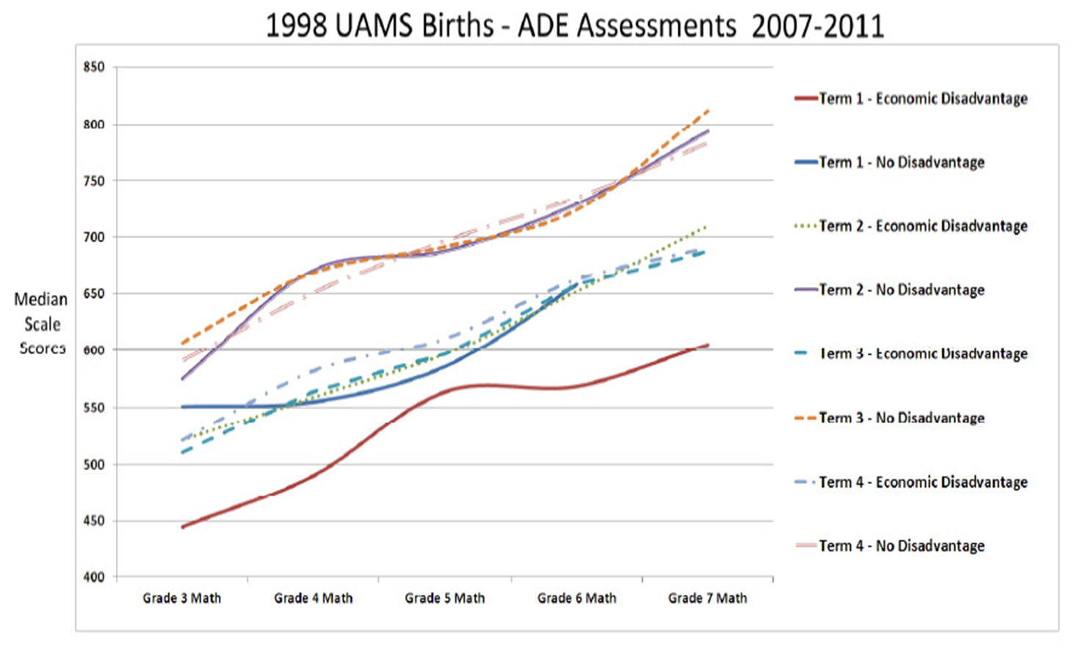
UAMS Neonatal Research

Slide 9
Improvement Plan Software

Slide 10
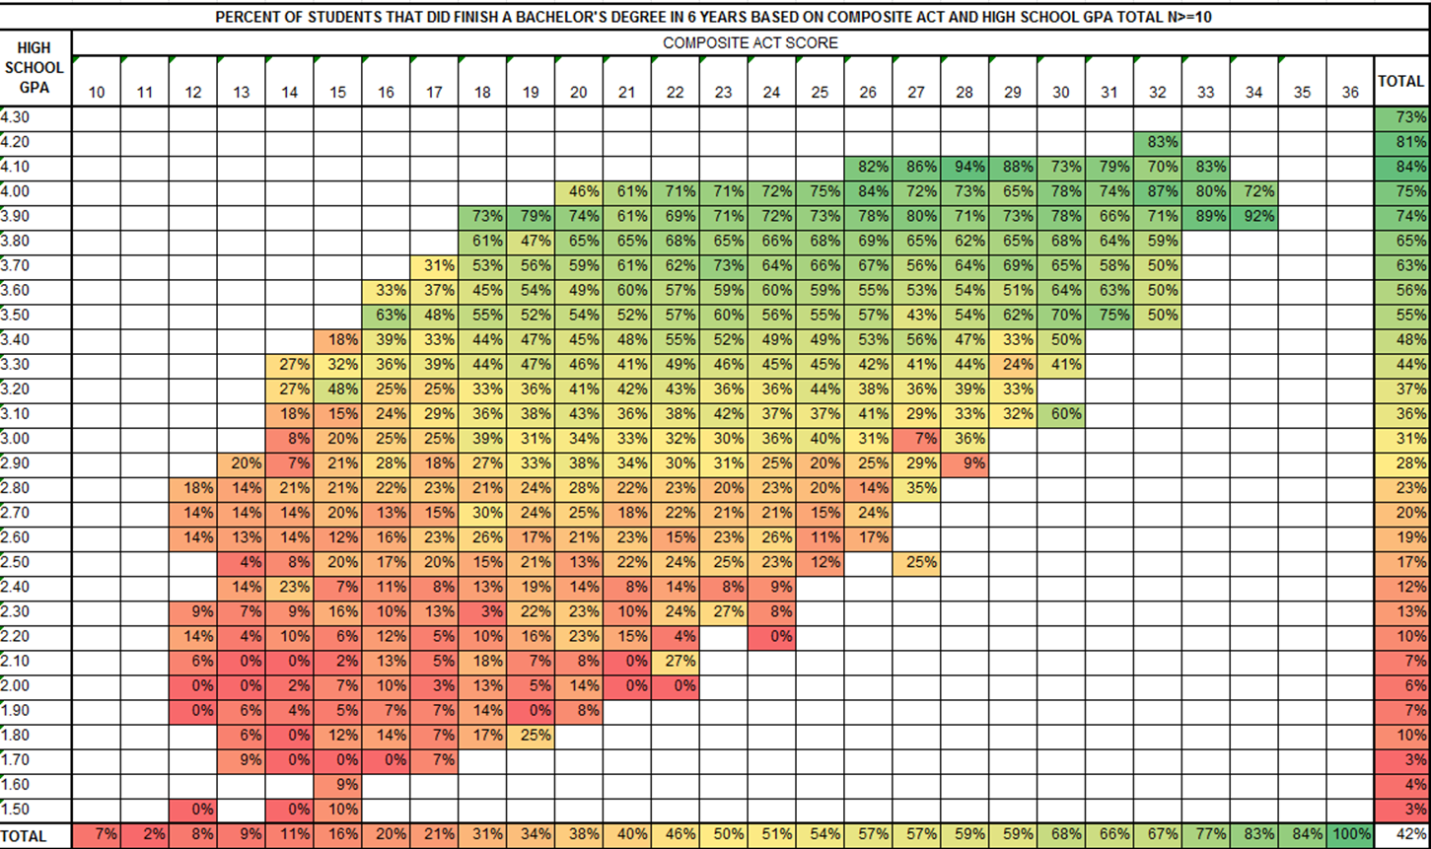
Legislature Reports

Slide 11

Texas Student Data System ROI
A balanced approach to benefits realization

Slide 12
Quantitative vs Qualitative ROI
Texas Project Delivery Framework (statutory)
Post-Implementation Review of Business Outcomes
Actual results of 4 quantitative and qualitative factors that were anticipated in the business case:
Statutory fulfillment
Strategic alignment
Agency impact analysis
Financial analysis
  Business justification
  Project planning
  Solicitation and contracting
  Project implementation
  Benefits realization
Business Case
Comparative information between business solution cost and project benefits, based on a business case analysis process

Slide 13
Return on Investment Value to the State (ROIv)
M + S + C + I
2√R
ROIv =
  M = Mandate
  S = Value to state
  C = Value to customers
  I = Investment value
  R = Risk

Slide 14
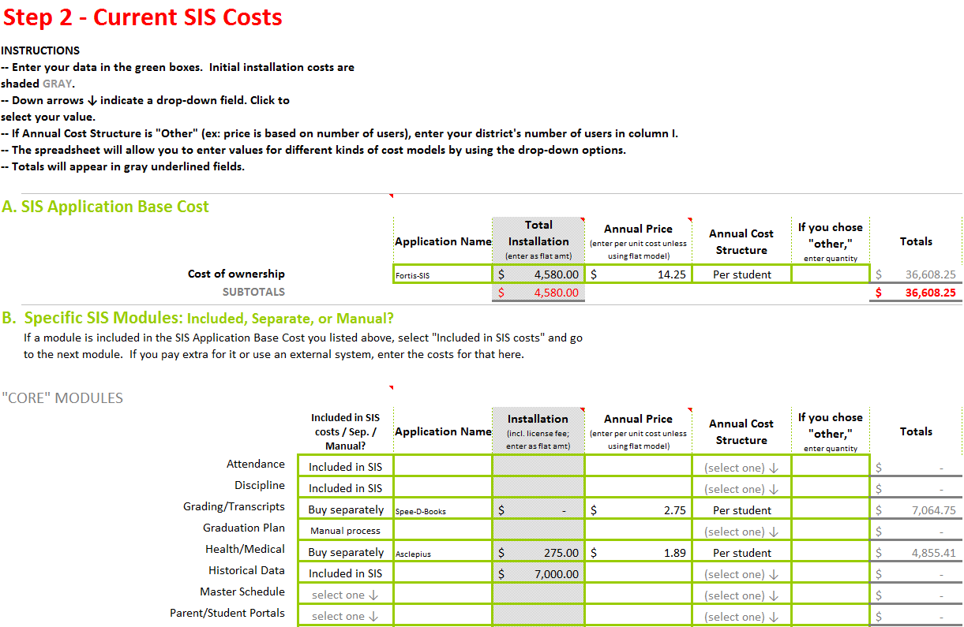
Statewide vs Local ROI
  EX: State-sponsored Student Information System (SSIS)
  TCO Tool helps LEAs compare costs of current SIS against prices for SSIS contracts
Current SIS Annual Costs | Potential SIS “Cloud-based” Costs
SIS application base | Annual subscription
Vendor adaptation | Annual hosting
Hardware/software | One-time installation
Facilities & internet | Internet service
Training/sustainability | Training/sustainability
Support
Staffing

Slide 15

Summary

  Balanced approach to ROI
  Quantitative ROI satisfies fiduciary responsibility
  Qualitative factors ensure comprehensive perspective
  Statewide focus satisfies “funders”
  Local focus satisfies local control needs

Slide 16
Wisconsin’s Return on Investment

Slide 17
Wisconsin
Quantifiable Cost Savings
Data Collection
  $30M+ per year currently
Software Licensing
  Reduced by 25 to 50%, ~$4.5M per year

Slide 18
Wisconsin
Wisconsin is uniquely organized for this sort of solution as a large collection of relatively small districts

Slide 19
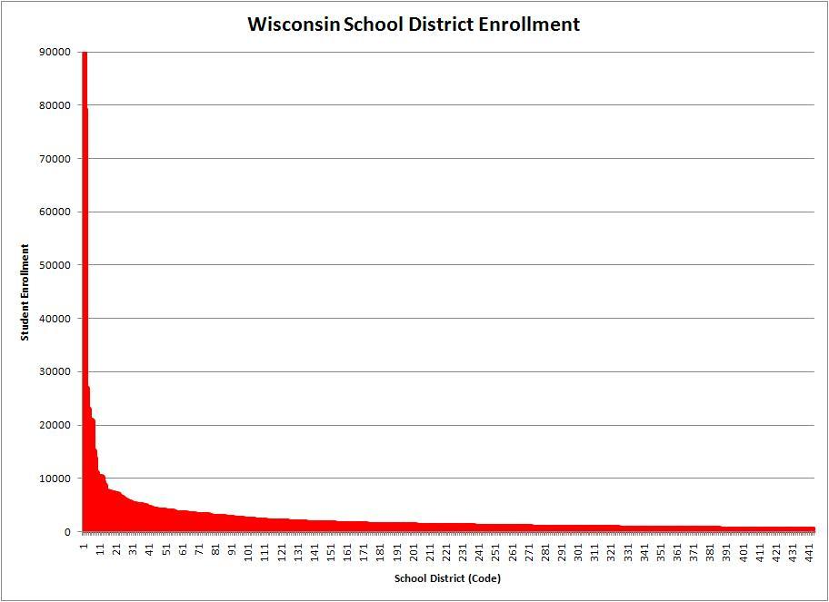

Slide 20
Wisconsin
Technology scales well
1,000 vs. 1,000,000 students – same system, similar effort and labor
Technology advances enable
bandwidth, cloud, SaaS

Slide 21
Wisconsin
Eliminates repeated tasks every district performs:
Procurement and negotiating contracts
Network Operations
  Installing and managing servers
Database and Application Management
  Installing and updating that software
  Fixing bugs
  Documenting changes
Updating training information

Slide 22
Wisconsin
Eliminates repeated tasks every district performs:
Data integration with external agencies
  Immunizations via the state registry
  Federal lunch program status via direct certification
  Transcripts to WI colleges and universities

Slide 23
Wisconsin
Provides not easily quantifiable benefits:
Equity – all get the same features
Improved data quality from common source
Electronic records for mobile students, eliminates cumulative folder
"Big data" for EWS, RtI, other research
Eliminates training
Facilitates implementation of specific data events, i.e., statewide surveys

Slide 24
Questions & Answers

Slide 25
Contacts & Additional Resources
Contact information:
Brian Rawson, Brian.Rawson@tea.state.tx.us
Kurt Kiefer, kurt.kiefer@dpi.wi.gov
Neal Gibson, neal.gibson@arkansas.gov
Jeff Sellers, jeff.sellers@sst-slds.org
For more information on Return on Investment:
Traveling Through Time: The Forum Guide to Longitudinal Data Systems Book II: Planning and Developing an LDS: http://nces.ed.gov/pubsearch/pubsinfo.asp?pubid=2011804

