Slide 1
P20 Data Governance
The presentation will begin at approximately 3:00 p.m. ET
Information on joining the teleconference can be found on the “Info” tab in the upper left of this screen. Be sure to use the “Attendee ID” number on the Info tab when dialing in to associate your name with your phone.
In order to cut down on background noise, please mute your phone by dialing *6 upon entry into the meeting.
During the question and answer portion of this presentation:
You can re-enter *6 to unmute your phone and ask a question; or
Type your question into the Q&A panel below the participant list and clicking “Send”.
A copy of this presentation and a link to the recording will be shared with the IES Grantees and EIMAC listservs.

Slide 2
P20 Data Governance
Panelists
Melissa Beard (Washington)
Domenico “Mimmo” Parisi (Mississippi)
Neal Gibson (Arkansas)
Agenda
Background on P20+ systems
The various sources of data
The authority granted to collect and report P20+ data
How the P20+ reporting agenda is defined
How are decisions made as to what data go into the P20+ system
Lessons learned
Questions from participants

Slide 3
P20 Data Governance
EDUCATION RESEARCH AND DATA CENTER
Melissa Beard
Data Governance Coordinator

Slide 4
ERDC’s authorizing statute
Creates ERDC in the Governor’s budget agency
Makes ERDC a state education authority
Requires ERDC to:
Enter into data sharing agreements with the education and employment agencies
Compile a list of critical P-20 questions
Analyze

Slide 5
Types of data at ERDC
State-funded early learning
K-12
Public postsecondary (enrollment, completions, financial aid)
Workforce
Corrections
Apprenticeship
Teacher retirement

Slide 6
Process to request a data set
Data sets released are primarily de-identified
Request evaluated by ERDC
Does the requestor have legal authority to have it
Does ERDC have the data requested
ERDC informs the affected agencies of the request and begins the data sharing agreement process
ERDC can enter into an agreement on behalf of the education agencies
If workforce data is requested, the employment agency is included in the agreement
ERDC fulfills the request and requestor is required to share drafts prior to public release

Slide 7
Lessons Learned
Important for ERDC to be separate from the other education agencies
ERDC focuses on cross-sector analyses (refers any single-sector requests to the appropriate agency)
P-20 analyses are new to most agencies and education on the types of questions that can be answered is critical
Processes built on personal relationships need to be documented and agreed to by all
Agencies are not data owners, they are considered data contributors
The education agencies share one asst. attorney general who answers all FERPA questions

Slide 8
P20 Data Governance
National Strategic Planning & Analysis Research Center
Domenico “Mimmo” Parisi

Slide 9
About nSPARC
nSPARC is a university-level research center at Mississippi State University.
Statewide clearing house since 1999
Scientific and technical expertise
SLDS partners have authority over use of their data and release of information.
Regulated through MOUs

Slide 10
Sources of Data
For workforce issues, the agenda is clearly set by the State Workforce Investment Board.
Agenda for Early Childhood and Education not yet formalized
Sources of data:
Early Childhood
K–12
Two-Year Community College
Four-Year University
Graduate School
Workforce Service and Training
Employment Data

Slide 11
Lessons Learned
Partners decide what goes into the P20.
Lesson learned: disconnect between vendor goals and state vision.

Slide 12
P20 Data Governance
Arkansas Research Center
Neal Gibson

Slide 13
Arkansas Research Center

Slide 14
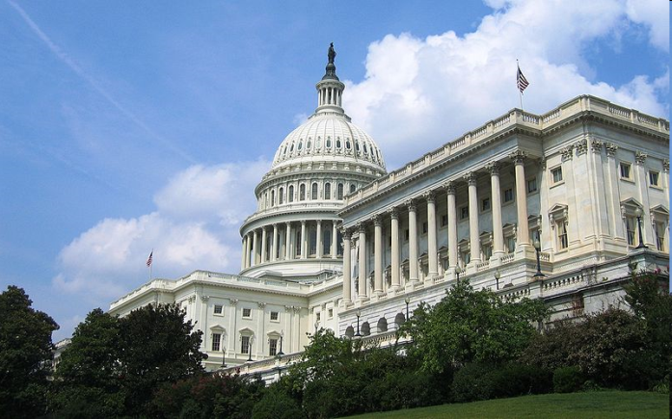
Key Problems
Regulations/Privacy
Identity Resolution/Management
Data Standards
CEDS NEDM
P20 Core ED-FI
SIF IPEDS PESC
NCES Handbooks

Slide 15
Privacy
Center on Law and Information Policy Highly Critical of Federal Plan to Relax Restrictions on Education Records
This notice of proposed rulemaking (NPRM) represents a significant
new privacy invasion.
We do not oppose general collection of information about students and its use in a nonidentifiable form. In fact we believe that the collection of aggregate information on students is a critical tool for civil rights enforcement and in assuring that every student receives equal access to a high quality education.
CLIP’s Academic Director, Professor Joel R. Reidenberg, stated that “the promiscuous sharing of children’s educational records that would be permitted by these proposals undermines privacy and is outside the Department’s authority.”

Slide 16
Regulations: FERPA/HIPPA
Both are similar in that they require permission before private information can be disclosed, but both also allow for research without disclosure if the data is “de-identified.”

Slide 17
Identity Resolution (ADE)
There are 4,026 students in Arkansas that share an SSN with at least one other student in the state.
Between August and January, 874 student transfers to other schools resulted in an SSN change.
Between August and January, an additional 1,018 students changed their SSN—we have records for only 300 of these changes.
There are ~17,000 students in Arkansas with a “900” SSN

Slide 18
Identity Management: Knowledge Base Approach
Identity information (ONLY identity information is exchanged for this process) from multiple agencies is merged and consolidated using both fuzzy and logical associations. Knowledge base identifiers are used to manage the references.
Bob Smith, Conway High School
Robert Smith, Acxiom
Knowledge Base
Probabilistic
“Fuzzy” Match
Identifier | Representation
KB5765 | Bob Smith, CHS
KB5765 | Robert Smith, Acxiom
KB5765 | Bob Smith, UCA
Deterministic Match
Bob Smith, UCA
Google: Oyster UALR

Slide 19
Dual Database: Regulatory Compliance and Privacy
Identity Information: Agency ID Generated
Information of Interest: Stored With Agency ID
Knowledge Base:
Identity Management
Edge Servers:
Shareable Data

Slide 20
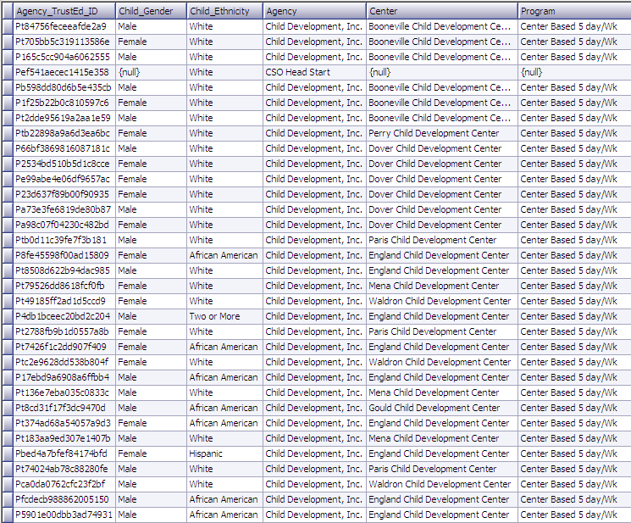
De-identified Data

Slide 21
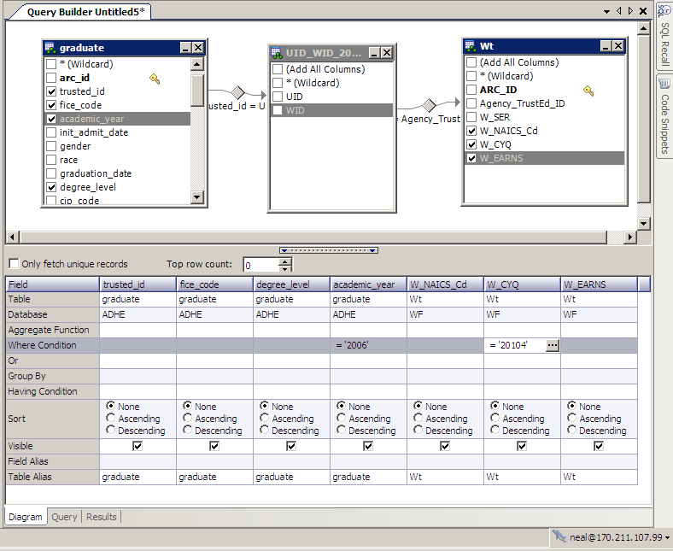
Cross Agency Query

Slide 22
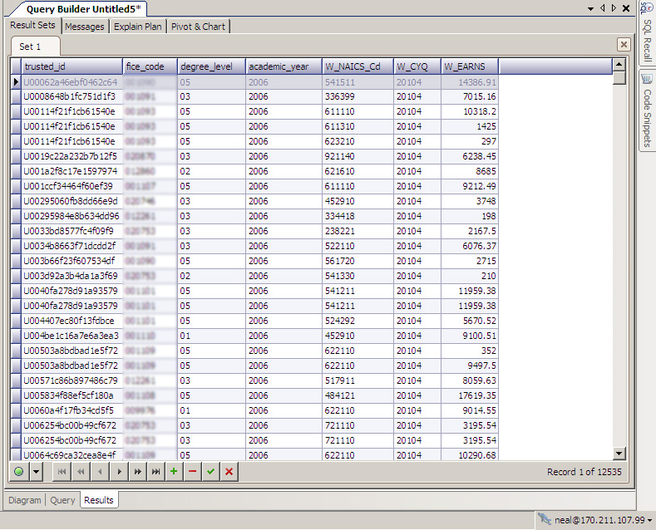
Cross Agency Result Set

Slide 23
Cross Agency Result Set

Slide 24
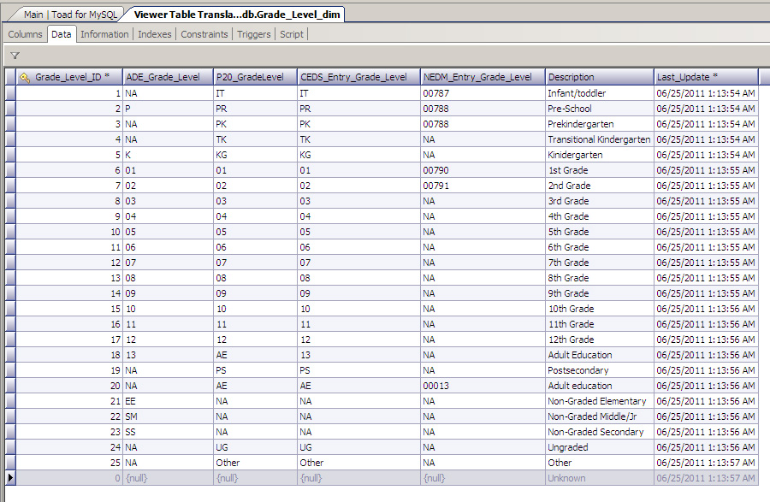
Common Standards

Slide 25
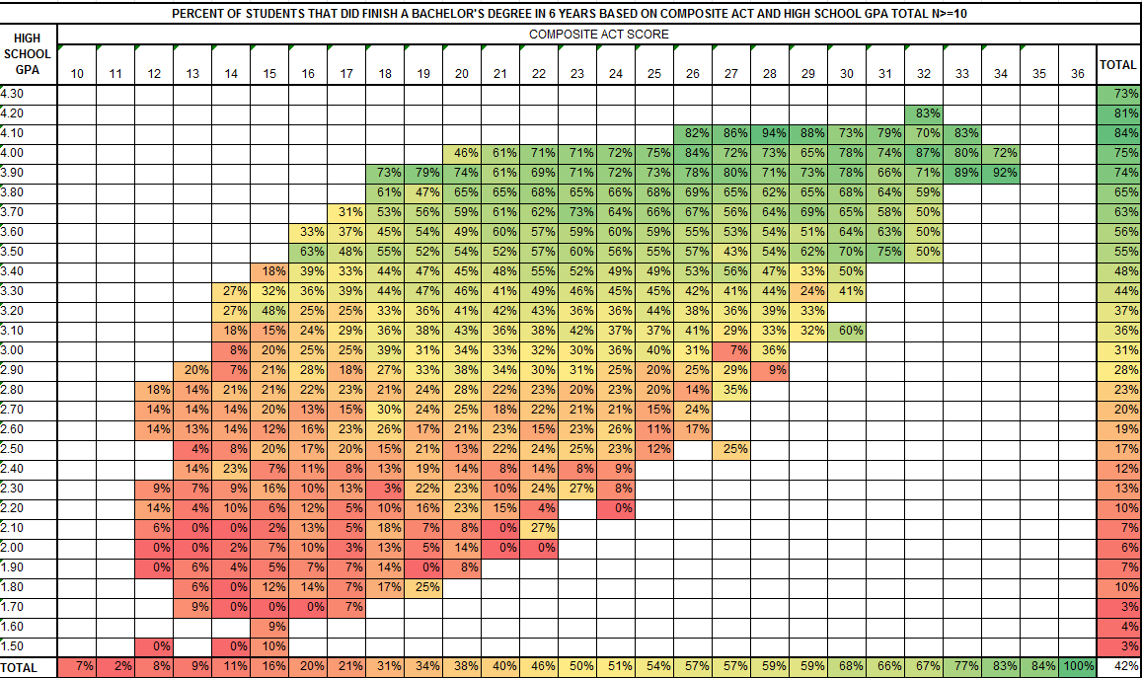
On Time Graduation

Slide 26
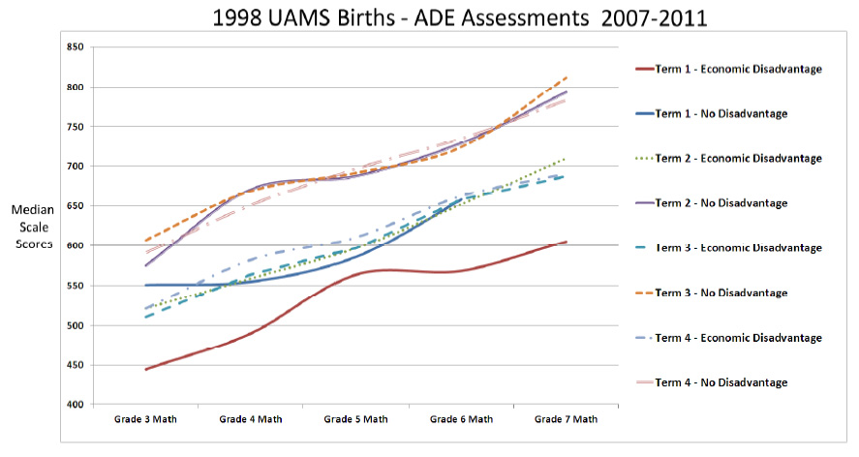
UAMS Study

Slide 27
P20 Data Governance
Questions?
Contact Info and Resources:
Requests from State Support Team or SLDS Team:
Rosemary Collins, (202) ###-#### or Rosemary.Collins@ed.gov
Jeff Sellers, (850) 544-4191 or Jeff.Sellers@sst-slds.org
Panelists:
Melissa Beard, Washington ERDC
Melissa.Beard@OFM.WA.GOV
Domenico “Mimmo” Parisi, Mississippi nSPARC
DParisi@nsparc.msstate.edu
Neal Gibson, Arkansas ARC
Neal.Gibson@arkansas.gov

