Slide 1
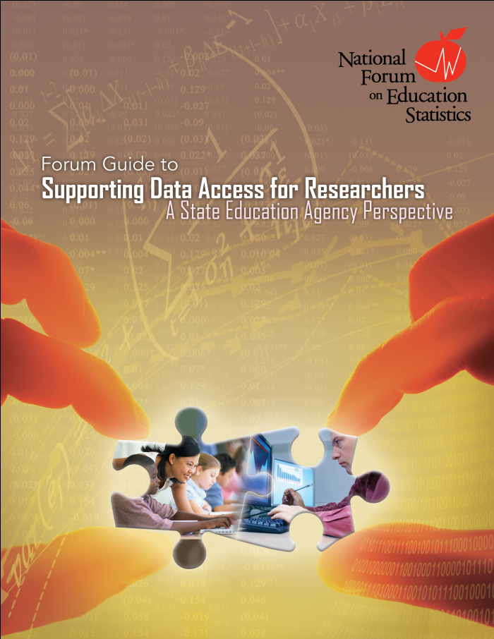
Forum Guide to Supporting Data Access for Researchers A State Education Agency Perspective
Kathy Gosa, Kansas State Department of Education

Slide 2
Introduction
Data use should drive data collection
The “research community” is an important user of education data
Developing mutually beneficial relationships between education agencies and the research community makes sense

Slide 3
Data Partnerships
Data are an integral component of our education system
Most SEAs view responding to requests for data as a major responsibility to their stakeholders and a wise investment in education
Partnerships with researchers can lead to numerous tangible benefits to education agencies, such as:
Encouraging research projects that reflect an education agency’s information needs and priorities
Supporting data-driven decisionmaking by educators and policymakers
Providing an SEA with access to additional research, statistical, and program expertise
Building the research skills of SEA staff who will work with members of the research community while reviewing and servicing data requests

Slide 4
Foundations for Data Sharing
Data governance
Data sharing infrastructure
Priorities and goals of the agency
Recognize the numerous dimensions of a research proposal
Which data are being requested and for what purpose?
Whether the requested data are appropriate to address the research question(s)?
Which data are actually available from the agency?
Which data can be shared?
Which data need to be masked, de-identified, or otherwise altered to protect individual privacy?

Slide 5
Challenges to Sharing Data
Supplying data to the research community comes at a cost to the SEA
Responding to the growing volume of data requests can become a full-time job for one or more staff members
There are also practical concerns about sharing education data
Confidentiality and security issues
Data ownership conflicts
Concern regarding the potential for misusing or misinterpreting data
Resource allocation
Staff time required to establish an infrastructure, implement core data sharing practices, and manage and monitor requests can create a significant resource burden for an SEA.
Data limitations
Data collected by SEAs are intended for specific purposes and may not necessarily meet the precise needs of research projects.

Slide 6
Effectively Managing Data Requests
Chapter 2. Core Practices
1. Help Researchers Understand Agency Data and the
Data Request Process
2. Create Effective Data Request Forms for Researchers
3. Review Data Requests Strategically
4. Manage the Data Request Process Efficiently
5. Release Data Appropriately
6. Monitor Data Use

Slide 7
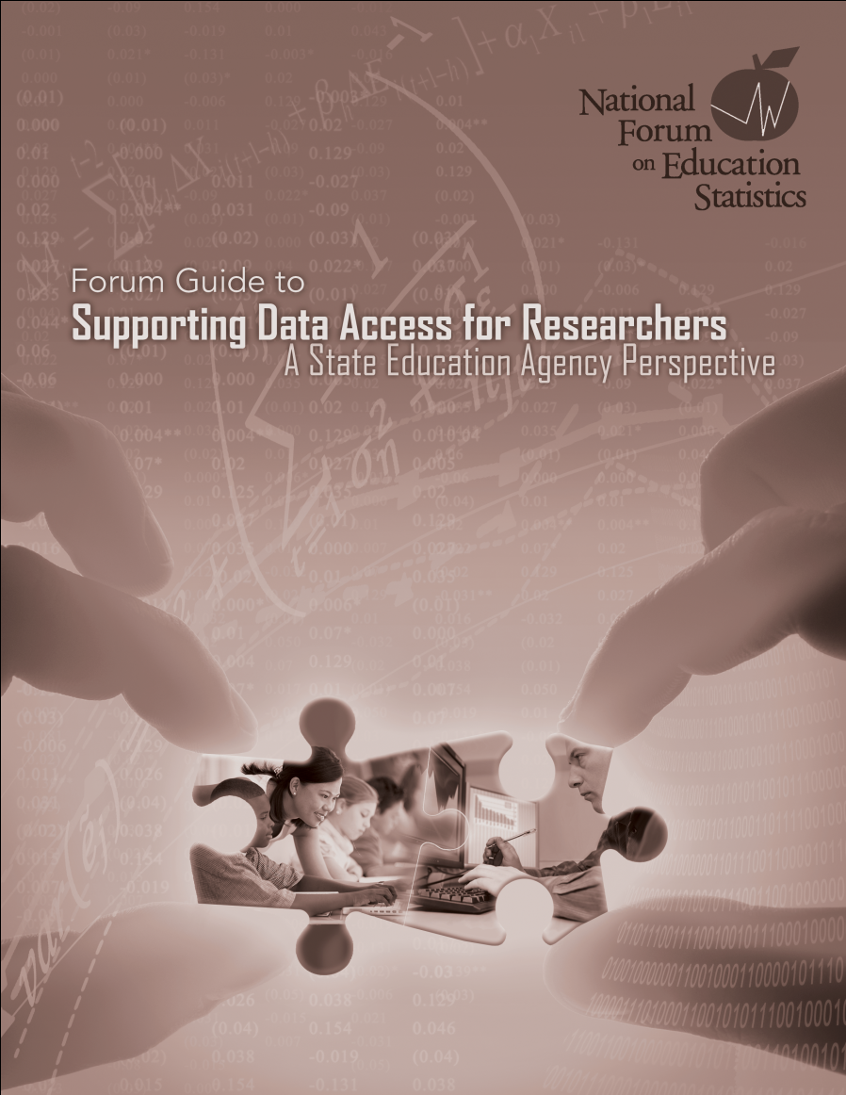
Core Practice 1: Help Researchers Understand Agency Data and the Data Request Process
Develop training materials about an agency’s use of data terms, definitions, coding instructions, and metadata
Disseminate accurate information about relevant data sharing procedures and request forms
Provide a detailed description of all expectations to ensure that researchers are aware of their responsibilities for complying with policies for protecting, managing, and using data
Establish training topics, such as
SEA research priorities
Data governance and privacy policies
Data sources
Metadata
Data management expectations
Ethical and legal responsibilities
Communications responsibilities

Slide 8
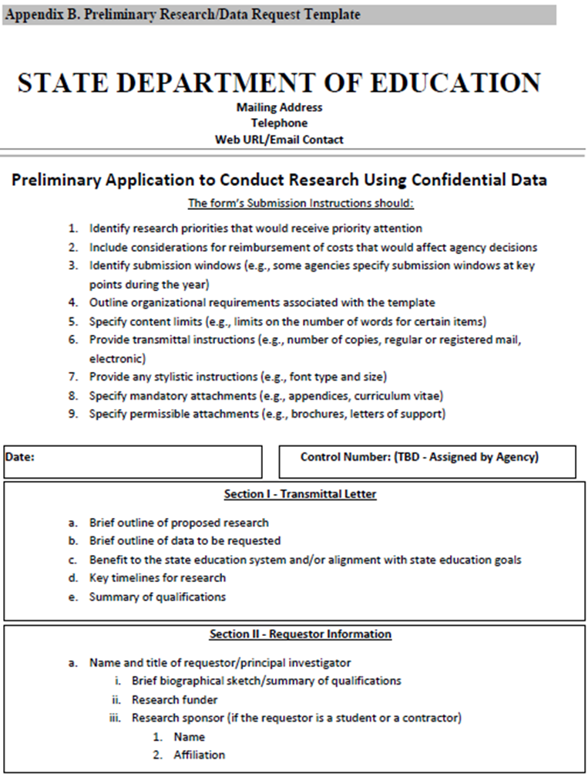
Core Practice 2: Create Effective Data Request Forms for Researchers
Creating standardized forms will streamline the request and evaluation process
Preliminary Research/Data Request Form
Full Research/Data Request Form
Data sharing agreements
Agreement modification forms
Personal access agreement
Certification of data destruction
Standardized forms should
Help researchers accurately identify the data they are requesting
Concisely, yet comprehensively, describe the proposed research plan
Accurately capture all information needed by SEA staff to evaluate a request

Slide 9
Core Practice 3: Review Data
Requests Strategically
Staff review
Data steward review
Review boards (including IRBs)
Legal counsel review
Working with outside agencies
By linking education data with data from outside agencies, researchers can answer questions about education that go far beyond the classroom
Memoranda of understanding (MOU)
When beginning the review, consider
Does the SEA have the requested data?
Can the SEA legally provide the data?
Has the researcher completed all training?
If this researcher has previously been granted access to data, did he or she adhere to all agency requirements? Were data managed and used appropriately?
Has the destruction of previously accessed datasets been certified?
If the researcher is affiliated with a research organization, such as a university, does the researcher have approval for the project from the organization’s IRB?
Will any fees be required? If so, have they been paid?
Does the SEA have the available resources to assemble the data?

Slide 10
Core Practice 4: Manage the Data Request Process Efficiently
Establish expectations for researchers
Eligibility to request data
Timelines for data use
Fee structures
Expectations for protecting confidentiality and security

Slide 11
Core Practice 4: Manage the Data Request Process Efficiently
Track data requests and use
From the point at which a request is received
Through its review, rejection, or approval
The delivery and receipt of data
The publication of research findings (e.g., articles and reports)
The certification of data destruction
Communicate with researchers
Timely communication with the researcher regarding the status of the request is appropriate until the request has been either refused or approved and fulfilled
SEAs may also find it advisable to provide researchers with predicted timelines for the data sharing process

Slide 12
Core Practice 5: Release Data Appropriately
Technical and statistical tools
Suppression, Masking, De-identification, and Anonymization
Media type
Email is considered secure only when data are appropriately encrypted and otherwise protected prior to attachment and delivery
Physical media, such as discs and tapes, require transport by entities that can guarantee safe and secure delivery to authenticated recipients
Physical access
Safe, highly monitored locations such as research data centers, secure facilities in business or universities, or similar locations

Slide 13
Core Practice 6: Monitor Data Use
Confirm adherence to agreements
Data use should be limited to the purposes stated in the Data Sharing Agreement and should not be used for other research without explicit approval
Review research outcomes
At the conclusion of a research project, an agency may wish to review the findings and proposed publications prior to public release in order to prevent the unintended disclosure of personally identifiable information

Slide 14
Core Practice 6: Monitor Data Use
Confirm project completion and data destruction
Researchers should be informed of appropriate data destruction procedures during data use training
Destruction should be consistent with all procedures described in the Data Sharing Agreement
Use research findings
Research results maybe adapted or adopted by an agency for policy development, program review and improvement, or the resolution of technical and operational issues
Build partnerships with researchers
Ongoing collaboration can benefit both the SEA and the researcher, and lead to better research

