Slide 1
State-Wide Standardized Course Codes
The presentation will begin at approximately 1:00 p.m. ET
Information on joining the teleconference can be found on the “Info” tab in the upper left of this screen. Be sure to use the “Attendee ID” number on the Info tab when dialing in to associate your name with your phone.
In order to cut down on background noise, please mute your phone by dialing *6 upon entry into the meeting.
During the question and answer portion of this presentation:
You can re-enter *6 to unmute your phone and ask a question; or
Type your question into the Q&A panel below the participant list and clicking “Send”.
A copy of this presentation and a link to the recording will be shared with the SLDS listserv and posted on the SLDS website: http://nces.ed.gov/programs/slds/webinars.asp.

Slide 2
State-Wide Standardized Course Codes
Panelists
Michael Plotnick (Alaska)
Robert London (Maryland)
David Ehle (Ohio)
Facilitator
Corey Chatis, State Support Team
Topics
State Context
Implementation Approach
Key Issues, Lessons Learned, and Best Practices

Slide 3
State-Wide Standardized Course Codes
Alaska – State Context
Background
Vast state covering 600,000 square miles; comprised of 54 geographically and culturally diverse districts with local control.
Established academic standards that align what is being taught, but do not have alignment between similar courses being taught in different districts. Non-alignment of course codes between districts is an issue.
Cross walking of district course codes to a single set of state and federal course will be essential for teacher and student course information to be collected and utilized to better assess student achievement.
Intent: have the common set of courses offered within the state in addition to the set of courses that are offered nationally. Vast majority of Alaska courses can be mapped directly to the SCED (School Codes for the Exchange of Data) developed by the NCES. However, the Alaska course list will also contain courses that are unique to Alaska.
Motivation: provide evaluation of student performance; connection of teacher to student; equitability of teacher evaluations; improvement of instruction; fulfill requirements of Alaska Scholarship Program; ensure that children in each district be given the same choices and opportunities.

Slide 4
State-Wide Standardized Course Codes
Alaska – Implementation Approach
Developed one common set of course codes, and a system whereby each district can crosswalk their local code sets to the statewide codes and the SCED codes. Maintains each district’s unique independence. Alaska is “in the process” of completion.
First component: develop comprehensive list of courses offered in Alaska secondary schools.
Second component: map course codes by LEAs to an Alaska state code and then to national SCED codes.
Vendor assists the agency in mapping.
CourseWalk facilitates the matching of local course codes to state or national course code standards.
Stores local, state, and SCED course catalogs in a central database accessible via the internet to users with CourseWalk accounts, makes AutoMapping recommendations to map local and state courses to SCED or local courses to the state’s course codes.

Slide 5
State-Wide Standardized Course Codes
Alaska – Implementation Approach, cont.
Statewide Course Codes
An extended set of codes used at the state level, which assists in “cross walking” individual district course codes sets to the SCED codes.
Alaska’s list of courses will be more extensive than the national SCED codes to cover unique state courses or special arrangements such as joint English/Social Studies courses. If the courses have merged content, they are included in both subject areas, or a single most appropriate subject area.
The Alaska Course Code List is the SCED list with a format of a 4-character subject area code (AK01 –AK22). These subject areas are identical to the national subject area codes, but have AK added in front of the 2-digit code. Additional subject areas can be added when needed.) A 3-digit course code - these codes are identical to the national course codes. If new course codes are desired, they can be added within this coding structure.

Slide 6
State-Wide Standardized Course Codes
Alaska – Key Issues, Lessons Learned, and Best Practices
Key Issues
Districts are ultimately responsible for the entry of their courses, course codes and mappings. AKDEED does provide consultation and technical support.
Increase LEA participation
Lessons Learned and Best Practices
Form the right team
Find the proper software/system to do the job
Contact the LEAs/districts to form a pilot group
Analyze existing LEA course structures determine scope and develop a plan
Educate districts on the process
Assist pilot LEAs/districts in mapping codes to the state/federal codes
Document procedures
Work with remaining LEAS/district to complete mapping

Slide 7
State-Wide Standardized Course Codes
Maryland – State Context
Local controlled LEAs
Standard course codes at the state level legislated
Result: LEAs – voluntary adoption but once the SEA sets a standard, LEAs must provide SEA with a translation table if standard not adopted
SEA adopted the SCED
Built a crosswalk system to help LEAs maintain LEA to SCED mappings, but LEAs can provide a translation file
Crosswalk system used for
Standardizing student courses collected each term
Standardizing student courses on the e-transcripts
Identify courses not mapped by the LEA
Identify students qualifying for scholars grants
SLDS Webinar

Slide 8
State-Wide Standardized Course Codes
Maryland – Implementation Approach
Oracle database
APEX HTML front end
OBIEE Dashboard
LEA
manual
review & edits
LEA fixed exceptions
SEA Table
maintenance
SCED
Table
LEA
Course
Crosswalk
Table
LEA
Batch
Translation
file
Student
Courses
Table
E-transcript
translations
identify
unmapped
courses
OBIEE Dashboard
Non-authorized viewers
Comparative analysis
LEA
Exception
table
SLDS Webinar

Slide 9
State-Wide Standardized Course Codes
Maryland – Key Issues, Lessons Learned, and Best Practices
Key Challenges
Getting LEAs to participate – the law helped
Getting LEAs keep it up to date – the exception file and dashboard helps through transparency
Elementary school courses/subjects – considering a different data structure and database maintenance
Lessons Learned/Best Practices
Collaboration site
Automate or mechanize were possible
Patience and persistence
Transparency
SLDS Webinar

Slide 10
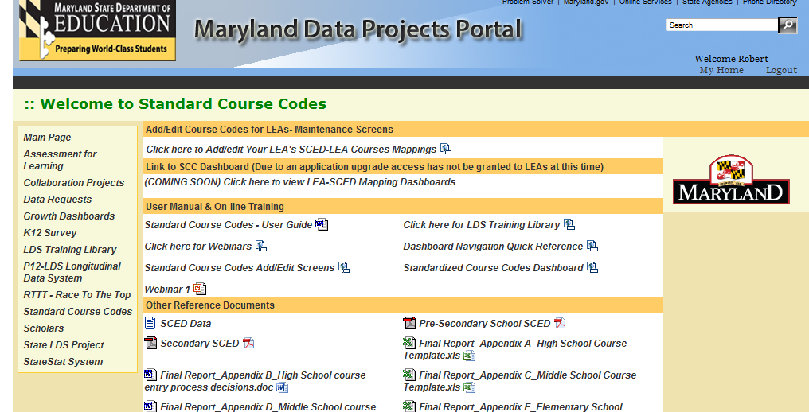
State-Wide Standardized Course Codes
Maryland SCC portal
SLDS Webinar
10

Slide 11
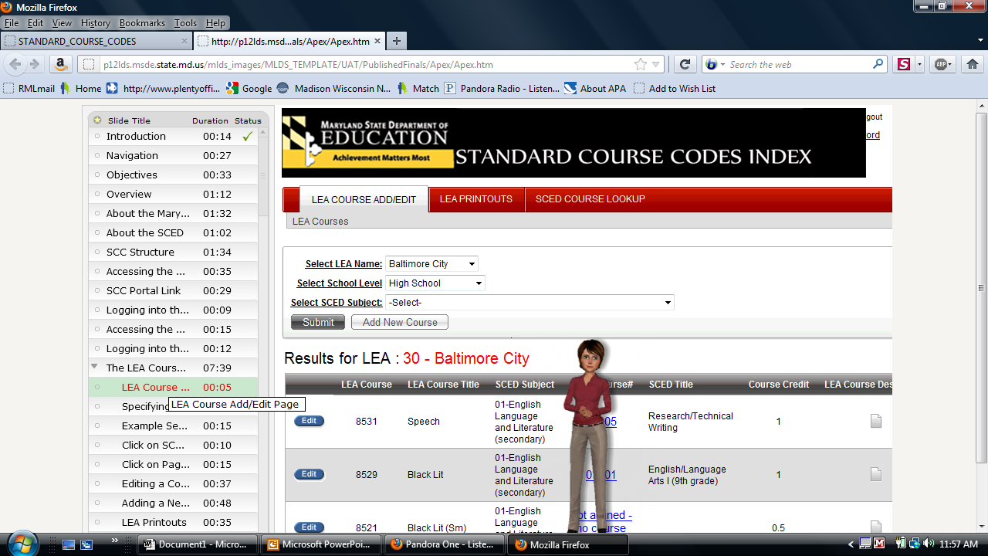
State-Wide Standardized Course Codes
Maryland SCC multimedia training
SLDS Webinar
11

Slide 12
Maryland SCC LEA Manual ADD/EDIT Screen
SLDS Webinar

Slide 13
Maryland Full Edit Screen
SLDS Webinar

Slide 14
Maryland SCC SCED Lookup Screen
SLDS Webinar

Slide 15
Maryland SCC OBIEE Lookup and Comparative Analysis Dashboard
SLDS Webinar

Slide 16
State-Wide Standardized Course Codes
Ohio – State Context
Ohio’s Education Management Information System (EMIS)
Established over 20 years ago
Collection of a code describing the subject taught to a group of students by a teacher has been a part of EMIS since its start; required in legislation
Many changes over the years as additional business requirements developed
A few Ohio realities…
Local control state
Very diverse data environment within 1,000+ districts/community schools
1.8 million students with 15 million enrollments in 900,000 course sections taught by 125,000 teachers

Slide 17
State-Wide Standardized Course Codes
Ohio – Implementation Approach
What is collected
Six digit Subject Code defines the content being taught at a high level
Nearly 600 codes currently active
Additional elements further define the content
Course Level- I, II, III, etc. or Advanced, Intervention
Curriculum- AP, IB, CTE, Postsecondary
Delivery Method- traditional, online, independent study, etc.
Student Population- designed for special ed, gifted, etc.
Subject Area for Credit- relation to graduation requirements
Associated in the data structure to a section of students and one or more teachers for that section
Also collected as part of the financial data, either by subject category (first 2 digits) or actual subject code
Requirements detailed in EMIS manual, Appendix C and Chapter 3 http://www.ode.state.oh.us/GD/Templates/Pages/ODE/ODEPrimary.aspx?page=2&TopicID=1102&TopicRelationID=1102

Slide 18
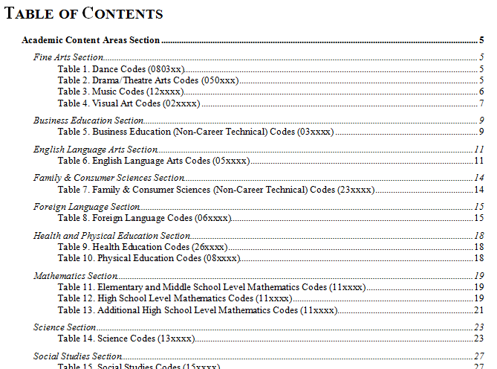
State-Wide Standardized Course Codes

Slide 19
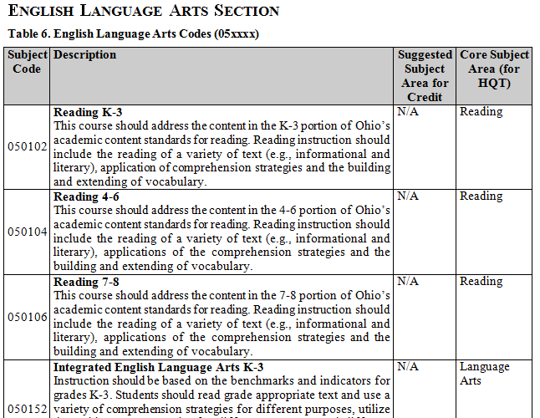
State-Wide Standardized Course Codes

Slide 20
State-Wide Standardized Course Codes
Ohio – Implementation Approach
Course Data Integration
Connected to MANY processes at the department
Matched to teacher credentials to verify qualified to teach course
HQT built from the course up, based in part on Subject Code
Used to determine state approval and funding of Career Technical programs
Validation that student has met graduation criteria
Other uses related to reporting to public and funding
Mapping Process
Most of state uses one of four SIS vendors, but around 15 total
Districts use own code for local use, but must map to state Subject Codes to report twice each year
Mapping to prior SCED codes did not work- new codes TBD
Update valid codes annually as dictated by legislation and user needs

Slide 21
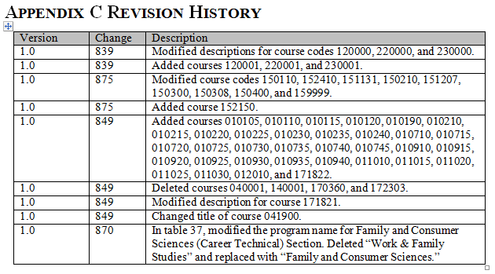
State-Wide Standardized Course Codes

Slide 22
State-Wide Standardized Course Codes
Ohio – Key Issues, Lessons Learned, and Best Practices
Collaboration
Within the department, work closely with Education Licensure, Curriculum, and Career Tech offices to insure all needs met
Monthly calls with SIS software vendors
Biweekly calls with regional IT support organizations that provide level 2 support to districts for EMIS reporting
Change Management
Changes sometimes rolled out over several years if have a major impact on licensure or funding
Every change has a cost in time and/or dollars for reporting entities
Longitudinal management- when does a change require edit to the description of an existing code vs. establishing a new code? (Common Core…)

Slide 23
State-Wide Standardized Course Codes
Contact Info and Resources:
Requests from State Support Team or SLDS Team:
Rosemary Collins, (202) 502-7354 or Rosemary.Collins@ed.gov
Corey Chatis, (206) 799-8768 or Corey.Chatis@sst-slds.org
Panelists:
Michael Plotnick, Alaska Department of Education
michael.plotnick@alaska.gov
Robert London, Maryland State Department of Education
rlondon@msde.state.md.us
David Ehle, Ohio Department of Education
david.ehle@education.ohio.gov
This presentation and the recorded webinar will be posted on the SLDS website: http://nces.ed.gov/programs/slds/webinars.asp

