Slide 1
Data for Action: How Oklahoma Is
Efficiently Expanding Data Tools
26th Annual Management Information Systems [MIS] Conference
Concurrent Session VIII
Thursday, 2/14/2013
11:30–12:30
Kraman, Barfield, Fey

Slide 2
Phases of Work
Develop Early Warning Indicator System (EWIS)
Address District Reporting (the “Data Pipeline”)
CPSI Roadmap and Ed-Fi Gap Analysis
Develop School Partner Data Tool (SPDT)
Leverage Accountability Certification
The Capacity Bottleneck
Launch Ed-Fi and PM Village Pilot

Slide 3
Background
The Wave
  530+ Districts (enrollment from 40 to 40K+)
  13 Local SIS Vendors
  Statewide SIF
Consolidation (July 2011-June 2012)
  OFS/OMES
District Engagement
  SLDS Committee and Workgroups

Slide 4
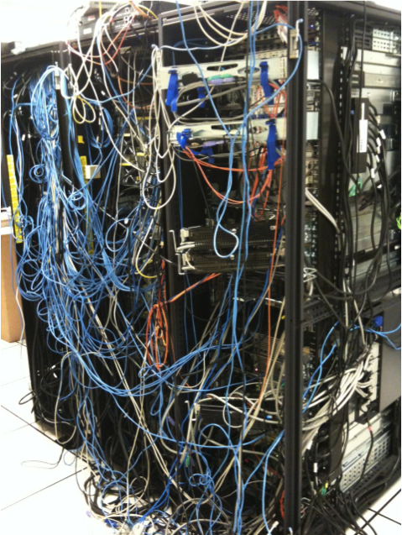
Oklahoma SDE’s “Wave” (July 2011)
Photo is property of the State of Oklahoma

Slide 5
Need for Data Governance that Connects SDE with Districts
The SDE is forming new workgroups in 2013 with clear definition of roles and responsibilities among SDE, OMES and LEAs
REAC³H SLDS Committee
Data Governance Workgroup
Data Use Workgroup
Data Reporting and Accountability Workgroup
Education Technical Advisory Committee

Slide 6
Oklahoma’s Early Warning Indicator System and School Partner Data Tool

Slide 7
Early Warning Indicators
Grade Level
Scheduled Graduation Date
Number of Credits
Assessments
School District
Grade Information
GPA
Demographic Information
Attendance
Mobility
Discipline Reports

Slide 8
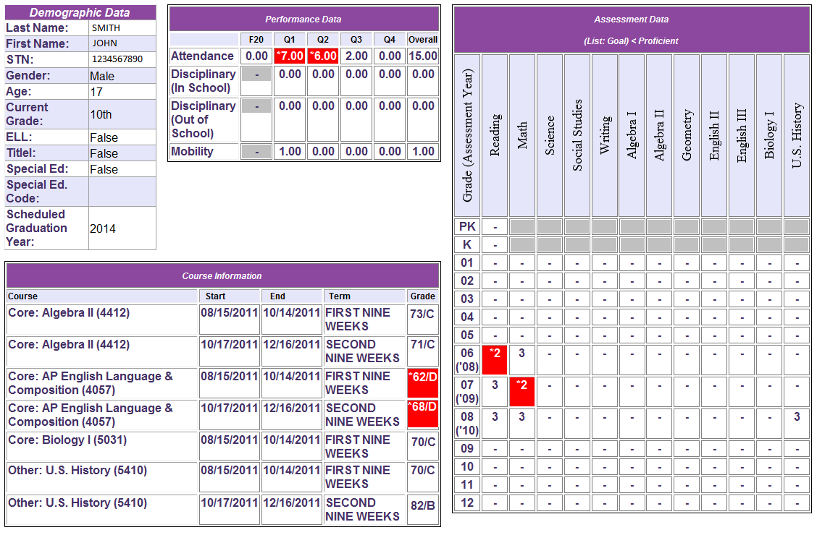
The Early Warning Indicator System
NOTE: Data in these screen shots are fictitious.

Slide 9
Districts Reporting of the 14 Required EWIS Data Objects

Slide 10
EWIS vs. SPDT View of Students
SPDT Perspective
Early Warning Indicators System Perspective
All Students in the District
All Students in the School
All Students in the Classroom
Members/Participants across Districts
Members/Participants across Schools
Specific Program Members/Participants

Slide 11

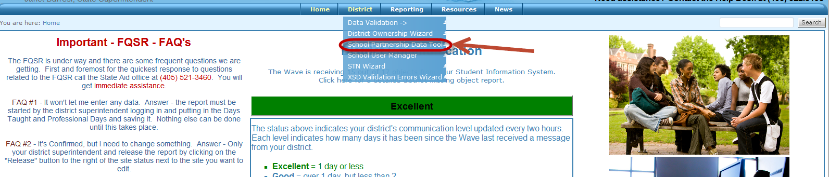
OSDE
District View
Log into the Wave, use the School Partnership Data Tool.

Slide 12
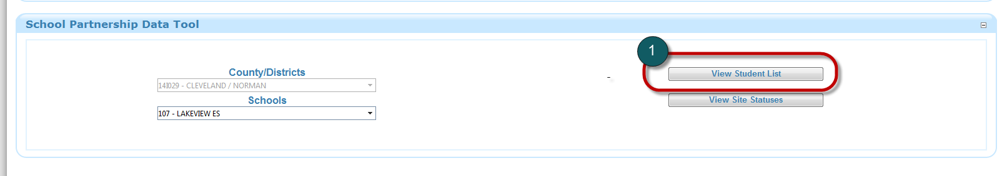
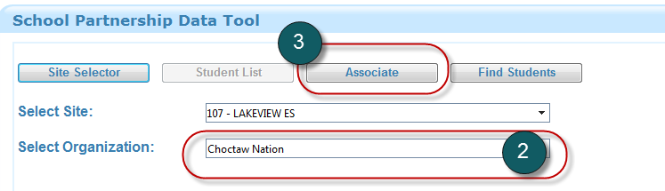
OSDE
District View
Select View Student List
Select Organization
Select Associate

Slide 13
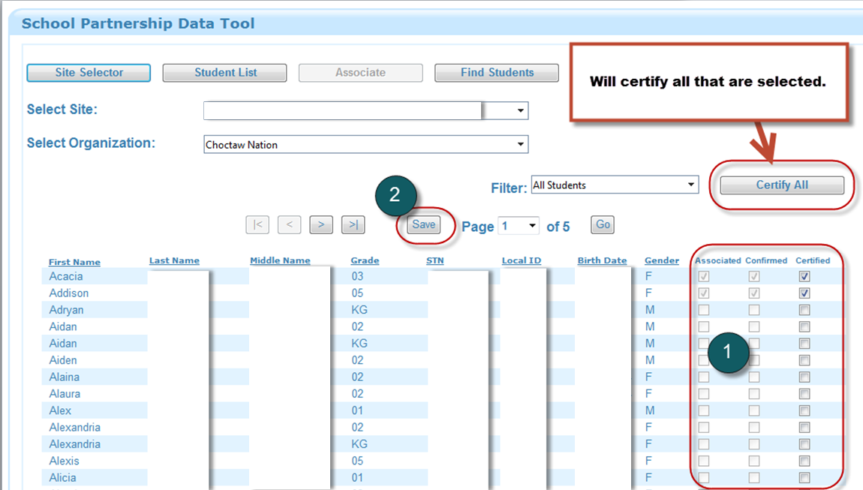
OSDE
District View
Identify students who have turned in the Release Form and depending on your security level select Associated, Confirmed, or Certified.
NOTE: Data in this screen shot are fictitious.

Slide 14

OSDE
District View
District Superintendent is the only one who can certify.
School Principal is the only one who can confirm.
Anyone whom the Superintendent gives access can associate.
Associate
Confirm
Certify
Complete Release Form

Slide 15
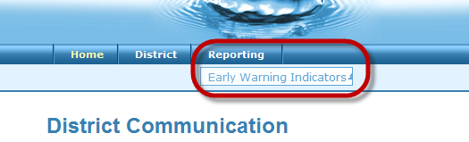
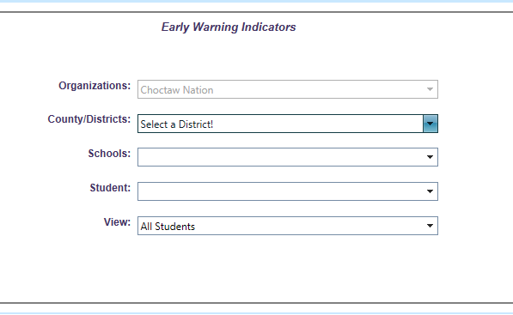
OSDE
Organization View
Log in, using the User Name assigned by SDE
Go to Early Warning Indicator Application
Make selections on view level
Notes:
Depending on your access, you may need to select the District and Site that you would like to view. For most, this screen will be automatically populated based on your credentials and the sites you are allowed to view. From the summary screen you can also go directly to a student by selecting his/her name in the student dropdown box. The view list allows you to see only the active students who are considered at-risk or a complete list of students at a particular district or site. After selecting the appropriate information, select “View Student at Risk Summary.”

Slide 16
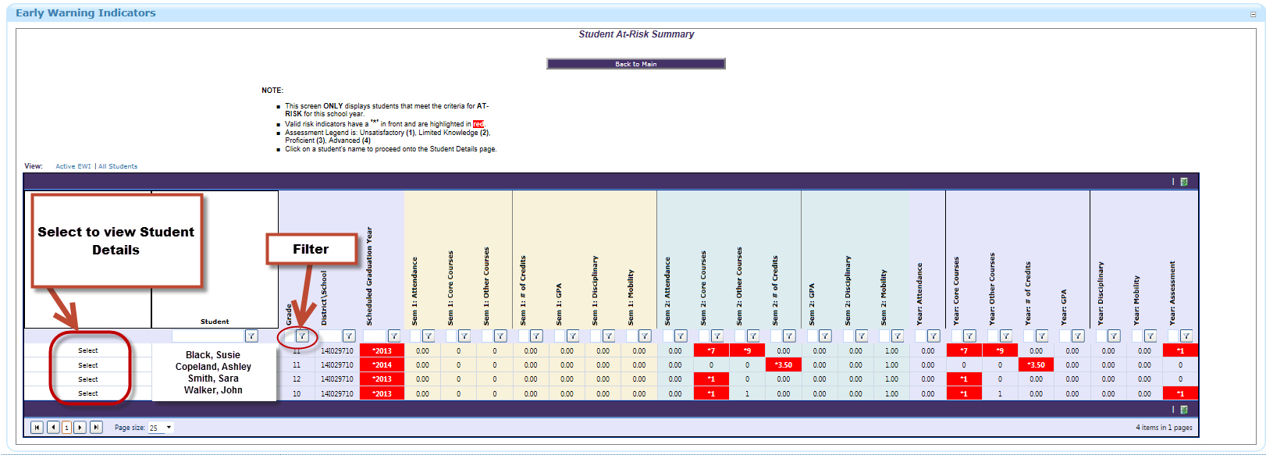
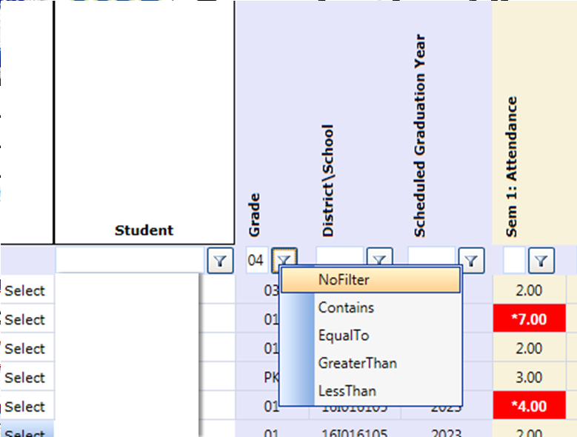
OSDE
Organization View
Review list of students and indicators.
Apply filter, if needed.
Select to view Student Details.
NOTE: Data in these screen shots are fictitious.
Notes:
The summary report includes a list of the students who are considered at-risk for the district/site you chose. This is a high-level view that shows why they are considered at-risk. Below is a list of the columns that are viewable on this screen and their descriptions. The Risk Indicators are broken down into specific timeframes: Semester 1 – the first day of school to the end of the first semester; Semester 2 – from the beginning of the second semester to the end of school; Year – from the beginning of the school year to the last day of school. If a student is being indicated as at-risk the item(s) that are being indicated are highlighted in red.
To each column on the Summary Screen, filters can be applied to only show the students you want. For example, if you only want to see the 4th grade students at-risk, you would put “04” in the Grade filter, select the Filter Icon and select the filter criteria that you would like; Contains, Equal To, Greater Than, or Less Than. To remove a filter, select the filter icon and select No Filter.
To the left of each student’s name is a Select link. Once selected, the Student Details report is presented with the specific student’s data for Demographics, Performance, Assessments, and Grades. If a student is being indicated as at-risk, the item(s) that are being indicated are highlighted in red. If one of the sections is not supplied to the Wave via the local student information system, a notice will appear indicating no information is available.

Slide 17
OSDE
Organization View
Review Indicators
NOTE: Data in these screen shots are fictitious.
Notes:
Demographics Data: The Demographics section presents the following: Student’s Name, Age, STN, Gender, Current Grade, ELL Indicator, Title I Indicator, Special Education Eligibility Indicator, the student’s Special Education Code if applicable, and the student’s Scheduled Graduation Year. The only item that can be flagged from the Demographics data is the Scheduled Graduation Year. The student’s scheduled graduation year is based on his/her initial enrollment in public education or IEP. The student may be indicated at-risk if his/her age is two years greater than normal for their current grade.
Performance Data: The Performance section presents information about the performance of the student based on attendance, disciplinary actions, and mobility. Each is separated into specified timeframes; by hovering over the column headers, it will show the dates that are included in that timeframe. Based on the indicator criteria, the appropriate at-risk indicators are highlighted in red.
Attendance shows the number of absences for the first 20 days of school, quarter 1 through 4 and the overall absences for the current school year. The student may be indicated at-risk if he/she was absent the first 20 days of the school year, or he/she missed 10% or more for the specified timeframe.
It shows the disciplinary actions through In-School and Out of School Suspensions for quarter 1 through 4 and the overall In-School Suspensions and overall Out of School Suspensions. The student may be indicated at-risk if he/she has received one or more Out of School suspensions or three or more In-School suspensions.
It shows the mobility rate for quarter 1 through 4 and the overall number of times the student has switched schools throughout the school year. The student may be indicated at-risk if his/her count is greater than 4.
Assessment Data: The Assessments section presents the score of the assessments taken throughout the student’s history in public education from Pre-Kindergarten to Twelfth grade. Assessments are scored with the following scores 1 = Unsatisfactory, 2 = Limited Knowledge, 3 = Proficient, and 4 = Advanced. The student may be indicated at-risk if he/she scored less than proficient (1 or 2) on any assessment.
Course Information: The Course Information section shows a list of the courses the student has taken for the current school year, including the start and end date of the course, the term that the course was provided in, and the grade marked as final for that course. Each course is marked as either Core or Other. Core courses include Math or Reading; other courses are all others excluding the core courses. The student may be indicated at-risk if a course grade is a D or F.

Slide 18
Oklahoma’s Five
Accountability Data Projects
(Q3 & Q4 of FY2013)

Slide 19
Five Interrelated Accountability Data Projects
A-F Report Card
Assessment “Post Code”
Cohort Grad Rate
TLE Roster Verification
Federal “October 1” Reporting

Slide 20
Integrated Timelines for Districts
Report | Feb | Mar | Apr | May | Jun/Jul
TLE Roster Verification | Engage | Train Districts | Train Teachers | Teachers Verify | Leaders Approve
Assessment “Post Code” | Engage | Focus Groups | Focus Groups | Train | Certify Report
A-F Report Card | Engage | Focus Groups | Focus Groups | Train | Certify Report
Cohort Grad Rate | Engage | Engage | Focus Groups | Train | Certify Report
SMART Report | Engage | Engage | Focus Groups | Train | Certify Report

Slide 21
Ed-Fi and PM Village

Slide 22
Oklahoma’s Ed-Fi Gap Analysis
Class Periods
Course Subject Area
Staff Employment/Assignments
Grades per Grading Period
Credits
Students/Parents
Program Participations and Teachers
Cohort

Slide 23
Ed-Fi Pilot Next Steps
Evaluate Project Plan for Interrelated Accountability Data Projects and identify available resources (i.e., the Capacity Bottleneck)
Recruit districts to join the Data Use Workgroup and become an Ed-Fi pilot district
Discuss with Local SIS vendor about additional Ed-Fi data requirements/needed modifications
Host Focus Groups (Spring 2013)
  Identify Needs/Concerns re: Implementation/Use, including Required State-Level Support

Slide 24
Next Steps—the Data Use Workgroup
Request similar Gap Analysis for PM Village
Launch pilot (Fall 2013)
Field Trip to Texas (or other location) to view Ed-Fi and PM Village in use in the classroom
Community Outreach – lessons learned from the School Partner Data Tool Pilot
Recruit new districts for expanded pilot (Spring 2014)

Slide 25
Data for Action: How Oklahoma Is
Efficiently Expanding Data Tools
Concurrent Session VIII
Thursday, 2/14/2013
11:30–12:30
Kraman, Barfield, Fey

