Slide 1
Developing a Statewide Early Warning System
Doug White, DPI
Jared Knowles, DPI
Presentation on Wednesday, February 13th
26th Annual Management Information Systems [MIS] Conference, Washington DC

Slide 2
Early Warning System
Overview
What does Early Warning System mean?
How can it work in Wisconsin?
What other systems does it leverage?
What will it look like now?
What does the future hold?
When can you have it?

Slide 3
Executive Summary
Statewide Longitudinal Data Systems enable a new type of EWS
Wisconsin DPI has developed such an EWS, and will deploy it statewide in 2013; pilot next month
The DPI EWS is fully modular, open source, and extensible
When can you have it?

Slide 4
DPI’s System is in Development
More than 60% of students who eventually do not graduate after 4 years of high school can be identified with current data before the start of 7th grade
DPI is working to improve this through better techniques to allow students to be identified earlier and with more accuracy
The system will continually improve with better data, better mathematical models, and more real time results

Slide 5
Early Warning System
Early: Identify students at risk soon enough to allow time for effective interventions
Warning: Provide sense of possible negative outcomes to a student, not absolute
System: A cycle of identification, intervention, evaluation, and learning—continuous feedback loops

Slide 6
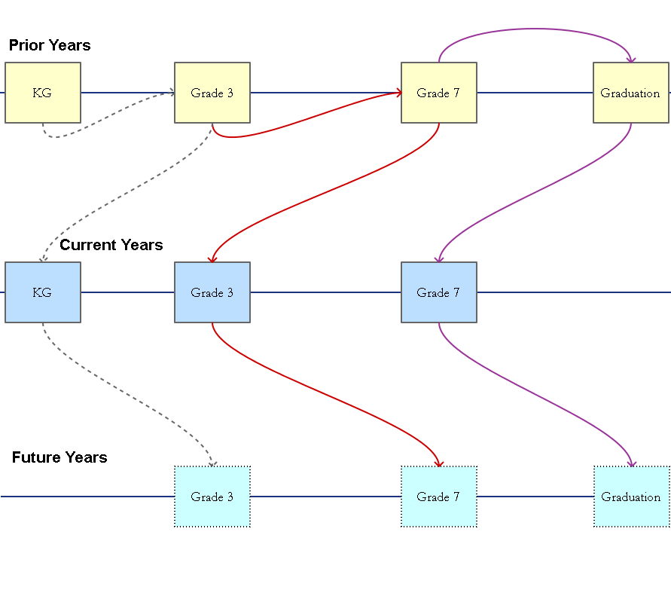
EWS Logic

Slide 7
Why early is so important!
Earlier interventions are more effective and less costly
More planning time and careful consideration can be made with earlier warning
Parents can use information to support students during key middle grades
Students can exit at any time during high school, but in middle school exit is much more difficult

Slide 8
Why now?
Finally have enough longitudinal data to observe students in both middle school and through completion of high school to draw comparisons
Consistent measures statewide allow a full picture
Part of our State Superintendent’s agenda!
Statewide data means many more patterns of student outcomes prior to graduation / non-completion can be combined and analyzed

Slide 9
Early Warning System
What EWS IS:
A tool to identify struggling students early enough to intervene
A way to target interventions based on data
Like a “service engine soon” light in cars
What EWS is NOT:
An accountability system
100% accurate
The solution to student problems

Slide 10
Early Warning System
Uses data already collected by DPI to identify student outcomes linked to dropout and late graduation
Reports student names/ids, risk scores and risk reasons to school districts via WISEdash
Provides examples of effective strategies to prevent dropout

Slide 11
EWS in a Multi-Level System of Support (MLSS or RtI)
Student Data Collected
At Risk Students Identified by EWS
Local Review of Results & Local Data
Plan Interventions
Determine how well interventions work

Slide 12
EWS in a MLSS
Student Data Collected
What student data is collected?
ISES and WKCE/Assessment Data
attendance
assessment
discipline
location
Future: SIS data, EWS can improve as datasets grow!

Slide 13
EWS in a MLSS
At Risk Students Identified
How are students identified?
Use data from previous cohorts statewide to identify students with same characteristics as dropout, late graduates
Generate secure reports to school districts via WISEdash

Slide 14
EWS in a MLSS
Local Review of Results & Local Data
EWS combined with local data:
Schools review identified students and compare them with local/real time data
Schools share information with and get input from parents
Schools use EWS risk score and local knowledge to determine current risk

Slide 15
EWS in a MLSS
Plan Interventions
Select and implement interventions:
Schools use risk data with other data, parent input and RTI methods to support student positive behavior, engagement and learning
Review best practices, local initiatives and identify alignment with student needs
Select/implement interventions

Slide 16
EWS in a MLSS
Determine how well interventions worked
Track outcomes:
Monitor interventions and student outcomes
Compare student outcomes with interventions to learn “what works”
Provide real time feedback to answer the “what next?” question
Share interventions across districts and schools

Slide 17
Inputs and Outputs of EWS
Inputs
ISES / WSAS / SBAC
Attendance
Discipline
SIS
Interventions
Outputs
Student-specific identification
WISEdash Dashboard
RTI module
Local analysis
NOW
LATER

Slide 18
Knowledge
STATE DATA
LOCAL KNOWLEDGE
Assessments
Teacher / program context
Parent input
Special circumstances
CONTEXT
Demographics
Attendance
Intervention Strategies
Disciplinary Events
Mobility
Location
Student Risk Identification

Slide 19
What does it look like?
DPI is ready to roll out the first pieces of this system:
Identify students at risk for dropout or late graduation
Use 7th grade data to identify students less likely to graduate on time by looking at how previous graduates and non-graduates performed in 7th grade
Which 7th grade indicators are warning signs for the student?
Deliver information in WISEdash
Provide links to information on effective strategies for dropout prevention

Slide 20
Can that work?
More than 60% of students who do not graduate after 4 years of high school can be identified with current data before the start of 8th grade
DPI is working to improve this through better techniques to allow students to be identified earlier and with more accuracy
The system will continually improve with better data, better mathematical models, and more real time results
This system will be piloted in March 2013, and will be fully operational September of 2013 in Wisconsin, statewide

Slide 21
What do we learn?
For each 7th grade student with data, we identify:
The “risk” or “probability” that the student will not complete high school in 4 years
Whether the student is above or below a risk threshold
The parts of the student’s record that are the strongest indicators of risk for dropout or late graduation
We can combine all of this with all of the other data on the student in WISEdash

Slide 22
Recap
DPI now capable of identifying 7th grade students at risk of dropout or late graduation
Data on specific student risk can be delivered securely through WISEdash
Districts can use risk data with current data and parent input to determine risk and select interventions
Useful for schools and parents
EWS is not part of accountability system

Slide 23
Let’s Get Technical

Slide 24
DPI DEWS Features
Free and Open Source Platform
Fully modular
Empirically Derived
Flexible
Extensible

Slide 25
Free and Open Source
A key feature of the DPI DEWS is that it is built on free and open source technologies
It is a series of 5 modules:
Data import
Data recoding / cleaning
Model selection
Prediction
Data Export
It has some pre-requisites to work

Slide 26
Technologies
The EWS is written for the R open-source statistical computing language
It is a series of modular scripts that perform some basic functions and may not be necessary everywhere
Each module expects data in certain formats and returns data in a specific format
This is entirely local to Wisconsin currently, but improvements made during the pilot phase should allow time to generalize it more

Slide 27
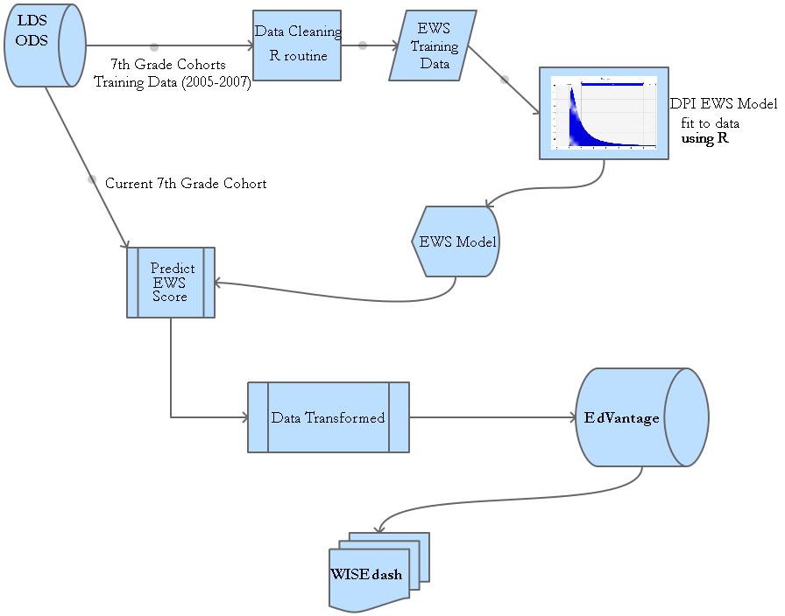
Modules

Slide 28
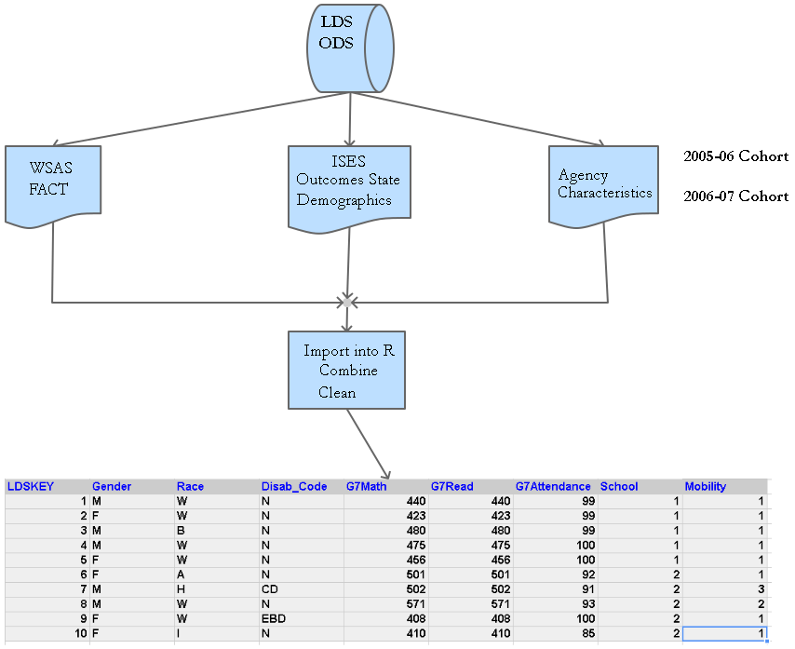
Data Import

Slide 29
Data Import
Extract raw data from an Oracle data warehouse
Extract needs all records for a grade of students from grade 7 to graduation
Extract will be reused to get data on current grade 7 students for prediction

Slide 30
Data Recoding and Cleaning
Data recoding is the only place that decisions are forced on the statistical model
Administrative records need to be reshaped in a way to fit the statistical procedures
Business rules need to be in place to enforce standardization of fields
Example: FRL is coded as “F”, “R”, “N”, “A”, “P”
Need to reduce this to “F” and “N” or “F”, “R”, and “N”
Use business rules from the Strategic Data Project
Enforce some rules to make statistical model easier to fit (grouping categories to increase cell size)

Slide 31
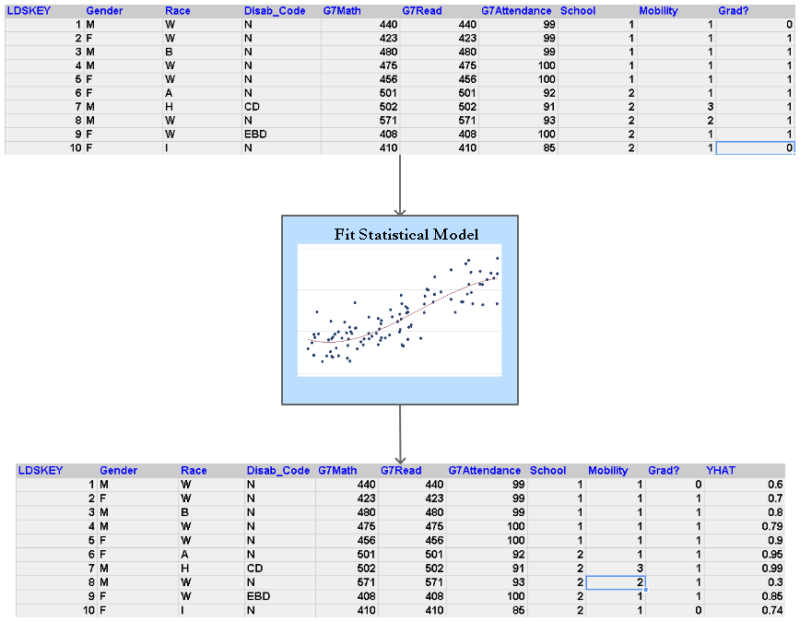
Inputs and Outputs

Slide 32
Model Selection
Fit a basic statistical model regressing a subset of the data on students in 7th grade on an indicator of whether or not they graduated
More variables are added to the model, and the prediction rate of each successive model is evaluated on a test set of data
Finally, when all variables have been exhausted, or the best possible prediction rate has been achieved, the process is stopped
This is repeated for other classes of models / functional forms until the best model from the best of each class is identified

Slide 33
Model Selection
Depending on the data available, the factors included in the model will change, as will their weight in predicting the outcome
The system is flexible to this, so it can expand as new data comes online, and as more longitudinal data is available on cohorts
For now, in Wisconsin, for two cohorts, these factors seem to matter
Assessments — Attendance — Mobility — Discipline
School of attendance

Slide 34
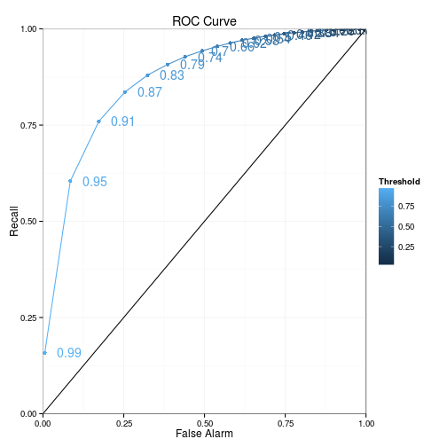
ROC Curve
Receiver Operating Characteristic (ROC): A measure of signal to noise in binary classification. http://en.wikipedia.org/wiki/Receiver_operating_characteristic

Slide 35
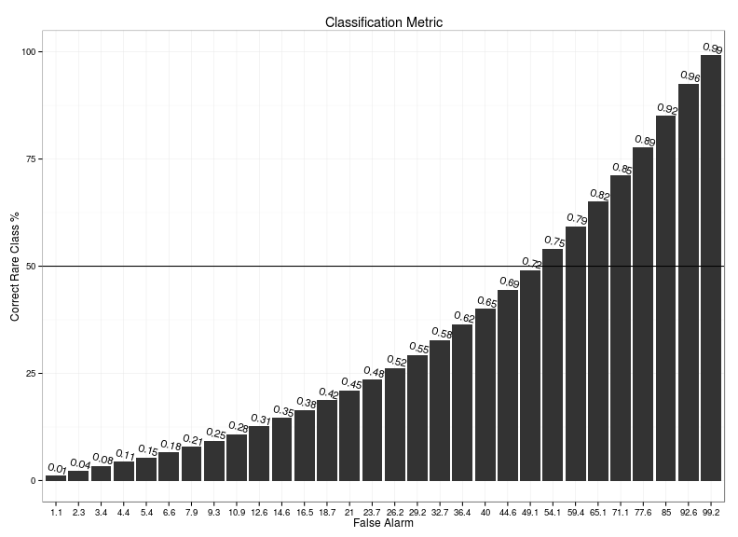
Binary Outcome Tradeoffs

Slide 36
Model Types
Currently a manual process, automation is the next step
Models Tried:
Probit (winner)
Logit
HLM
k-nearest neighbors (knn)
Gradient Boosted Machine
Random Forests
Models Yet Tried:
Cubist
Support Vector Machines
Multivariate Adaptive Regression Splines
Discriminant Analysis
Neural networks
Bayesian Model Averaging

Slide 37
Prediction
Prediction is handled by determining the risk score of an individual student and the uncertainty around that score
A threshold is set above which students are flagged
Districts will see both the score and the flag
The flag is based on a predetermined level of confidence in the prediction
e.g. 50% of flagged students are true dropouts, 50% are false negatives

Slide 38
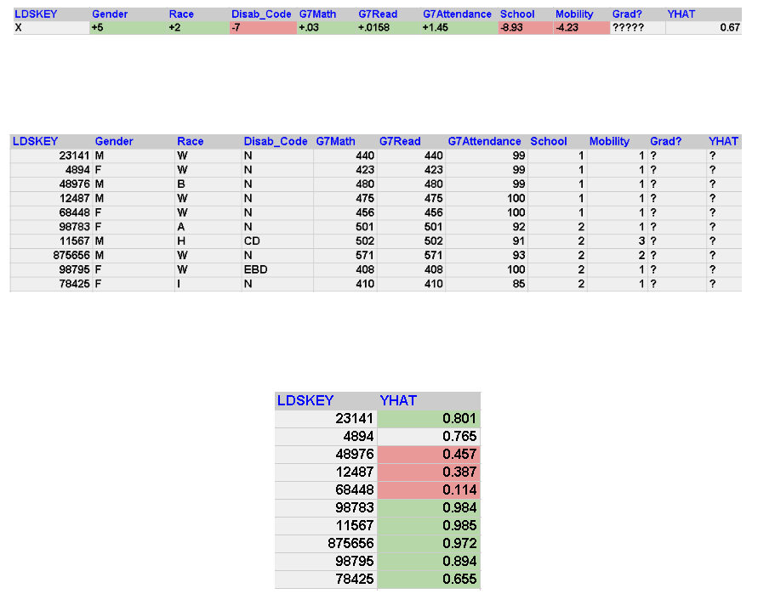
How?

Slide 39
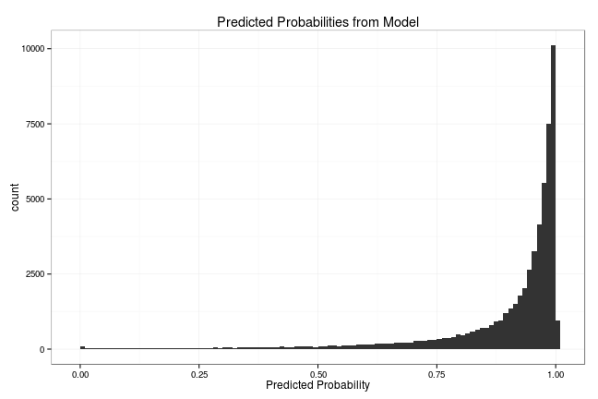
Example of Predictions

Slide 40
Reporting
Predictions are output to a data store, where they are loaded into our statewide reporting instance via ETL
Working on building the prediction module into the ETL process (easily done)
Allows the scores to be updated when new data are available
Crucial as state transitions to a Statewide Student Information System, allowing more frequent updates on data
Theoretically any reporting environment could be hooked up to the system
SAMPLE REPORTS

Slide 42
Student Overview

Slide 43
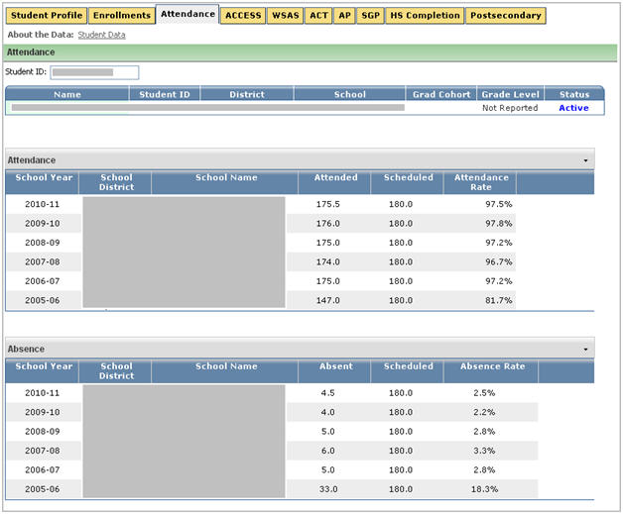
Get More Information

Slide 44
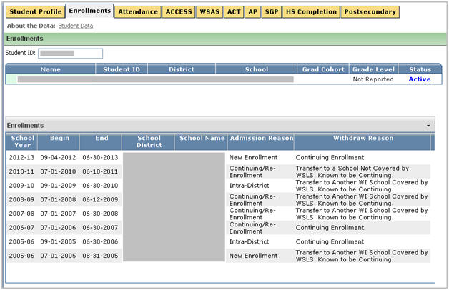
Mobility History

Slide 45
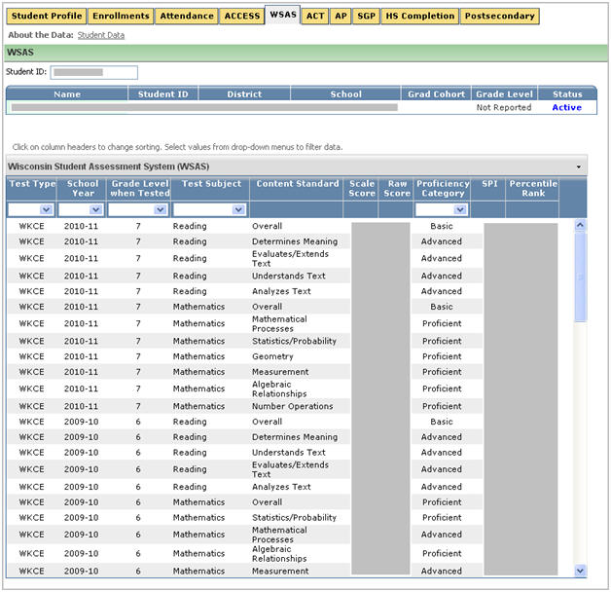
Detailed Assessment History

Slide 46
Requirements
Requirements
One cohort of students who has valid and reliable measurements of several attributes in the prediction year, and observed graduation, dropout, or transfer
Serious computing resources (depending on data size and complexity)
Preferences
Multiple measures and more than one cohort
No selection bias in students in the data

Slide 47
Flexibility
Open source code that can be viewed, modified, copied, enhanced
System is built on few assumptions; it learns from the data it is fed
Can input data from a variety of formats and output data in a variety of formats (JSON, SQL, ORACLE, CSV, etc.)
Modular—use only the pieces needed

Slide 48
Empirically Derived
The predictive model does not make assumptions about factors that increase or decrease risk
Searches among data provided to identify the combination of factors that provide the best prediction
Factors that matter more are given more weight, those that matter less are discarded
Depending on the data available this may dramatically change
With the data provided, the system will search for the best available model

Slide 49
Recap
Each student receives a score from 0 to 1 (or 0-100) representing the probability of graduation in 4 years of HS
DPI can transform this into a binary indicator (on-track, not-on-track) based on historical information about the prediction (above or below a threshold)
DPI can work on calibrating this binary indicator

Slide 50
Questions & DISCUSSION
Contact Information
Jared Knowles
E-mail : jared.knowles@dpi.wi.gov
Web : www.jaredknowles.com
Twitter : @jknowles

