Slide 1
DataFirst: A Tool on How to Use Data for Local Decision Making
MIS 2012 Conference
Friday, February 17, 2012
San Diego, CA

Slide 2
What is Data First?
8 hours of school board training in the effective use of data to:
make decisions most likely to improve student achievement
engage community support
Public website with:
national & state data for gauging school quality
links to district data as available
data lessons for presenting & interpreting data

Slide 3
How was it developed?
Developed over 18 months through a partnership of CPE and state school board associations in CA, IL & MI
Field-tested face-to-face training with 6 pilot school districts in 3 partner states
Supported by a $755K grant from the Bill & Melinda Gates Foundation

Slide 4
What’s different?
Addresses basics of using school data in school board work
Applies these lessons to policies related to teacher quality & high school completion
Provides tools for engaging community support behind these policies

Slide 5
Data decision making cycle
Baseline
Enrollment
Resource Alignment
Funding
Programs and Practices
Curriculum
Student Outcomes
Test scores
Student outcomes
Staffing
Monitoring
Supports
Postsecondary
Graduation
Facilities
Environment
Continuous Improvement
Accountability

Slide 6
What would a data-driven board do?
Your board is concerned about a persistently low-achieving school in your district. Your superintendent wants the board to approve an incentive plan she believes will lure the district’s best teachers to this school. The union isn’t supportive and parents in high-achieving schools protest.

Slide 7
What would a data-driven board do?
Get your baseline to set direction
Align your resources to your priorities
Define your program to meet your goals
Assess outcomes to evaluate progress
Engage your stakeholders!

Slide 8
What would a data-driven board do?
Get your baseline to set direction
identified low-achieving school as priority

Slide 9
What would a data-driven board do?
Align your resources to your priorities
Who are your ‘best teachers’?
How are they distributed throughout the district?

Slide 10
What would a data-driven board do?
Align your resources to your priorities
Who are your ‘best teachers’?
How are they distributed throughout the district?

Slide 11
What would a data-driven board do?
Look at your programs & practices?
Why is this school hard to staff?
What kind of incentives show promise for your teachers?
Does the school provide support for teachers?
Do you have a plan for monitoring progress?

Slide 12
What would a data-driven board do?
Assess your outcomes
Are this school’s students getting access to better teachers?
Are students learning?

Slide 13
Data first – act – monitor – repeat
Baseline
Enrollment
Resource Alignment
Funding
Programs and Practices
Curriculum
Student Outcomes
Test scores
Student outcomes
Staffing
Monitoring
Supports
Postsecondary
Graduation
Facilities
Environment
Continuous Improvement
Accountability

Slide 14
The data made me do it!

Slide 15
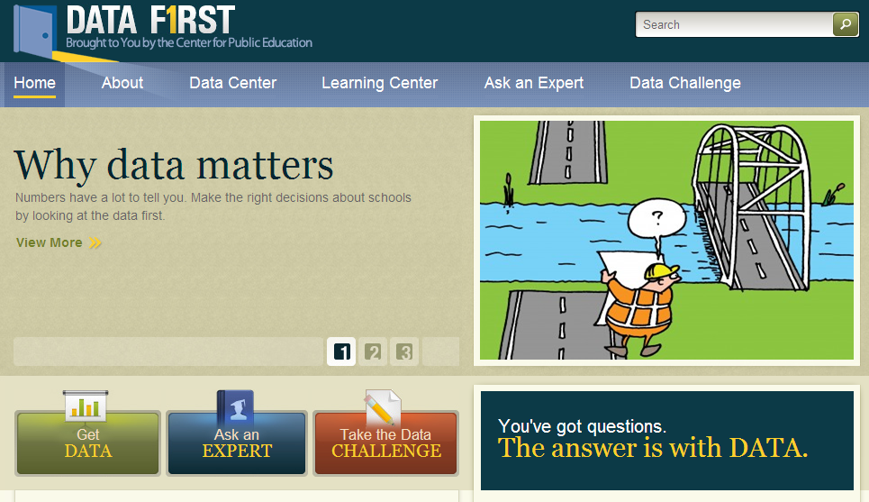
Data-First.org
public website
National & state data for 28 indicators of school quality
Learning Center with mini-lessons
Ask the expert
Can supplement face-to-face training

Slide 17
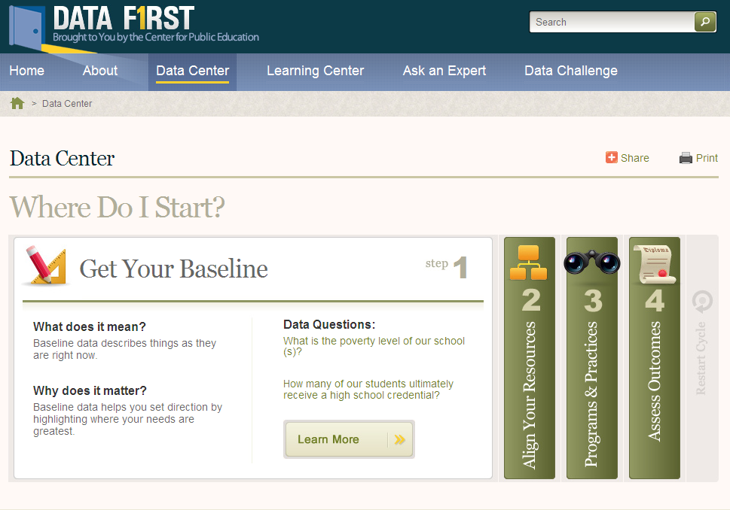

Slide 18
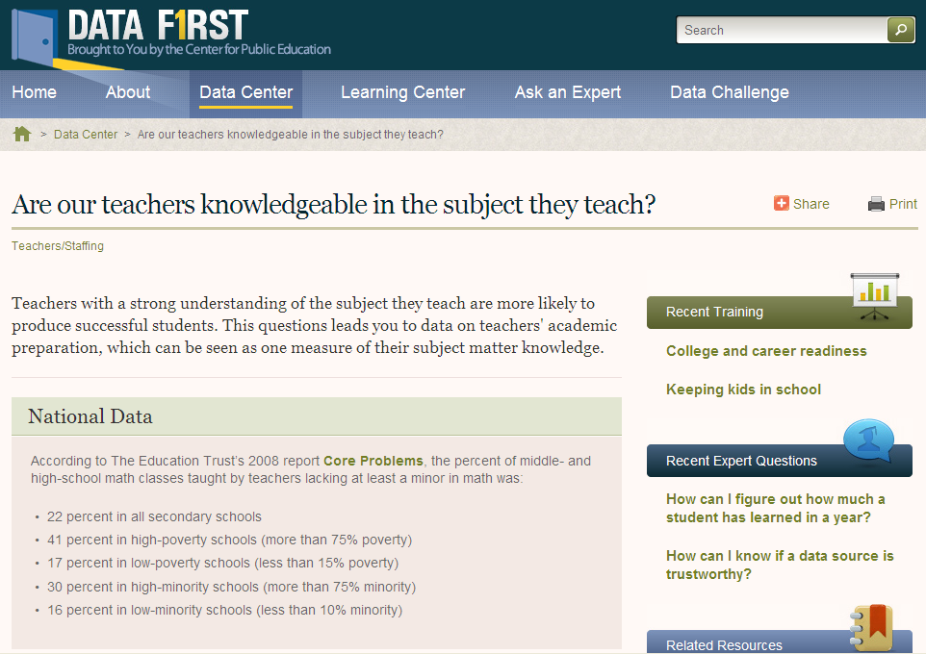

Slide 19
Data First indicators
Baseline | Resources | Programs | Student Outcomes
student outcomes school environment school safety student absenteeism discipline school demographics student population by race, ethnicity, family income, English language learners, and disability | staffing student-teacher ratio out-of-field teaching highly qualified teachers funding district expenditures district revenues funding equity facilities classroom overflow student-computer ratio school size | programs pre-k enrollments AP test-takers | achievement NAEP scores - math NAEP - reading state test scores AYP status SAT/ACT scores graduation & beyond graduation requirements high school grad rates 18-24 yr-olds with HS credential college-going rates 1st yr college retention

Slide 20
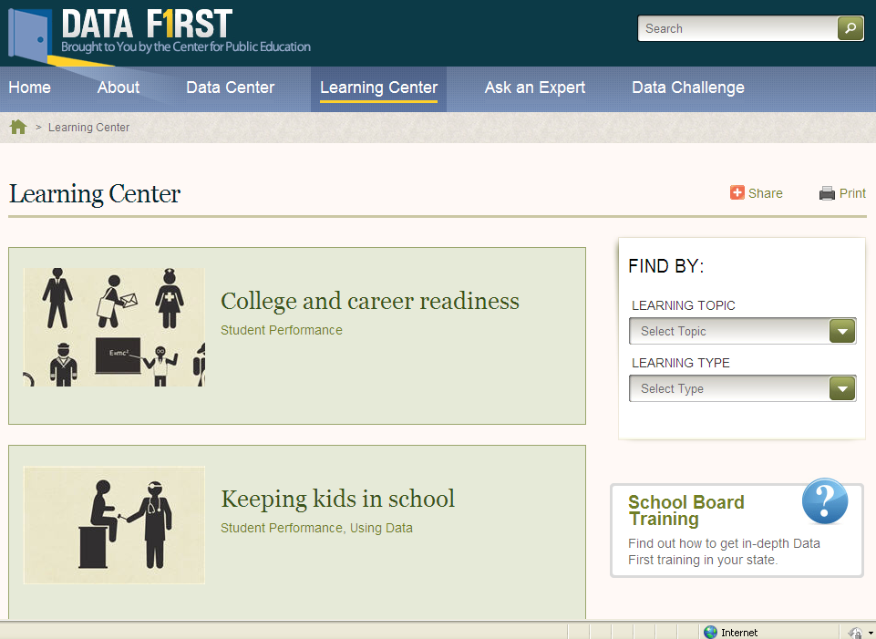

Slide 21
contact me: jhull@nsba.org or 703-838-6758
check out our websites:
www.centerforpubliceducation.org
www.data-first.org

