Slide 1
How GIS and Mapping Supports Data-Driven Decision Making:
Opportunity Mapping in a Full Service Community School District
Susan Lindell Radke
NCES 25th Annual MIS Conference
San Diego
February 2012

Slide 2
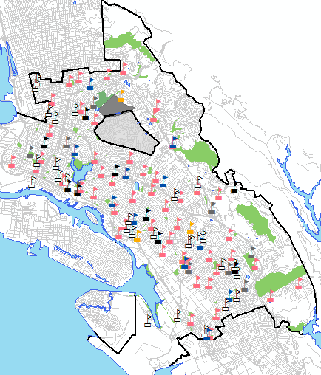
Oakland Unified School District
2011-12 enrollment: 38,110 (24% 10 year drop)
Elementary: 20,967 (55%)
Middle: 7,523 (20%)
High: 9,620 (25%)
(Charters: 7,755)
100 schools:
Elementary: 61(5 schools closing 2012-13)
Middle: 18
High: 21
(Charters: 32)

Slide 3
Opportunity Mapping in a Full Service Community School District
OUSD Five Year Strategic Plan
Full Service Community District
Role of data in developing the Plan
Healthy Kids, Healthy Oakland Data Framework
Opportunity Mapping

Slide 4
VISION:
All students will graduate from high school. As a result, they are caring, competent, and critical thinkers, fully informed, engaged and contributing citizens and prepared to succeed in college and career.
http://www.thrivingstudents.org/sites/default/files/Community-Schools-Thriving-Students-Strategic-Plan.pdf

Slide 5
Superintendent Tony Smith
http://www.pbs.org/newshour/rundown/2011/12/oakland-schools-superintendent-a-tough-job-for-a-tough-guy.html
http://www.thrivingstudents.org/sites/default/files/Community-Schools-Thriving-Students-Strategic-Plan.pdf
"What we're looking at is a failure of the system, the set of relationships among the different institutions that have produced the outcomes we've got. So we can't just transform a single institution and expect to change all the outcomes."

Slide 6
APPROACH:
To supplement traditional enrichment methods of enhanced curriculum and improved teaching practices, by aligning with other agencies to raise the entire student experience through housing, nutrition, health and welfare partnerships.

Slide 7
MISSION:
Oakland Unified School District is becoming a Full Service Community District that serves the whole child, eliminates inequity, and provides each child with excellent teachers every day.
http://www.thrivingstudents.org/sites/default/files/Community-Schools-Thriving-Students-Strategic-Plan.pdf

Slide 8
Full Service Community Schools
It’s with these beliefs that we engage in creating a Full Service Community district filled with Full Service Community Schools, in which schools act as resource and service hubs that connect with local partners to help build healthy and vibrant schools and communities.
http://www.thrivingstudents.org/sites/default/files/Community-Schools-Thriving-Students-Strategic-Plan.pdf

Slide 9
Healthy Kids, Healthy Oakland
Data Framework
Provide comprehensive information and analysis about the whole child, to include traditional AND non-traditional indicators.
New tools for presenting data in actionable ways, in order to address inequities and improve educational outcomes for all Oakland students.
Help to move every child closer to opportunity and further from constraints, to create conditions for learning and thriving.

Slide 10
Healthy Kids, Healthy Oakland
Place-based approach…one solution doesn’t work for all kids in all places.
Where do students live?
What are the needs of students in different places?
Alameda Co. PLACE MATTERS initiative

Slide 11
Race, Income & Place Impact Health
Compared to a White child in the Oakland Hills, an African American born in West Oakland is…
1.5 times more likely to be born premature or low birth weight
2.5 times more likely to be behind in vaccinations
5 times more likely to be hospitalized for diabetes
7 times more likely to be born into poverty
4 times less likely to read at grade level
2 times more likely to die of heart disease
INFANT
CHILD
ADULT
Cumulative impact:
15 year difference in life expectancy
Courtesy of Health Impact Assessment, from Life and Death from Unnatural Causes, Alameda County Public Health Department (2008)

Slide 12
Alameda Co. PLACE MATTERS
“Where we live, our race, our income shapes how long we live. Children do not choose to grow up in neighborhoods with no grocery stores, closed parks and struggling schools.
The lack of opportunities for good health in some neighborhoods is rooted in persistent injustices shaped by a legacy of segregation, widespread disinvestment in communities of color, and exclusion of people of color from decision making venues.
And so, the difference of a couple of miles, the color of their skin, and poverty level adds up to 15 years of life.
And from what we can tell, this difference is increasing.”

Slide 13
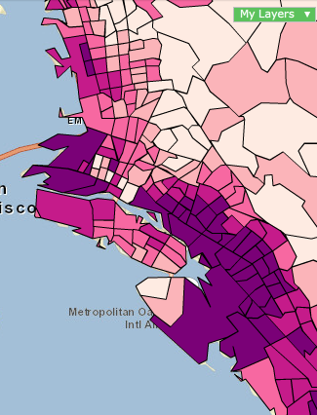
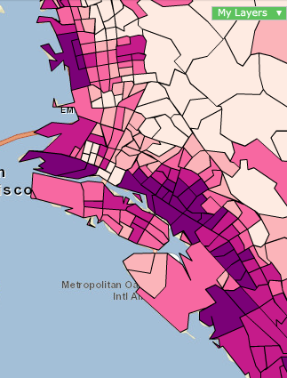
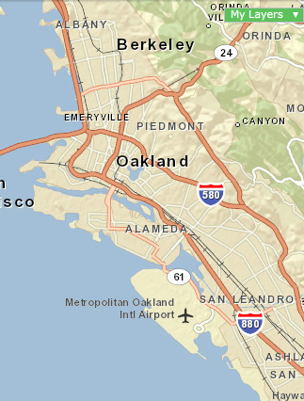
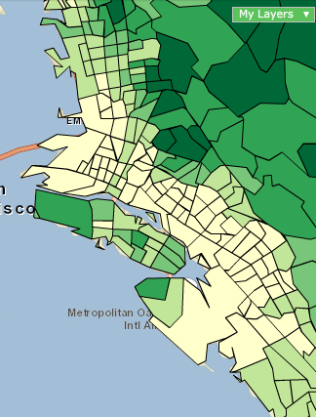
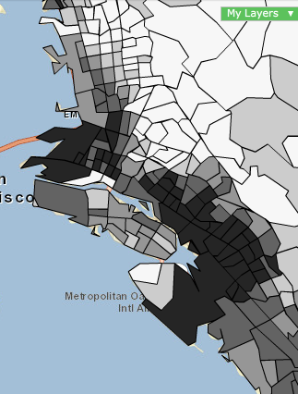
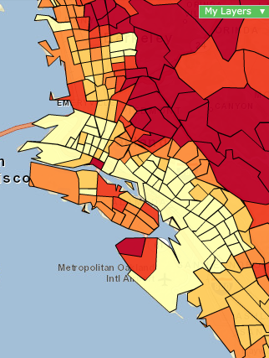
Oakland Geography: Sample Indicators
Hills
Flatlands
The geographic divide…
2010 Adults some high
school/No diploma
% Hispanic 1990
% Hispanic 2010
2010 Median Home Value
2010 Per Capita Income
http://communityanalyst.esri.com
http://www.esri.com/library/whitepapers/pdfs/diversity-index-methodology.pdf

Slide 14
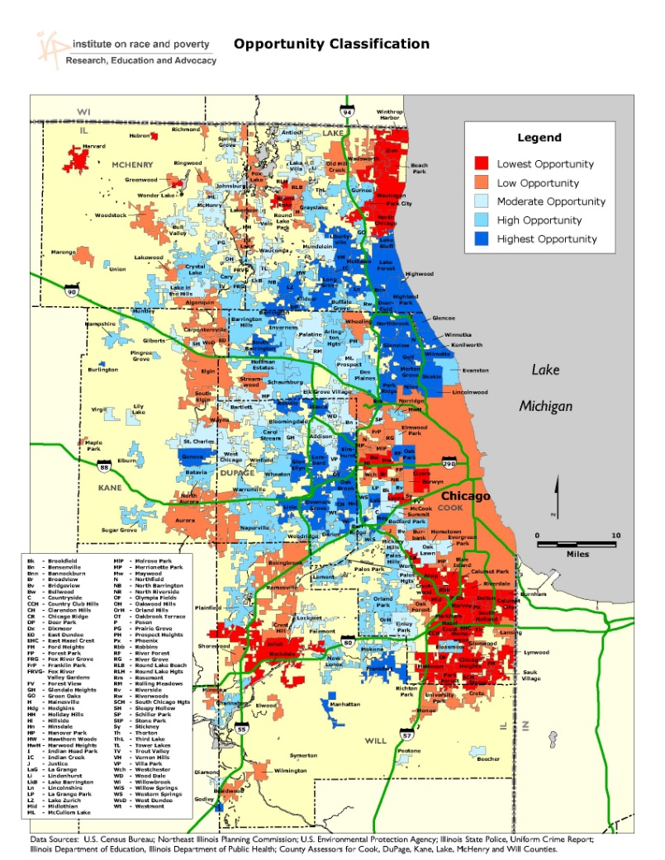
Healthy Kids, Healthy Oakland
Opportunity Mapping
Kirwan Institute,
The Ohio State University
Opportunity Mapping is a research tool used to understand the dynamics of “opportunity” within metropolitan areas.
The purpose of Opportunity Mapping is to illustrate where opportunity rich communities exist, and assess who has access to these communities.
OUSD Healthy Kids, Healthy Oakland analysis adapted from Opportunity Mapping to determine which city locations have greater access to school and community opportunities.
http://research.kirwaninstitute.org/category/opportunities-communities/opportunity-mapping/

Slide 15
Healthy Kids, Healthy Oakland
Opportunity Mapping: Program Objectives
Democratize data to raise community awareness of inequities.
Inform agencies of inequities to promote data sharing.
Inform decisions about school services.
Begins the conversation…

Slide 16
Healthy Kids, Healthy Oakland
Opportunity Mapping: YEAR “0”
Foundational 10 Planning –
Student/School-based Indicators
School Sites & Enrollment
Graduation Rates
Healthy Food Programs, and Free/Reduced Price Lunch Status
Academic Performance & Physical Fitness Assessment
Chronic Absenteeism
Early Childhood Education/Head Start centers
Student Ethnicity
Community-based Indicators
Life Expectancy
Community Resources (public)
Housing Vacancy
start with what we have & know

Slide 17
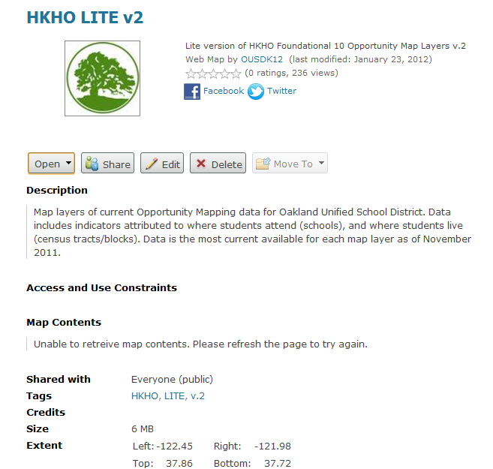
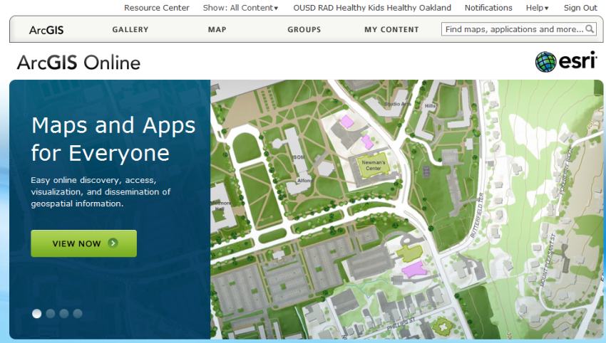
HKHO Opportunity Mapping
ArcGIS Online
HKHO LITE v2

Slide 18
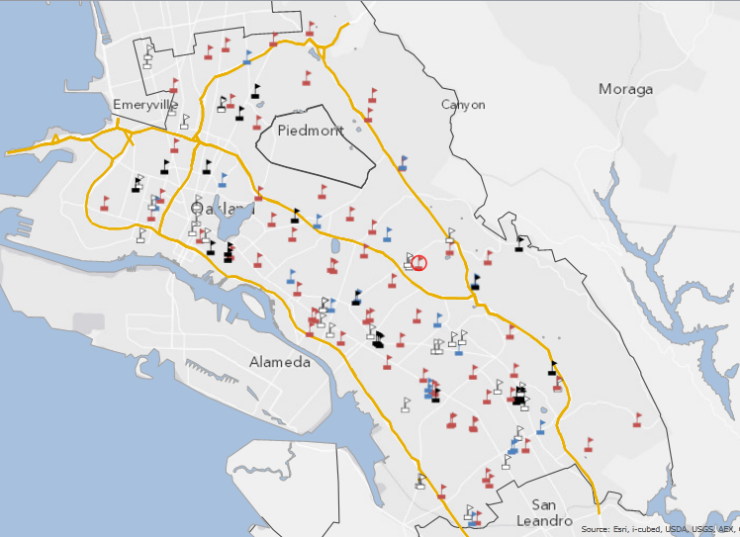
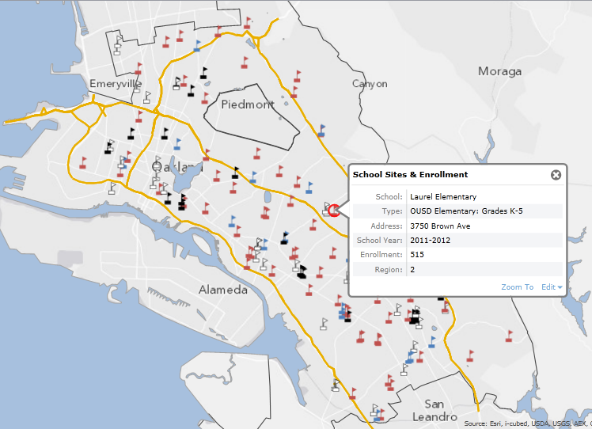
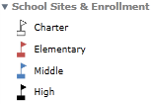
Opportunity Mapping
School Sites & Enrollment
Geocoded site addresses
Offset schools sharing common campus

Slide 19
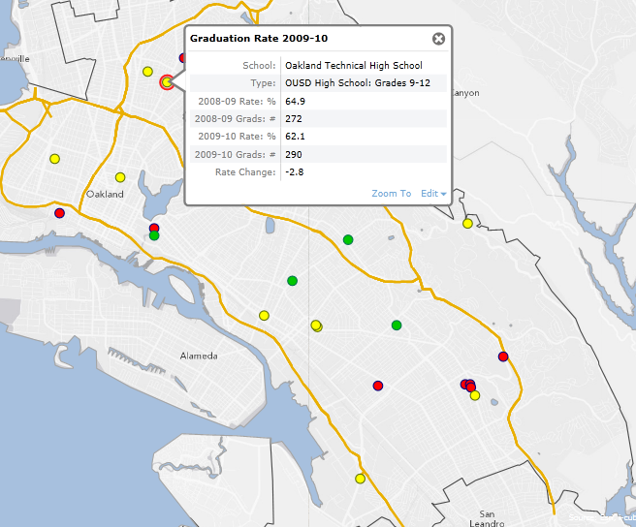
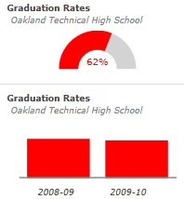
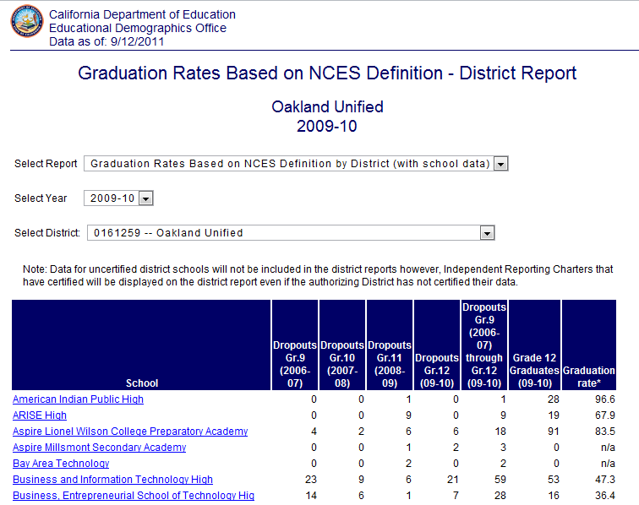
Opportunity Mapping
Graduation Rates

Slide 20
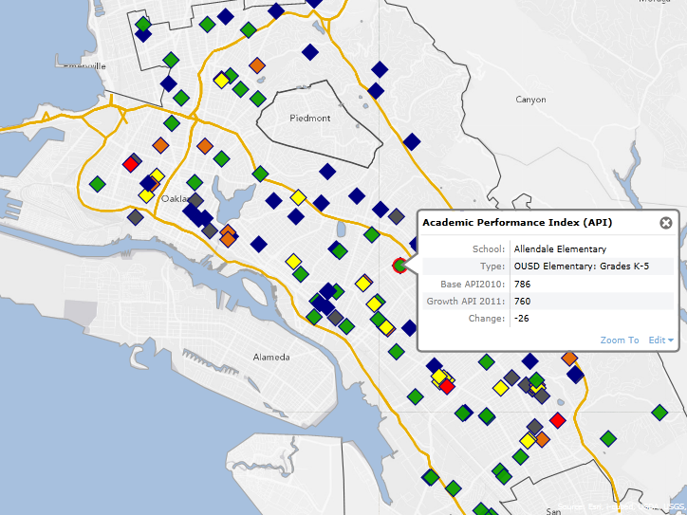
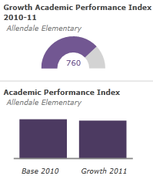
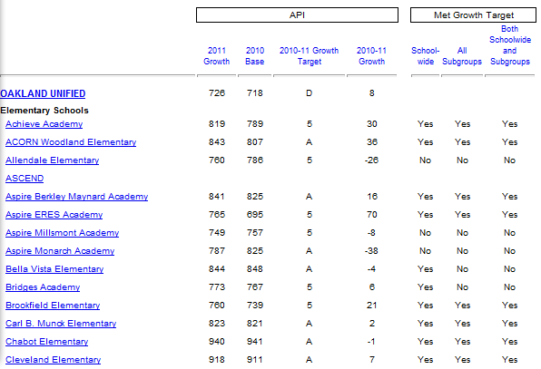
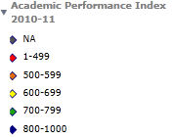
Opportunity Mapping
Academic Performance Index (API)

Slide 21
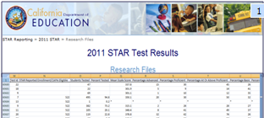
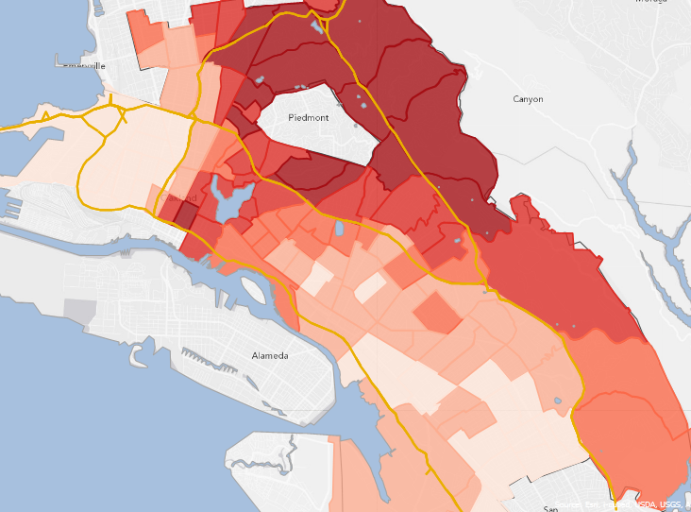
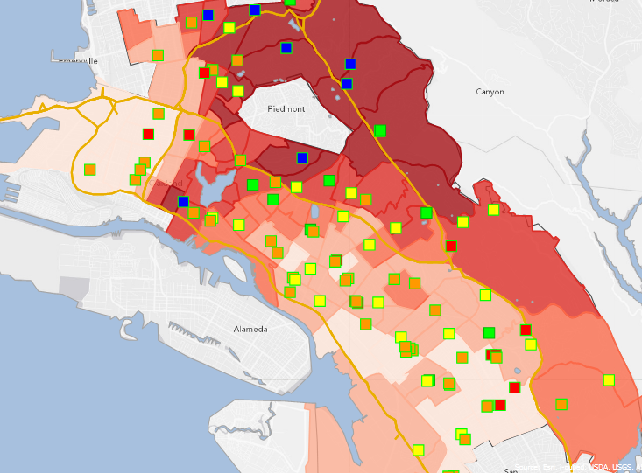
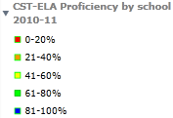
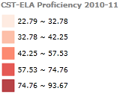
Opportunity Mapping
% Grades 2-11 Students CST-ELA* Proficient
*California Standards Test/English-Language Arts

Slide 22
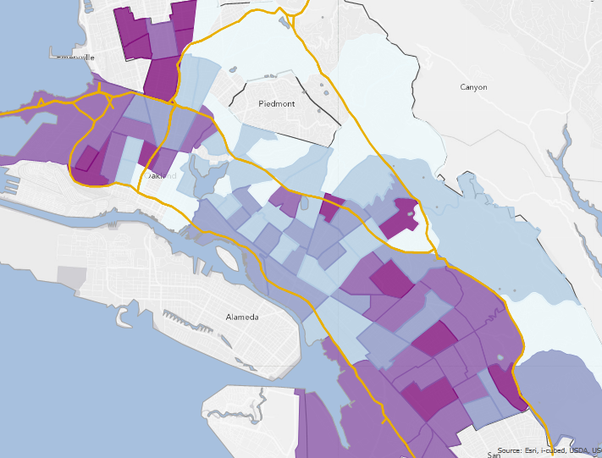
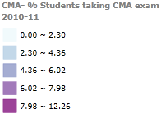
Opportunity Mapping
% Students taking CMA* exam
*California Modified Assessment

Slide 23
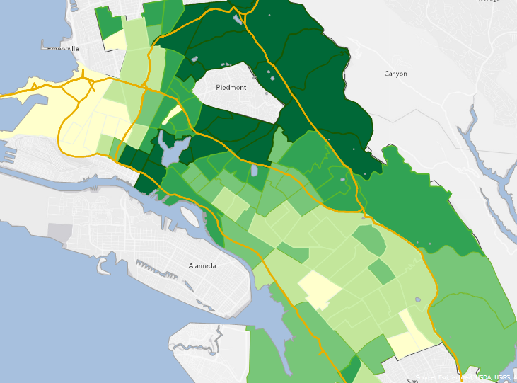
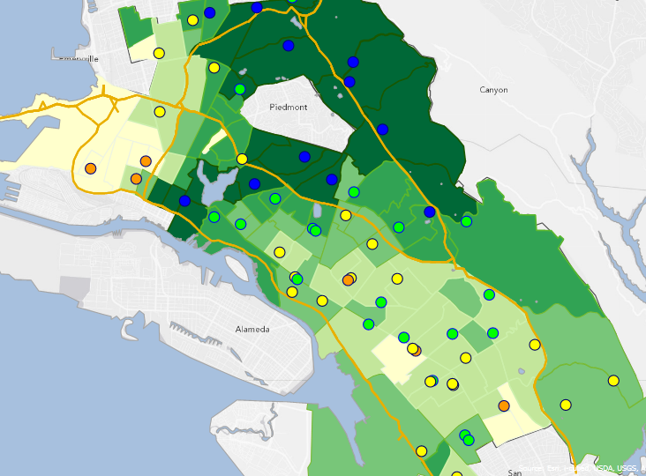
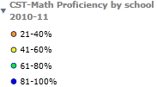
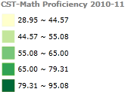
Opportunity Mapping
% Grades 2-5 Students CST-Math Proficient

Slide 24
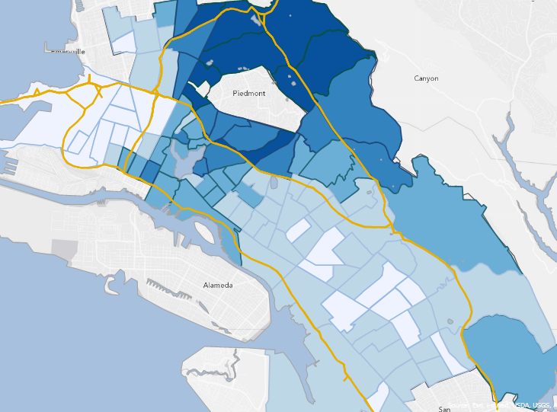
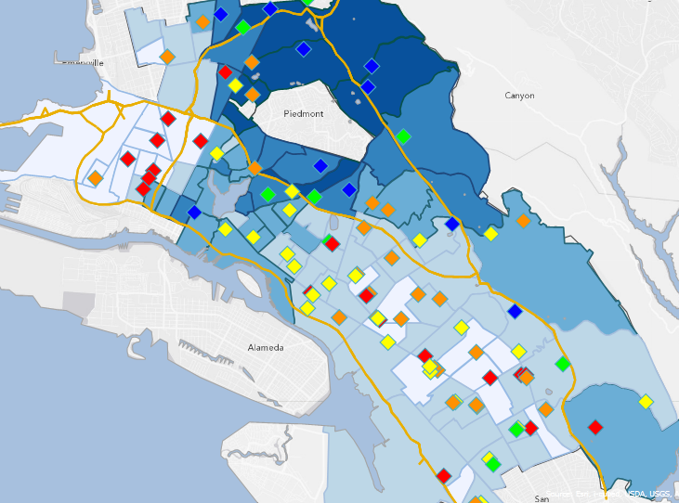
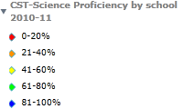
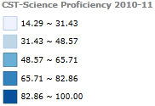
Opportunity Mapping
% Grades 5,8,10 Students CST-Science Proficient

Slide 25
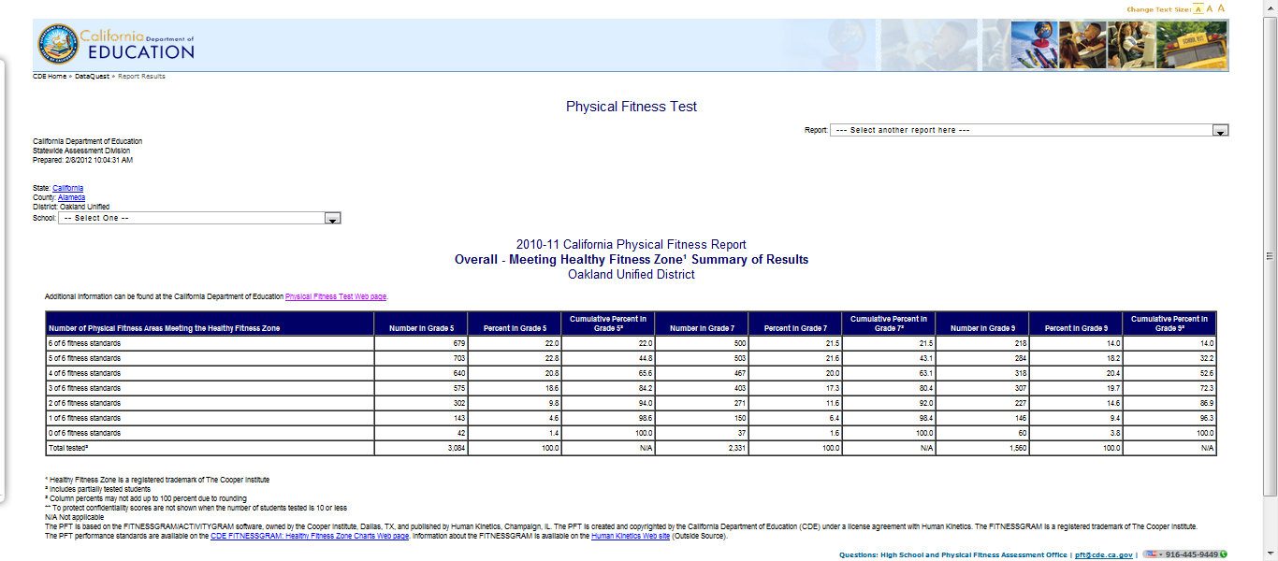
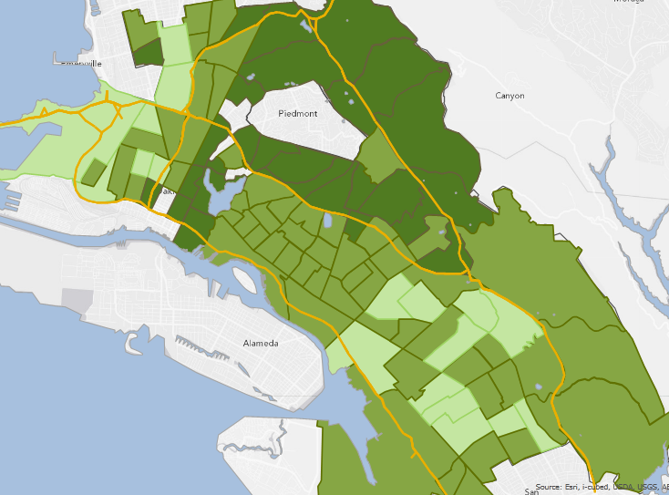
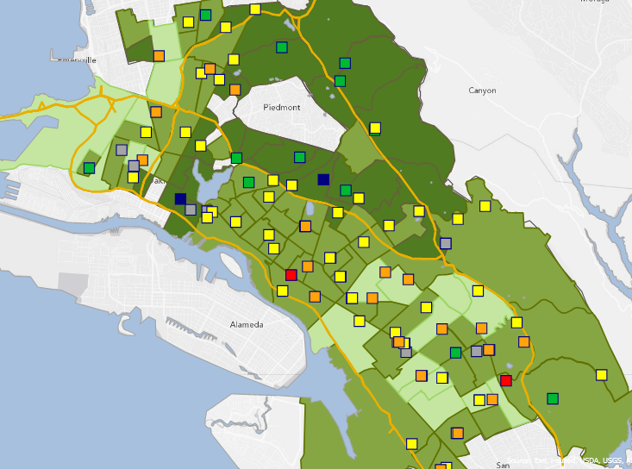
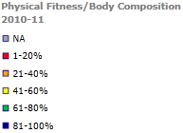
Opportunity Mapping
% Grades 5,7,9 PFT: Meeting Healthy Fitness Zone
*California Physical Fitness Test/Body Composition Score

Slide 26
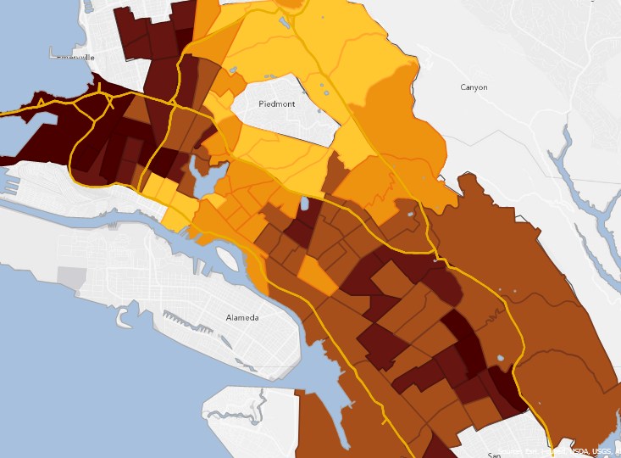
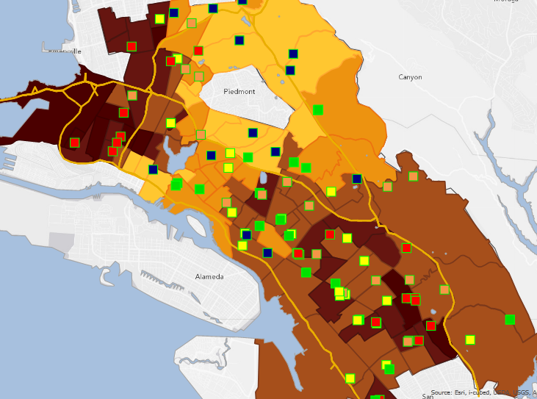
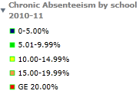
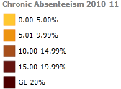
Opportunity Mapping
% Chronic Absenteeism
(% students absent 10% or more of enrolled days)

Slide 27
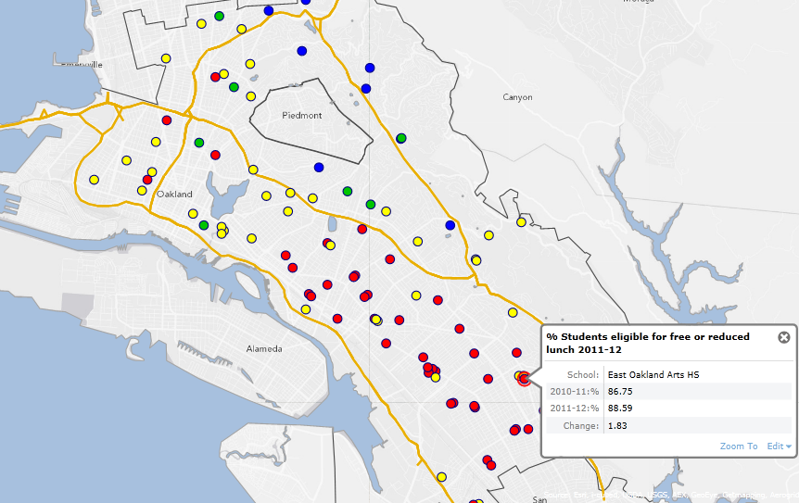
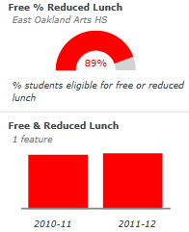
Opportunity Mapping
Nutrition Services
% Students eligible for free or reduced lunch

Slide 28
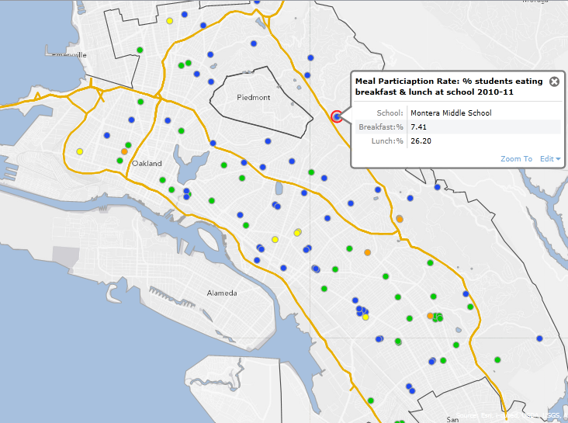
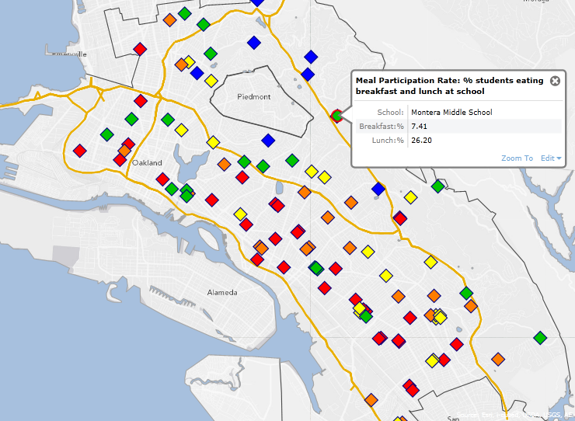
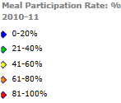
Opportunity Mapping
Nutrition Services
Meal Participation Rate
Lunch
Breakfast

Slide 29
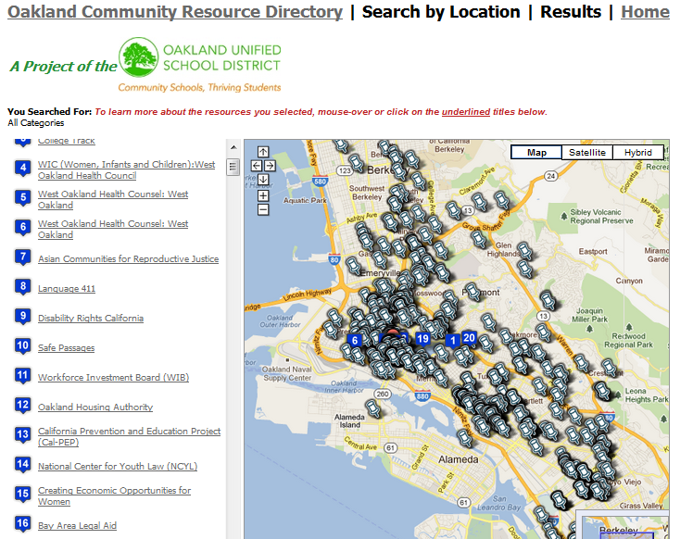
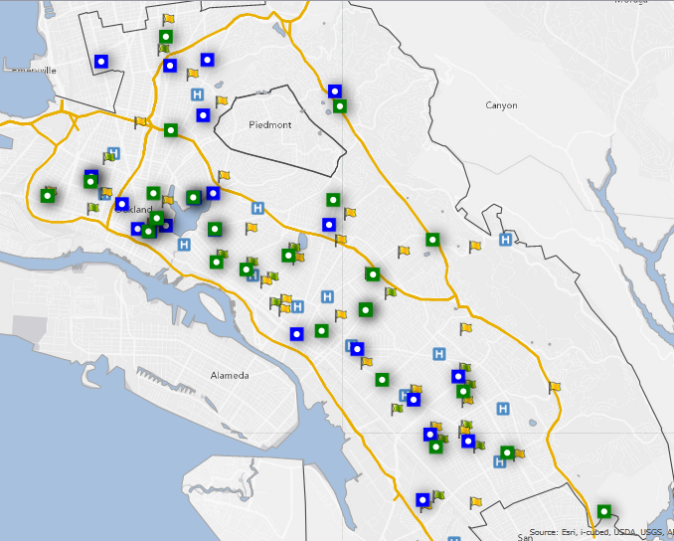
Opportunity Mapping
Public Community Resources, Early Childhood Education, Campus Health Centers

Slide 30
Opportunity Mapping
Nutrition Services
Complementary Learning
Campus Food Programs

Slide 31
Opportunity Mapping
Dominant student ethnicity

Slide 32
Opportunity Mapping
Life expectancy

Slide 33
Opportunity Mapping
Vacant Housing Units
2010
2000

Slide 34
Opportunity Mapping
Geographic Relationships: Correlation?
PFT & Campus Food Programs

Slide 35
Opportunity Mapping
Geographic Relationships: Correlation?
PFT & Chronic Absenteeism

Slide 36
Opportunity Mapping
Geographic Relationships: Correlation?
PFT & CST-ELA Proficiency

Slide 37
Opportunity Mapping
Geographic Relationships: Correlation?
Chronic Absenteeism & Free or Reduced Lunch

Slide 38
Opportunity Mapping
Geographic Relationships: Correlation?
Life Expectancy & Campus Health Centers

Slide 39
Opportunity Mapping
Geographic Relationships:
Dominant Student Ethnicity & CST-ELA Proficiency
One Map…Many Devices
Tablet
Smartphone

Slide 40
Healthy Kids, Healthy Oakland
Opportunity Mapping: YEAR 1 (current)
Longitudinal study of Foundational 10 Indicators
Extended Indicators
Student/School-based Indicators
Social & emotional student health (California Healthy Kids Survey)
Transitional families (homeless, refugee/asylee, migrant)
Housing status: public housing
Career pathways
Community-based Indicators (in partnership with outside agencies)
Healthy neighborhood indicators (student ground-truthed fresh food locations)
Crime analysis
Housing foreclosure rates (Info Alameda/Urban Strategies Council)

Slide 41
Healthy Kids, Healthy Oakland
Info Alameda County

Slide 42
Opportunity Mapping
Mapping these indicators helps district leaders and school communities to see where the gaps are.
It is a new way of using place-based data to drive strategies and decisions such as allocation of resources to places and students where the need is greatest.
It also helps community partners align their resources with the school district, which is especially important in a time of diminishing resources across-the-board.

Slide 43
Healthy Kids, Healthy Oakland
www.thrivingstudents.org/opportunitymaps
Oakland Unified School District
Research, Assessment & Data
1011 Union Street
Cafeteria Annex Building
Oakland, CA 94607
(510) 451-4164
Jean Wing, Executive Director
Susan Lindell Radke, GIS Analyst/Demographer

