Slide 1



Mapping to the Common Education Data Standards
2012 MIS Conference
February 15, 2012

Slide 2
Introductions
Kathy Gosa
  Kansas State Department of Education
Jay Pennington
  Iowa Department of Education
Josh Klein
  Oregon Department of Education
Anthea Brady
  Public Consulting Group

Slide 3
Overview
What is CEDS?
Data Mapping Process
Metadata Management
State Case Studies
Future Mapping
Discussion

Slide 4
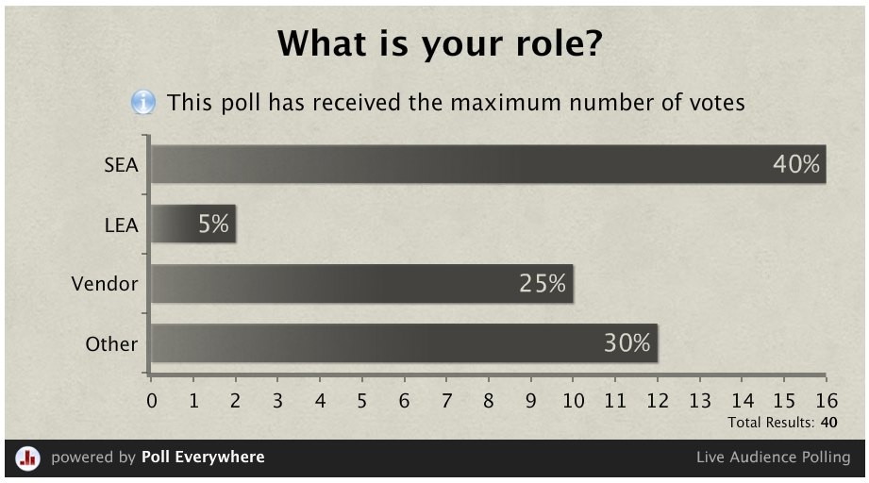

Slide 5
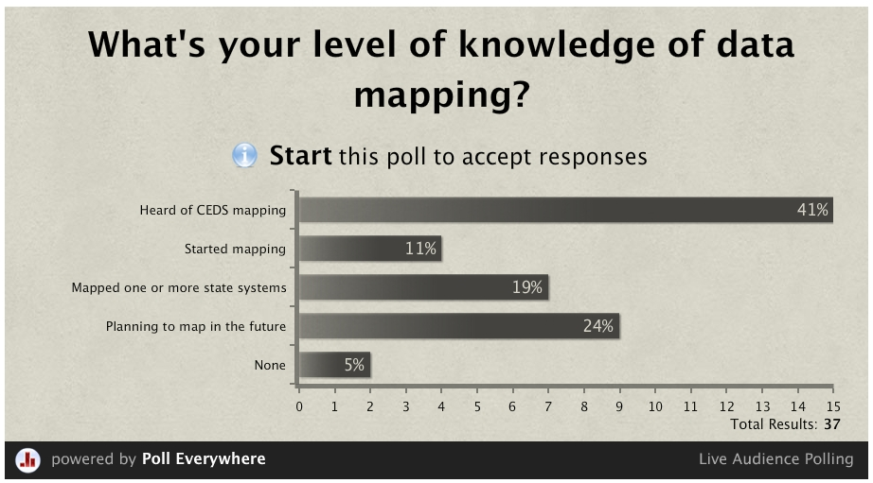

Slide 6
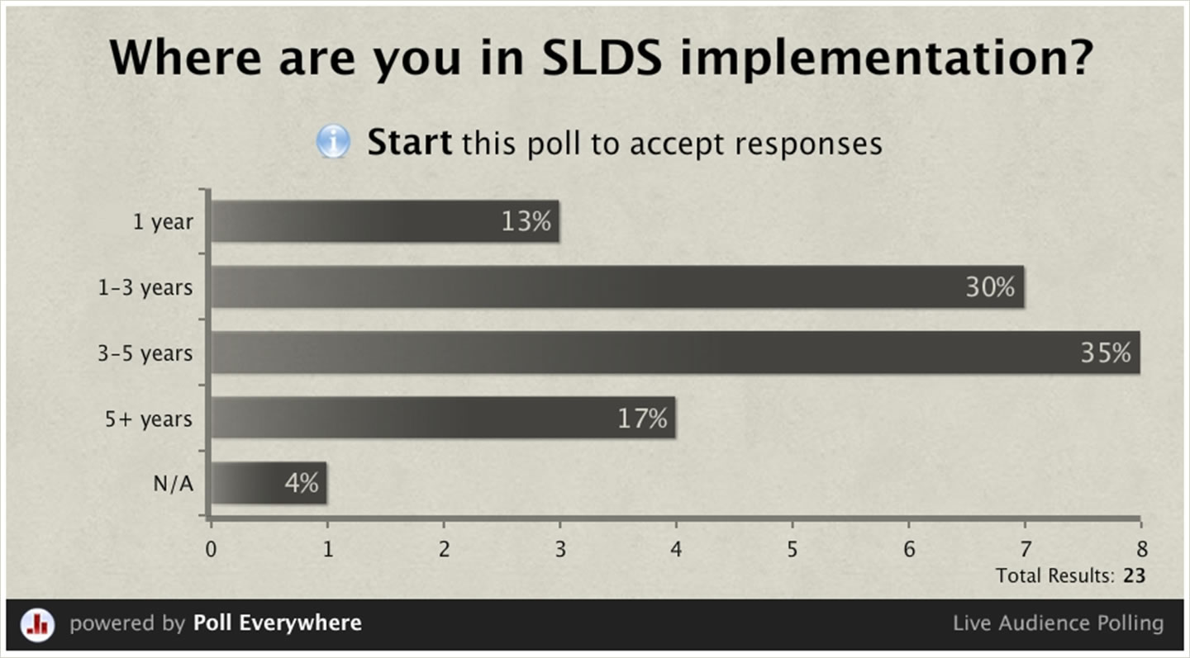

Slide 7
States Involved in CEDS Mapping

Slide 8

Data Mapping Process
Metadata Audit
Data Mapping Team
Source Expert Review
Alignment and Gap Analysis
SEA Time Commitment
MSOffice Clipart Image

Slide 9
Data Mapping Process
SEA Team
SEA Team
Data Mapping Team
Data Mapping Team & SEA Experts
Metadata Audit
Mapping Team Review & Map
Source Expert Review
Alignment & Gap Analysis

Slide 10
Metadata Audit
Identify state systems and subject areas
  SIS, special education, staff, courses
Discover data dictionaries, user guides, schemas
  Identify depth of metadata documentation
Identify expert for each source system
  Who knows the tables inside and out?

Slide 11
CEDS Domain Entity Schema (DES)
Domain | Entity
EL | EL Child
EL | EL Family
EL | EL Staff
EL | EL Organization
EL | Parent/Guardian
Domain | Entity
PS | PS Institution
PS | PS Student
PS | PS Section
Domain | Entity
K12 | K12 School
K12 | Local Education Agency
K12 | State Education Agency
K12 | K12 Student
K12 | K12 Staff
K12 | K12 Section
K12 | K12 Course
K12 | Assessment
K12 | Program
K12 | Incident
K12 | Calendar
K12 | Parent/Guardian
Domain | Entity
Assessments | Assessment
Assessments | Assessment Administration
Assessments | Assessment Form
Assessments | Assessment Item
Assessments | Assessment Item Response
Assessments | Student Assessment Registration
Assessments | Assessment Subtest Score
Domain | Entity
Learning Standards | Learning Standards Document
Learning Standards | Learning Standards Item

Slide 12
Data Mapping Team
Parse metadata documentation
  Transform metadata to excel format for alignment to CEDS
Map or “Align” state metadata to CEDS
  Are these elements the same?
  Are definitions and code sets the same or do they require transformation?
Identify elements that do not align with CEDS

Slide 13
Source Expert Review
Present
Review
Identify New Metadata
Revise
Mapper presents initial mapping
Source experts review and provide feedback
Source experts identify and share additional metadata
Mapper reviews new metadata and revises maps to CEDS

Slide 14
Gap Analysis

Slide 15
 | Iowa | Kansas | Oregon
K12 Student | 14 | 18 | 21
Demographic | 9 | 13 | 12
American Indian or Alaska Native | 1 | 1 | 1
Asian | 1 | 1 | 1
Birthdate | 1 | 1 | 2
Black or African American | 1 | 1 | 1
City of Birth |  | 1
Country of Birth Code |  | 1
Economic Disadvantage Status |  | 1 | 1
Hispanic or Latino Ethnicity | 1 | 1 | 1
Home Language Code | 1 | 1 | 1
Native Hawaiian or Other Pacific Islander | 1 | 1 | 1
Sex | 1 | 1 | 2
State of Birth Abbreviation |  | 1
White | 1 | 1 | 1
Identity | 5 | 5 | 9
First Name | 1 | 1 | 2
Generation Code/Suffix | 1 | 1 | 1
Identification Code (Student) | 1 | 1 | 1
Last/Surname | 1 | 1 | 1
Middle Name | 1 | 1 | 2
Other Name |  |  | 1
Grand Total | 14 | 18 | 21

Slide 16
SEA Time Commitment

Slide 17
Metadata Management Helps:
Compare across and within states
Identify conflicts in data definitions
Identify authoritative source for identification data
Use plans to reduce data burdens
Streamline definitions
Prepare for updating and consolidating data systems

Slide 18
State Case Studies

Slide 19

Kansas
Process
Commitment
Outcomes
Decision-making
Next Steps
MSOffice Clipart Image

Slide 20
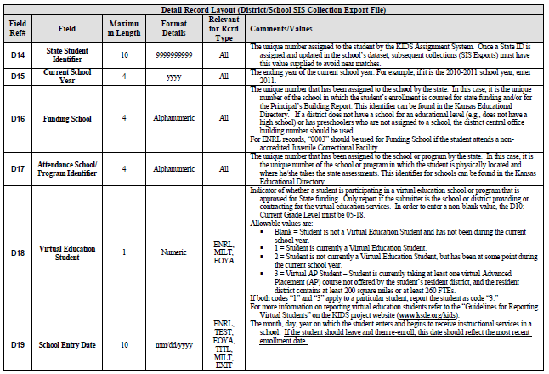

Slide 21
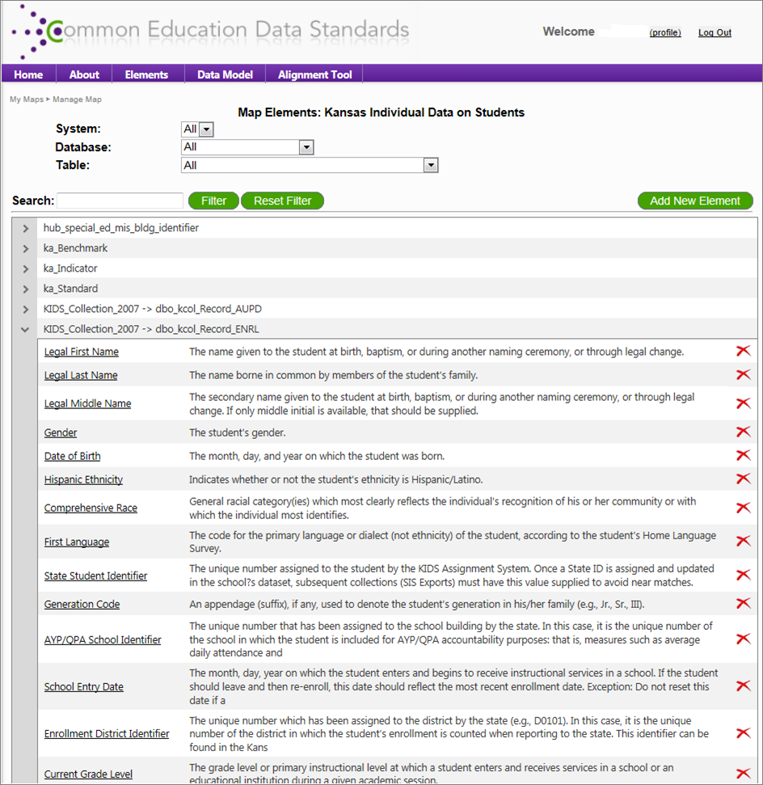

Slide 22
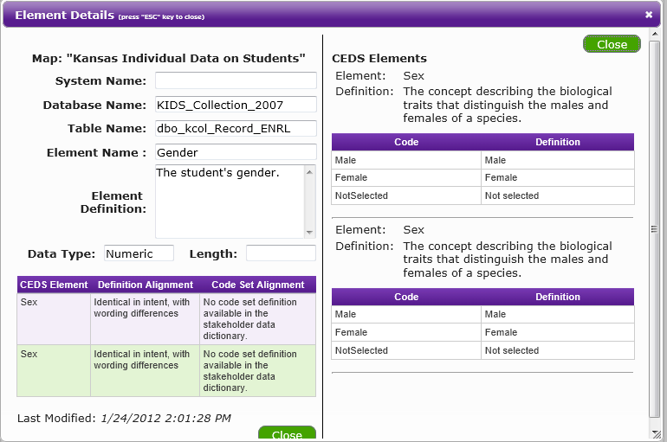

Slide 23
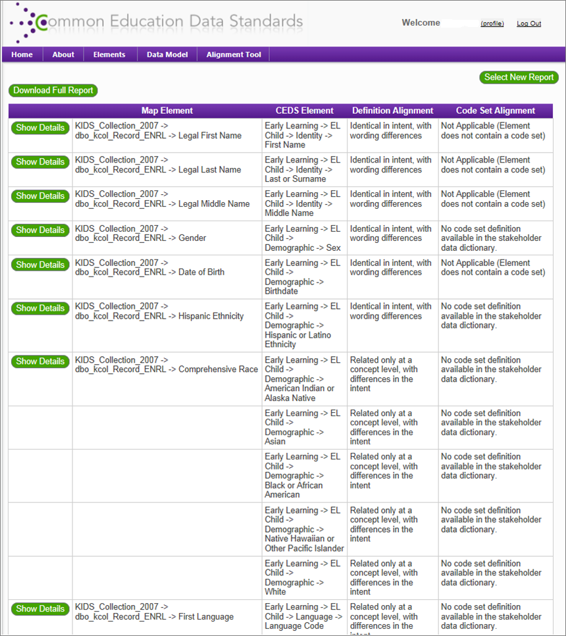

Slide 24

Iowa
Process
Commitment
Outcomes
Decision-making
Next Steps
MSOffice Clipart Image

Slide 25
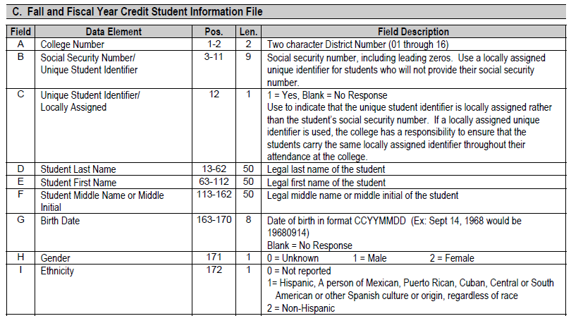

Slide 26
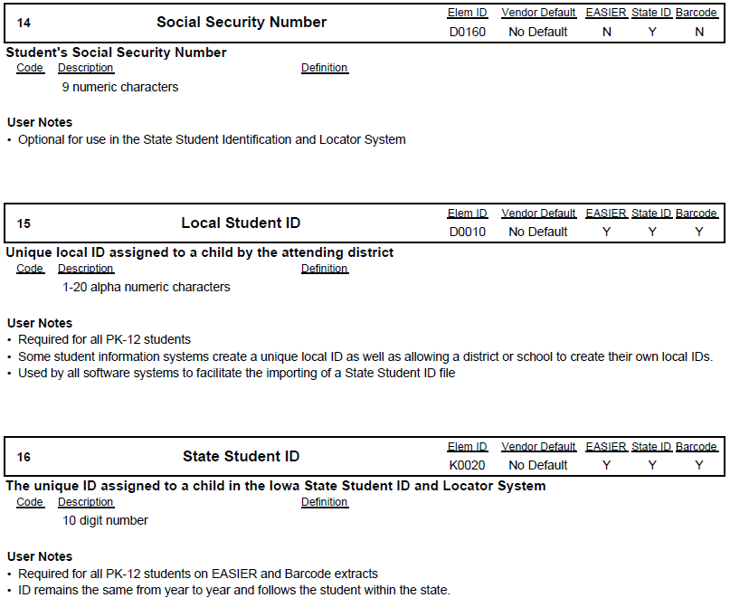

Slide 27
Another State’s Experiences
Josh Klein, Oregon

Slide 28
Future Mapping
CEDS Alignment Tool
  Import Data Dictionaries
  Align to CEDS
  Compare to CEDS and Other States

Slide 30
Questions?

Slide 31
Contact
Kathy Gosa: kgosa@ksde.org
Jay Pennington: jay.pennington@iowa.gov
Josh Klein: josh.klein@state.or.us
Anthea Brady: abrady@pcgus.com

