Slide 1
Documenting and Quantifying Return on Investment
Tuesday, April 30, 2013
Sharon Gaston and Melody Parrish , Texas Education Agency
Kurt Kiefer, Wisconsin Department of Public Instruction
Joyce Popp, Idaho Department of Education

Slide 2
Overview
Approaches to ROI
Wisconsin
Texas
Idaho
Questions & Answers

Slide 3
Wisconsin’s Return on Investment

Slide 4
Wisconsin
Quantifiable Cost Savings
Data Collection
$30M+ per year currently
Software Licensing
Reduced by 25 to 50%, ~$4.5M per year

Slide 5
Wisconsin
Wisconsin is uniquely organized for this sort of solution as a large collection of relatively small districts

Slide 7
Wisconsin
Technology scales well
1,000 vs. 1,000,000 students – same system, similar effort and labor
Technology advances enable
bandwidth, cloud, SaaS

Slide 8
Wisconsin
Eliminates repeated tasks every district performs:
Procurement and negotiating contracts
Network Operations
Installing and managing servers
Database and Application Management
Installing and updating that software
Fixing bugs
Documenting changes
Updating training information

Slide 9
Wisconsin
Eliminates repeated tasks every district performs:
Data integration with external agencies
Immunizations via the state registry
Federal lunch program status via direct certification
Transcripts to WI colleges and universities

Slide 10
Wisconsin
Provides not easily quantifiable benefits:
Equity – all get the same features
Improved data quality from common source
Electronic records for mobile students, eliminates cumulative folder
"Big data" for EWS, RtI, other research
Eliminates training
Facilitates implementation of specific data events, i.e., statewide surveys

Slide 11
Texas Student Data System ROI
A balanced approach to benefits realization

Slide 12
Quantitative vs Qualitative ROI
Texas Project Delivery Framework (statutory)
Post-Implementation Review of Business Outcomes
Actual results of 4 quantitative and qualitative factors that were anticipated in the business case:
Statutory fulfillment
Strategic alignment
Agency impact analysis
Financial analysis
Business justification
Project planning
Solicitation and contracting
Project implementation
Benefits realization
Business Case
Comparative information between business solution cost and project benefits, based on a business case analysis process

Slide 13
Return on Investment Value to the State (ROIv)
M + S + C + I
2√R
ROIv =
M = Mandate
S = Value to state
C = Value to customers
I = Investment value
R = Risk

Slide 14
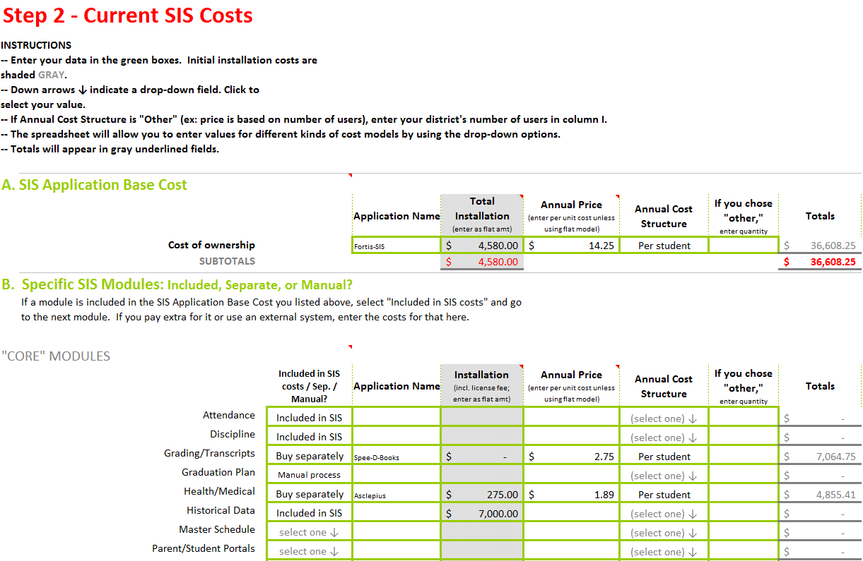
Statewide vs Local ROI
EX: State-sponsored Student Information System (SSIS)
TCO Tool helps LEAs compare costs of current SIS against prices for SSIS contracts
Current SIS Annual Costs | Potential SIS “Cloud-based” Costs
SIS application base | Annual subscription
Vendor adaptation | Annual hosting
Hardware/software | One-time installation
Facilities & internet | Internet service
Training/sustainability | Training/sustainability
Support
Staffing

Slide 15
Summary

Balanced approach to ROI
Quantitative ROI satisfies fiduciary responsibility
Qualitative factors ensure comprehensive perspective
Statewide focus satisfies “funders”
Local focus satisfies local control needs

Slide 16
Idaho’s Return on Investment

Slide 17
Return on Investment
Quantifiable saving $10-15M/Year
From over 180 data collections to one monthly
Accurate Student Data
Attendance
Enrollment
Special Program
Staff Funding
Correct Certifications & Endorsements
Highly Qualified Status
Experience & Education

Slide 18
Sustainability
$8.1M Total Spend (Federal Grants & State Allocation)
K-12 Statewide Longitudinal Data System
$1.8M/Year for On-going maintenance
System Maintenance
District Support Staff
System built with sustainability in mind
Digital Backpack for all Students
Scalable
Transactional, Relational, Reportable

Slide 19
Data Quality
Use data for all reporting
View data submitted as “sole source of truth”
Data is cross validated at time of submission
Demographic information used for all reporting
Senior Level buy-in
Data quality is everyone’s job
Make Data quality part of each employees job description
Stay the course

Slide 20
Processes
Local Control State – Rural/Remote
No Statewide Student Information System
174 Independent Districts/Charter Schools
7 students to 37,000 students
Local Districts oversight by School Boards
Ability to direct what, not how
Define data elements
Provide listing of acceptable responses
Provide extensive training and support

Slide 21
Data Use
EdFacts Reporting
All reports generated from SLDS
State Funding
Attendance/Enrollment
Salary Based Apportionment
IDEA and Title Programs
Standard State Testing
AYP/STAR Rating System
Advanced Opportunities, Growth/Excellence

Slide 22
Summary
Communication is Key
Superintendents, business managers, program directors, registrars
Data Governance
Team of all stakeholders to supply input
Data Stewards
Support
Team to work with districts
Provide value back to Districts
Instructional Improvement System

Slide 23
Questions & Answers

Slide 24
Contacts & Additional Resources
Contact information:
Kurt Kiefer, kurt.kiefer@dpi.wi.gov
Sharon Gaston, Sharon.Gaston@tea.state.tx.us
Melody Parrish, Melody.Parrish@tea.state.tx.us
Joyce Popp, jpopp@sde.idaho.gov
Jeff Sellers, jeff.sellers@sst-slds.org
For more information on Return on Investment:
Traveling Through Time: The Forum Guide to Longitudinal Data Systems Book II: Planning and Developing an LDS: http://nces.ed.gov/pubsearch/pubsinfo.asp?pubid=2011804

