Slide 1
Building a Centralized P-20 Data Warehouse
The presentation will begin at approximately 2:00 p.m. ET
Information on joining the teleconference can be found on the “Info” tab in the upper left of this screen. Be sure to use the “Attendee ID” number on the Info tab when dialing in to associate your name with your phone.
In order to cut down on background noise, please mute your phone by dialing *6 upon entry into the meeting.
During the question and answer portion of this presentation:
You can re-enter *6 to unmute your phone and ask a question; or
Type your question into the Q&A panel below the participant list and clicking “Send”.
A copy of this presentation and a link to the recording will be shared via the SLDS website

Slide 2
Building a Centralized P-20 Data Warehouse
Facilitator
Jeff Sellers (SLDS State Support Team)
Panelists
Charles McGrew (Kentucky )
Carol Jenner (Washington)

Slide 3
Kentucky

Slide 4
Kentucky’s Data Linkage History
The MAX Project (2003)
KEN Project and P-20 (2005/07) Multi-agency group developed a proposal to pursue efforts to develop a centralized P-20 style data system with a de-identified production system to be housed independent of the participant agencies.
K-12’s KIDS Project – 1st Round SLDS Grants (2006)
P-20 Data Collaborative – SLDS Grants (2009)
Phase I (Expanding KIDS)
Phase II (Current)
4

Slide 5
Kentucky P-20 Governance
Joe Meyer (chair)
Education and Workforce Development Cabinet
Secretary
Dr. Terry Holliday
Kentucky Department of Education, Commissioner
Robert King
Council on Postsecondary Education,
President
Alicia Sneed
Kentucky Education Professional Standards Board
Interim Executive Director
Kentucky’s P-20 Data Collaborative is governed by the three founding agency heads and is chaired by the Education and Workforce Development Secretary. All project and fiscal decisions are made by this group and must be unanimous. The Collaborative staff and budget are attached to the Secretary’s Office.
5

Slide 6
Kentucky P-20 Governance continued
Legal Authority
Collaborative established through an MOA in 2009 for agencies participating in the grant.
P-20 Shared Repository established in 2010 by an Executive Order with authority to match data across collaborative and other agencies.
Fiscal Authority
Kentucky’s 2010/11-2011/12 budget allocated an ongoing budget for the project to the Education and Workforce Development Secretary’s Office – which is where the project is housed for administrative purposes.
Data Ownership
Each participating agency is a member. Each member owns and maintains control of its own data within the central warehouse.

Slide 7
Kentucky P-20’s Role
Provide better, more timely information to inform policy makers than has ever been available before by:
Providing a secure way to link data across agencies to show a more complete picture than any agency can do,
Identifying the state’s critical policy questions and developing processes to answer them either by the agencies or by bridging the gaps between agencies, and
Working with policy makers and stakeholders to provide the information they need in the format they need it to improve programs and services. This requires tools and expertise that each agency may not possess.
P-20 is a complement and not a replacement for agency data systems unless the agencies want it to be otherwise.

Slide 8
Kentucky P-20’s Advantages of a Centralized Model
P-20 can centralize a number of functions that would be much more work if each agency did it themselves such as:
Focusing more time and resources on processes related to data matching and de-identification than agencies can currently do.
Provide a state-level, big-picture perspective of the state’s needs without being too entrenched in a single agency perspective.
Maintain resources for analysis and research centrally that can be used by all the agencies and other groups.
Provide a stable platform despite changes within agency infrastructures.
Provide a method for fiscally supporting the project with one budget request.
Provide a platform on which other data warehouses can be build more economically than creating additional “silo” systems.
Create a better data matching process that improves over time by filling in incomplete data and updating erroneous information.
Ability to address issues which may be politically difficult for agencies.
It is easier to monitor and audit third-party use of the system for researchers and others.
Easier to identify issues like changing definitions and data quality problems that are too difficult to spot “on the fly”

Slide 9
Kentucky P-20 Data Warehouse Architecture
Data Sources
Data Users
KDE
K-12 Students
24/7 Secure
Data Collection,
Processing,
and Matching
De-Identified
Files and
Reporting
System
Agencies
EPSB
Teacher Cert.
State
CPE
Postsecondary
Researchers
CPE
Adult Education
P-20
Staff
Early
Childhood
Reports via
Web Portal
Workforce
Public

Slide 10
Kentucky P-20 Data Matching Process
P-20 Master Person Record
Last Name | First Name | DOB | SSN | Gender
Smith-Johnson | Mary | 10/10/89 | 888-88-8888 | F
Smith | M | History records allow for all changes to be retained so we can match against any name or any SSN etc. that has been attached to a “person” etc.
Jones | Mary Jane
Agency Records
Source/Yr | Last Name | First Name | DOB | SSN | Gender
UI / 2012 | Smith-Johnson | M | Not Collected | 888-88-8888 | Not Collected
PSE / 2010 | Smith | Mary | 10/10/89 | 888-88-8888 | Unknown
K12 / 2008 | Jones | Mary Jane | 10/10/89 | 888-88-8887 | F

Slide 11
Kentucky P-20 Centralized Coordination
2005-06 Graduates’ Median Wages by Credential Level in 2010-11
Sources: Kentucky P-20 Data Collaborative, Council on Postsecondary Education, Unemployment Insurance.
Calculated as the median annualized wages during the 2010-11 fiscal year (all 4 quarters added together) for 2005-06 completers who had employment records in Kentucky.

Slide 12
Kentucky P-20 Centralized Coordination
Percentage of HS Graduates College Ready in all Three Subjects by Teacher Preparation Program – SELECTED DISTRICTS ONLY

Slide 13
Kentucky P-20 Centralized Coordination
College Going Rates by County Percentage of 2010 High School Graduates Attending College in 2010-11
Sources: Kentucky P-20 Data Collaborative, Kentucky Department of Education, Council on Postsecondary Education and Kentucky Higher Education Assistance Authority

Slide 14
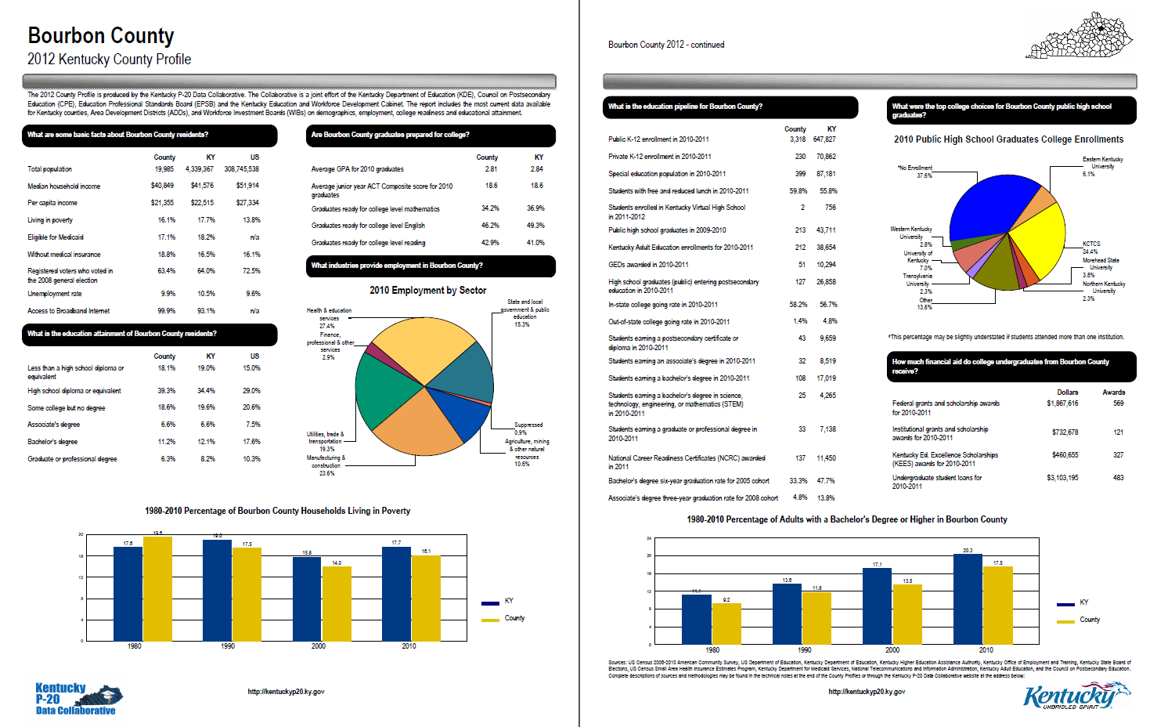
Kentucky P-20 Centralized Coordination

Slide 15
Washington

Slide 16
The Washington Setting
Education Research & Data Center (ERDC) is the focus of P20/W work in Washington State.
The Office of Superintendent of Public Instruction (OSPI) is developing a K-12 SLDS, which will serve as the source of K-12 data for the P-20/W system.
ERDC is a state education authority by statute, based in the research division of the Office of Financial Management (also home to the state’s unit-record public baccalaureate data system).
ERDC has been funded by the Legislature since 2007 and has had 2009 ARRA SLDS grant funding since 2010.
ERDC, collaborating with the state labor agency, is a 2012 Workforce Data Quality Initiative grantee.
We are now building our data warehouse.

Slide 17
A P-20W, Cross-Sector Focus: Think P-20!
Sectors: early learning, K-12, higher education (2/4-year), workforce
Focus on cohorts – a group of individuals sharing a common characteristic and observed over time (longitudinally) as a group. Two examples:
–Graduates from a particular year
–Entering 9th graders in a particular year
Two approaches
–Outcomes for a cohort (looking forward)
–Previous experiences of a cohort (looking backward)
Focus on transitions across sectors: entering kindergarten students, transition out of high school, transition from 2-year to 4-year higher ed, bachelor’s degree recipients, early leavers

Slide 18
P-20W = Longitudinal, Cross-Sector
Year-to-year change in 4th grade assessment scores
□ Longitudinal □ Cross-sector □ Trend □ P-20
High school assessment scores of 2009 graduates taking pre-college mathematics in Fall 2009
□ Longitudinal □ Cross-sector □ Trend □ P-20
Year-to-year postsecondary enrollment rate of previous spring high school graduates
□ Longitudinal □ Cross-sector □ Trend □ P-20
✓
✓
✓
✓
✓
✓
✓
✓

Slide 19
The Foundation: Identity-Matching
Personal information
Name, birthdate, ID numbers, demographic characteristics
Contextual information
Location, entry and exit dates, program participation, graduation status, GPA
Deterministic and probabilistic approaches
Currently using Link Plus software and home-grown routines
Adding Informatica tools
Use of reference data (non-education/workforce sources)
Confirmation of birthdate, last 4 of SSN, name changes
An on-going process, a continuing investment in data quality

Slide 20
Model Based on Person-Role-Organization (PRO)
Person-Role-Organization (PRO) conceptual model
–Roles include student, teacher, employee, client
–Organizations include schools, colleges, classes, employers
–A person may have several roles simultaneously, including several roles within an organization
–Program participation, assessments, achievements, characteristics, and identifiers are all related to Person-Role-Organization
Each person is associated with one P-20 ID
–the person entity is used only to assign a unique P-20 ID since all characteristics and events are captured at the PRO level
– Data warehouse contains de-identified data related to the P-20 ID. Personally identifiable information (PII) contained in a separate database with limited access.
The P-20 ID is the product of identity matching of data both within an organization and across organizations
Linking – using the P-20 ID to relate data for each individual across education sectors and employment

Slide 21
Benefits of Centralized P-20W
Dedicated to true P-20/W work – research that addresses critical questions. No within-sector transactional activity conducted using the P-20/W data warehouse.
Lean and mean – only elements required for P-20 research and policy analysis are included in data warehouse. Data warehouse contains de-identified data. PII details are handled in a separate database.
Investment in identity-matching is retained and improved over time.
Prior studies can be replicated – “from” and “to” dates stored for all elements, also “as of” dates – i.e., a bitemporal structure.
Persistent research IDs can be maintained, allowing for updating of research data sets. Identities can be merged and unmerged.

Slide 22
What’s Working for ERDC
Engaged and supportive leadership
Communication
ERDC Newsflash, press releases
Well-defined critical research and policy questions
Persistence is critical
Data governance
Organized consensus-based approach to data governance
Recognition that de-identified data is sufficient for most purposes
Master data-sharing agreement template covering release of de-identified data
Standard request process that applies to all
Data familiarity attained through use of data
Use of data to inform data warehouse development

Slide 23
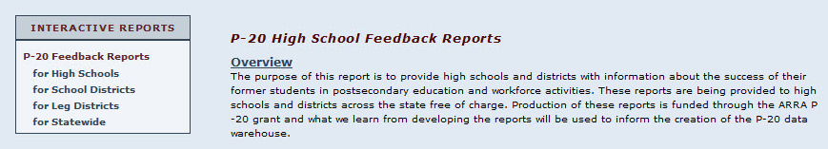
Examples: Sector-Specific P-20W Reports (+datasets)
High School Feedback Reports
Reports for community & technical colleges
Incoming students
Transfers to baccalaureate institutions
Reports for baccalaureate institutions
Incoming students
Workforce outcomes
erdcdata.wa.gov

Slide 24
Example:
K-12 student characteristics with postsecondary status
All high school graduates
By income status and type of institution.
(Universe: 2008-09 public high school graduates)
Distribution of enrollment
By income status and type of institution.
(Universe: 2008-09 public high school graduates enrolled
in any postsecondary institution)
Not enrolled
Out of state
Washington private
Washington public 4-year
Washington CTC
See www.erdc.wa.gov/briefs/pdf/201005.pdf for full report.

Slide 25
Example:
K-12 Student Employment
School-Year Employment (in high school) by Student GPA at H.S. Graduation
Universe: 2009 High School Graduates for whom employment status could be determined

Slide 26
Example: K-12 Student and School Characteristics and
Postsecondary Remedial Math Taking Rates
1
By school income level (based on percent of graduates eligible for free or reduced-price lunch (FRPL)
2
By student FRPL eligibility
Pre-College Math Course-Taking Rates,
2008-09 Public High School Graduates enrolled in public postsecondary institutions (both CTCs and 4-year institutions) in 2009-10.
Student low-income status is tied to FRPL eligibility.
Schools are classified into three categories based on the percentage of graduates FRPL-eligible.
Approximately 31,000 high school graduates are included in this analysis.
3
By combination of school income level and student low-income status
Students: Low-income
Students: Not low-income

Slide 27
Responsibilities and Principles for Sharing and Using
P-20W Data
Principle 1: Education Research and Data Center provides cross-sector, linked data to all data consumers in a consistent, transparent way.
Principle 2: Education Research and Data Center maintains the P-20W data warehouse.
Principle 3: Protecting the privacy of individuals is a priority.
Principle 4: Partner agency data contributors (at the state and local levels) are experts at understanding and explaining the data.
Principle 5: Common understanding and use of data increases its value.
Complete document: www.erdc.wa.gov/datasharing/pdf/workgroup/mou_final_201109.pdf

Slide 28
Questions & Contacts
State Support Team & SLDS Team:
Rosemary Collins, SLDS Program, Rosemary.Collins@ed.gov
Jeff Sellers, State Support Team, Jeff.Sellers@aemcorp.com
Panelists:
Charles McGrew, Charles.McGrew@ky.gov
Carol Jenner, Carol.Jenner@ofm.wa.gov

