Slide 1
Using SLDS for Federal & State Reporting
Monday, October 29, 2012
Facilitator: Jim Campbell (SST)
Panelists:
Karl Pond, North Carolina Department of Public Instruction
Bill Huennekens, Washington State Office of Superintendent of Public Instruction

Slide 2
Washington

Slide 3
Washington
BACKGROUND
Summer of 2009 awarded $5.9M Federal SLDS Grant
First grant for WA
Fall 2010 conducted an RFP for a data warehouse and reporting solution
Choice selected as vendor, contract signed in Feb. 2011 and work started.
Federal reporting was not in the scope of the grant work
Goal of work is to facilitate the transition from using data only for compliance and allocation of funding to education improvement.

Slide 4
Washington

Slide 5
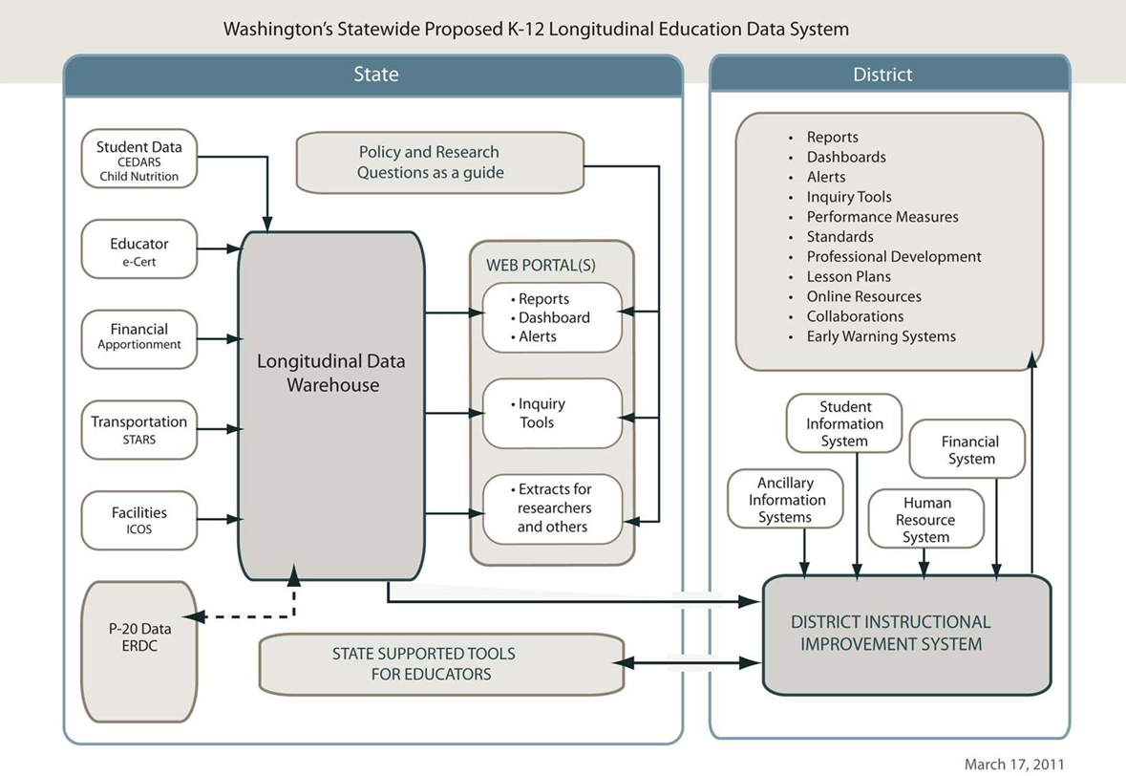
Washington
DATA SYSTEM VISION

Slide 6
Washington
MOVING FORWARD
Phase II SLDS work – not determined yet. I will argue that EDFacts should be included.
What is the database of record for EDFacts reporting?
In some cases it will be the SLDS warehouse
Other cases it will continue to be the transactional data system
Collaborative effort with business and IT staff to determine which is appropriate.
Questions to consider
Timing of data loads to warehouse and file due dates
Business rules applied as part of ETL\EDFacts requirements
Others?
Major consideration – one source of truth for data reporting. Using different sources inevitably gives you different results.

Slide 7
North Carolina

Slide 8
North Carolina
KEYS TO DATA MANAGEMENT
Factors of Success
Statewide SIS
Statewide Authoritative Sources
Data Management Group (DMG)
Lessons Learned
Support of Leadership
Business/Program Area By-in
Data Management: The Right Staff
Agency/State Priorities

Slide 9
North Carolina
DATA FLOW IN NORTH CAROLINA
Data are merged within CEDARS (Common Education Data Analysis and Reporting System) utilizing a statewide unique identifier (UID)
Files are produced from the SLDS per each EDEN specification
Files are converted to XML and submitted to EDEN
Progress To Date
2010-11 Federal reporting: 50% out of CEDARS
1011-12 Federal reporting: 100% out of CEDARS

Slide 10
Contacts & Additional Resources
Contact information:
Bill Huennekens bill.huennekens@k12.wa.us
Karl Pond Karl.Pond@dpi.nc.gov
Jim Campbell jim.campbell@sst-slds.org

