Slide 1
Texas Student Data System (TSDS)
Monday, October 29, 2012
Sharon Gaston, Texas Education Agency

Slide 2
Overview
What is TSDS?
How does TSDS work?
Demonstration
Questions & Answers

Slide 3
What is TSDS?

Slide 4
TSDS Vision
Reduce the data collection burden on LEAs, while putting real-time performance oriented dashboards in the hands of educators to improve student achievement.

Slide 5
Four Key Projects
• Opt-in, voluntary SIS
• 2 SIS vendors to choose from
• TSDS will integrate with other SIS’s – no requirement or mandate to switch
• Powers StudentGPSTM Dashboards
• Supported by TEA, but the data only available to educators
• Conduit to submit PEIMS data
• Non-PEIMS data is strictly optional, at the LEAs’ discretion
• XML data standard will make it easier to submit and certify data
• Realigns statewide data collection standards and protocol for LEAs (i.e., TEDS)
• Expanded to link pre-K, college readiness, and workforce data
• Load college readiness test score collections (SAT, ACT, AP Test data)
State
Sponsored SIS
Education Data Warehouse
TPEIR
PEIMS
Stock photos – approved for non-promotional web distribution

Slide 6
What Functionality Will TSDS Provide?
TSDS allows you to:
See student, classroom, campus, and LEA performance graphically
Save time by not having to search multiple sources for student and LEA data
Get a complete view of student performance, not bits and pieces
Use data to set goals with students, campuses, and your LEA
Get faster access to student data so you have more time for your students
TSDS offers:
A client-side validation tool for PEIMS and Dashboard data
Loading and validation of your PEIMS data not restricted to current submission windows
Potential cost savings for your student information system (SIS) contracts
TSDS will help you do ALL of the above.

Slide 7
How Does TSDS
Work?

Slide 8
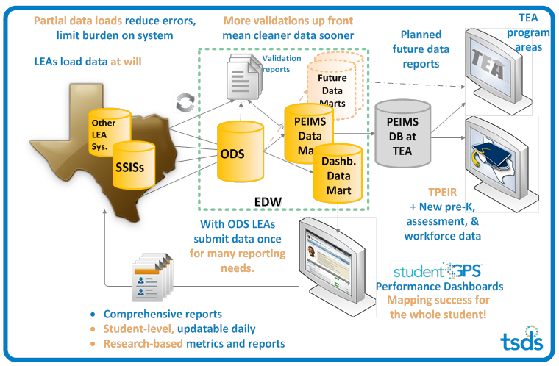
Introducing TSDS

Slide 9
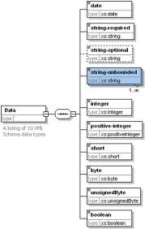
How Does TSDS Work?
EDW based on Texas Education Data Standards (TEDS)
Ed-Fi
National CEDS compliant standard
11 interchanges
Some elements dashboard specific, other used for PEIMS and dashboards
Texas Extensions
PEIMS-specific elements that can’t be fulfilled through Ed-Fi
7 interchanges
TEDS
XML-based standard
Common Data Model across all 1,237 LEAs
18 interchanges in total
For both PEIMS and dashboards
2013-14 standard stable, released to public March 2012

Slide 10
How Does TSDS Work?
Benefits to LEAs
Efficiency: TSDS can collect data once for multiple reporting requirements and can scale for growth of future collections (long-term goal).
Also, LEAs will be able to begin loading their data up to a year in advance to eliminate some of the submittal stress on LEAs.
Cost: Federal and private grants allow TEA to provide TSDS components to LEAs free of charge.
Classroom Impact: Daily uploads allowed, providing timely LEA access to performance data.
Availability: Data provided to TEA will be more accessible by all at LEAs, from classroom teachers to central office staff.

Slide 11
Student Performance Dashboards
Dashboards*
Initial dashboards based on national education research and review of best practices across the country
Received and incorporated feedback on dashboards from 4,500 educators in Texas (including LPRs)
Enhancements to dashboards based on stakeholder feedback
FERPA and HIPAA compliant—only available to authorized educators and administrators
* “StudentGPS: Mapping success for the whole student.”

Slide 12
Demonstration

Slide 13
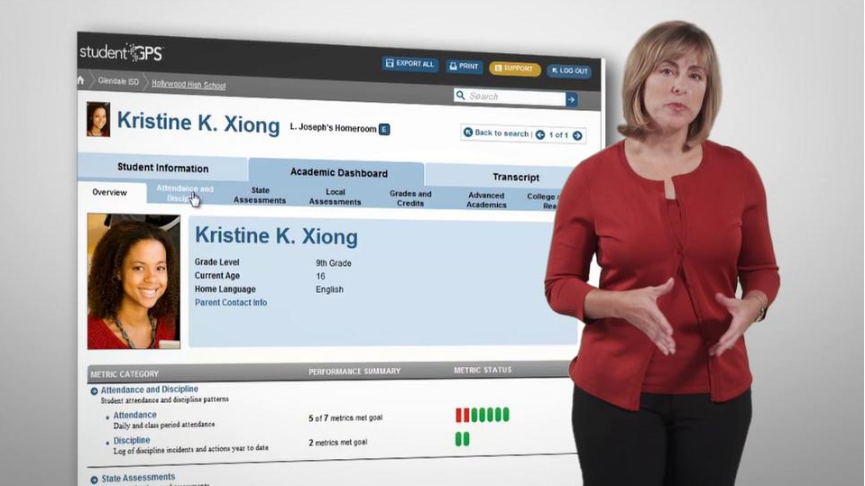
Demonstration of the Dashboards
Student and Classroom Dashboards: http://vimeo.com/47511948

Slide 14
Initial Feedback
“This will be so valuable in communicating with parents.”
“I do LOVE that now I can access info about absences, credits, college readiness, etc. at the same time!”
“With this data we would be able to identify and challenge our power kids!”
A Valuable Tool for Educators
100% of Lubbock ISD and 98% of PSJA ISD users said they are likely or very likely to recommend the dashboards to their colleagues

Slide 15
Initial Feedback
“Attendance did surprise me! Our goal is set at 95% and we are still missing the mark.”
“It surprised me to see all the red for TAKS. Our campus goals are high!”
“WOW! Everything about my school is here. Unbelievable! It’s everything I need to do my job.”
New Insights on Campus & Students
87% of PSJA users could see themselves using this tool on a regular basis to make decisions about instruction

Slide 16
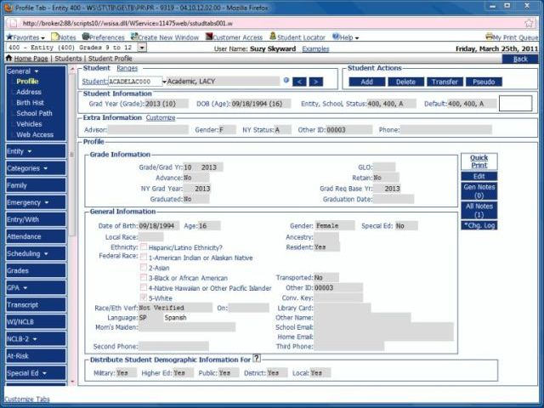
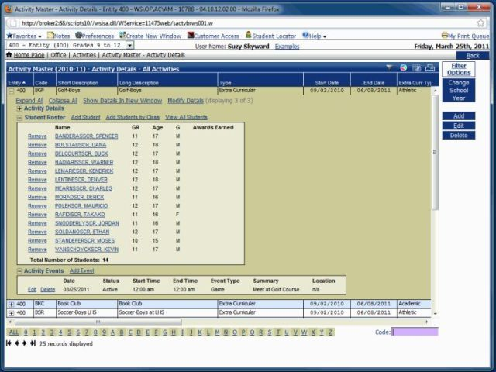
Dashboards Save Users Time
It takes 10 – 15 screens in the student information system to get the information on the dashboard student profile page

Slide 17
Inquire And Acquire Data
It takes 10 – 15 screens in the student information system to get the information on the dashboard student profile page
Which students are consistently missing class?
From the Subject-Specific Class Overview page, sort by Current Class Absences.
7 students have a high number of absences.

Slide 18
Analyze Date: Layer 1
It takes 10 – 15 screens in the student information system to get the information on the dashboard student profile page
Look across each student’s metrics.
Most have a troubling attendance trend and poor performance.
Ryan Plata’s data look a little different:
Troubling attendance trend
Declining benchmark and grades
But, meeting TAKS standard

Slide 19
Analyze Date: Layer 2
Go to Ryan’s student page to investigate.
Attendance and Course Grades are flagged telling you to dig deeper in these areas.
Interestingly, Advance Academics shows a red stoplight.
Go to the detailed metric pages to learn more.

Slide 20
Analyze Date: Layer 3
Start by looking at the attendance page.
The daily attendance rate detail available in the more menu shows us Ryan has just started having unexcused absences this grading period.

Slide 21
Analyze Date: Layer 4
The class period absence detail available in the More menu shows us Ryan recently had a death in the family.

Slide 22
Analyze Date: Layer 5
Exploring the Advanced Academics page shows us Ryan is not meeting his potential.
Ryan scored Commended on the TAKS ELA, but is not enrolled in an advanced class.

Slide 23
Take Action and Evaluate
Speak with Ryan about the recent loss in his family.
Contact the counselor and/or parents for support.
Potentially, change Ryan’s schedule to an advanced ELA course.
Check back to the dashboards frequently to monitor his attendance and academic metrics.

Slide 24
Questions & Answers

Slide 25
Contacts & Additional Resources
Contact information:
Sharon Gaston, Sharon.Gaston@tea.state.tx.us
Jeff Sellers, jeff.sellers@sst-slds.org
For more information on TSDS:
The Texas Student Data System: http://www.tea.state.tx.us/tsds/

