Slide 1
Early Childhood Data Use
The presentation will begin at approximately 1:00 p.m. ET
Information on joining the teleconference can be found on the “Info” tab in the upper left of this screen. Be sure to use the “Attendee ID” number on the Info tab when dialing in to associate your name with your phone.
In order to cut down on background noise, please mute your phone by dialing *6 upon entry into the meeting.
During the question and answer portion of this presentation:
You can re-enter *6 to unmute your phone and ask a question; or
Type your question into the Q&A panel below the participant list and clicking “Send”.
A copy of this presentation and a link to the recording will be shared with the IES Grantees and EIMAC listservs.

Slide 2
Introduction to
Early Childhood
Data Use
Part II

Slide 3
Welcome
Panelists
Mike Taquino (Mississippi)
Gayle Kelly (Minnesota)
Rich Miller (Kentucky)
Agenda
Introduction to using EC data use- Create
Learn about examples from other states creating early childhood products and use
Share ideas about future possibilities of using EC Data
Questions from participants

Slide 4
Early Childhood Data Use
What does it mean to effectively use early childhood data?
Determine the mission and/or goals (i.e., what are you trying to do?)
Identify and prioritize the users/roles you want to serve in support of the goals
Determine and prioritize the decisions or actions by those roles that you want to inform and influence
Identify the appropriate, relevant data necessary to inform and influence those decisions and actions
Notes:
Corey

Slide 5
Data use Framework
CREATE
SUPPORT
PLAN
large images

Slide 6
Review- Data Use Framework: PLAN
CREATE
SUPPORT
PLAN
Mission and Goals
What is the point?
Identification and prioritization of users
Who are we serving?
Identification of uses
What types of decisions and/or actions will the system inform?

Slide 7
Data Use Framework: CREATE
CREATE
SUPPORT
PLAN
Stakeholder engagement
How do we involve those whom
we intend to serve?

Slide 8
Data Use Framework: CREATE
CREATE
SUPPORT
PLAN
Stakeholder engagement
How do we involve those whom
we intend to serve?
Products/Resources
What types of products
and resources will the SLDS generate?

Slide 9
Data Use Framework: CREATE
CREATE
SUPPORT
PLAN
Stakeholder engagement
How do we involve those
whom we intend to serve?
Products/Resources
What types of products
and resources will the SLDS generate?
Delivery
How will you deliver data to key users?

Slide 10
Early Childhood Data Use
Mississippi Context:
How did this work begin?
Three Aspects of SLDS in Mississippi
Workforce
Education (P-20)
Early Childcare
How is Early Childcare linked to P20 Efforts?
Early Childcare is part of the SLDS Team in Mississippi

Slide 11
Early Childhood Data Use
Mississippi Context:
How do we involve those whom we intend to serve?
Partnership with data and programmatic stakeholders, including state agencies (e.g. Departments of Health, Human Services), other early childcare groups (e.g. Head Start), and programmatic experts
What types of products/resources will the EC/SLDS generate?
The MS SLDS provides technical, analytical, and research expertise
Early Childcare data is linked to P20
How will you deliver data to key users?
Aggregate statistics are delivered through an online portal (Mississippi Lifetracks) and through ad hoc reports, primary data collection

Slide 13
Early Childhood Data Use
Minnesota Context:
Data aggregation grew out of the State Association’s learning community around Quality Assessment (formed in 2006)
Early questions from the State SLD developers prompted the community to want to explore their aggregated data before entering the state system
Programs were challenged to gather data from different sources to build a data base that could address questions of child progress and program effectiveness

Slide 14
Early Childhood Data Use
Minnesota
Data sharing requires trust and a commitment to continuous improvement. Head Start grantees respond to opportunities that allow them to be a part of a community of learners without fear of consequences
The MN Head Start Longitudinal Data System should help us understand what to measure, how children make progress in EC and how progress can be sustained into formal education
Ideally, real-time data analysis is our goal to ensure the data going into the system is useful and informs instruction. As children leave Head Start we hope to archive a set of variables that will also be useful for research and advocacy

Slide 15
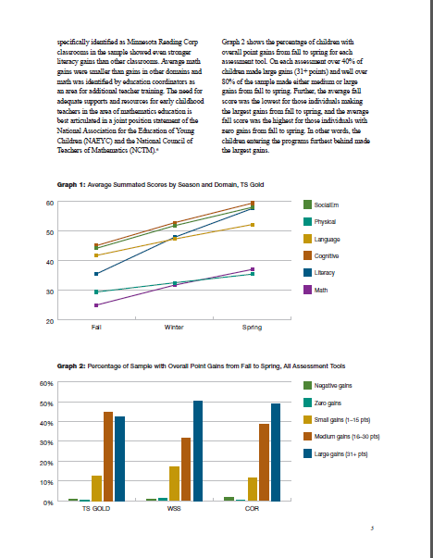

Slide 16
Early Childhood Data Use
Kentucky Context:
The Governor’s Office of Early Childhood created a Data Reporting focus Group for Communities – 6/2012
Vision – Increase school readiness – success
Improve environments – Support Families – Providing Data
Priority questions were developed
Are Children Ready? – Strengths and Needs – Target at-risk populations
Build an annual report card
Early Childhood funded SLDS data efforts and reports
EC data from OSEP assessments – Univ. of Kentucky
Brigance screener data from Department of Education
Family Services – Cabinet for Health and Family Services
Head Start – enrollments and participation – Head Start

Slide 17
Early Childhood Data Use
Kentucky
The GOEC created Early Childhood Communities through the Advisory Council – funding via grants to build community relationships with Education, head start and
Develop MOU’s if required, leverage public data, research data.
Build the baseline of EC Community data in 2013
The first deliverable was the 2013 Early Childhood County Profile – two pages of summary information for each county – state – technical notes.
http://kcews.ky.gov/Reports/EarlyChildhoodProfile/default.aspx
Expand data from CHFS – Kentucky Youth Advocates

Slide 18
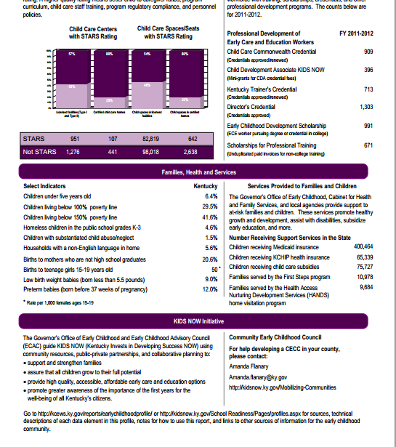

Slide 19
Summary:
Early Childhood Data Use
 | Kentucky | Minnesota | Mississippi
Example Primary Audience | Communities for planning/funding | Focused on Head Start | Focused on Head Start
Stakeholder Engagement | Focus groups | HS grantees conceptualized and carried out the project | Head Start was a partner in the study of the “fade out effect” of the assistance they provide
Products | Community Profile | Head Start Program Report | Analysis Report on Child Outcomes from Prek-3
Delivery | Share as a web-based tool | Real-time analysis for grantee use as well as reports for statewide advocacy | National Conference, Research article

Slide 20
Next Webinar in the Series
Early Childhood Data Use: Supporting Use of the Data
June 2013

Slide 21
Questions or comments

Slide 22
Page Title Here
Questions?
Contacts:
State Support Team & SLDS Team:
Missy Cochenour, (909) 241-4264 , Missy.cochenour@sst-slds.org
Panelists:
Mike Taquino: MTaquino@nsparc.msstate.edu
Gayle Kelly: gayle@mnheadstart.org
Rich Miller: rich.miller@ky.gov

