Slide 1
Researcher Access to the SLDS
The webinar will begin at approximately 1:00 PM EST.
Information on how to join the teleconference can be found on the “Info” tab in the upper left of this screen. Please be sure to use the “Attendee ID” when dialing in to associate your name with your phone.
  In order to cut down on background noise, please mute your phone by dialing *6 upon entry into the meeting.
  For the Question and Answer portion at the end of the presentation:
You can re-dial *6 to unmute your phone and ask a question; or
Type your question into the Q&A panel below the participant list and click “Send.”
A copy of this presentation and a link to the recording will be available at http://nces/programs/slds/webinars.asp

Slide 2
Webinar Overview
Panelists
Kansas: Kathy Gosa
Virginia: Bethann Canada
Kentucky: Charles McGrew, Kate Akers
Facilitator
Keith Brown, State Support Team
Topics
Data access policies
Restrictions on use of data
Responsibility for approval/review of data requests
Levels of data access
Funding policies/strategies for data access

Slide 3
Researcher Access to the SLDS
Kansas

Slide 4
Data Request / Access Process
  Requests for access to data are submitted online
    Phone calls and emails are referred to website http://www.ksde.org/DataReports/DataRequests/RequestforData.aspx
  Overseen by Data Request Review Board (DRRB)
    Five-member board representing agency divisions & reporting to Data Governance Board
    Meets monthly in person; ad hoc virtually
      Reviews status of routine requests
      Approves denials, charges, and non-routine requests
      All requests for PII must be presented to DRRB
    Mission … to implement processes for the provision of accurate, timely data and information to our internal and external customers while protecting personally identifiable student information and other confidential information
    Provides consistent treatment of data requests

Slide 5
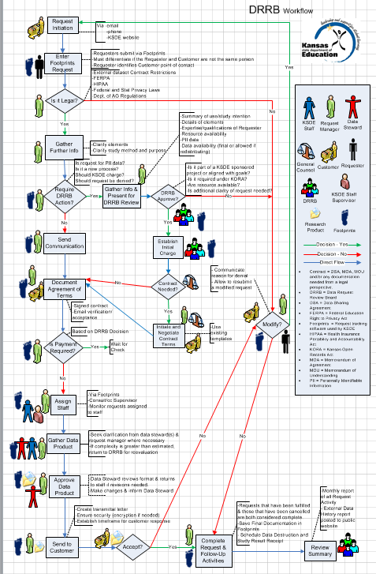
Considerations
Process for prioritization and denial
Process for routine requests and for exceptions

Slide 6






Data Request / Access Process
  Defined Roles & Responsibilities
    Data Request Review Board
    Request Manager
    Data Steward
    General Counsel
    Requester
    Customer
    Agency Staff

Slide 7
Data Request / Access Process
  Decisions
    Routine or requires DRRB action?
      Data Availability?
        Do we have it?
        Is it publically available?
      KORA?
      Restricted data?
      Charge?
        Reformatting
        Requires significant staff time
      Alignment with State Research Agenda/BOE Goals?

Slide 8
Data Request / Access Process
  Decisions
    Routine or requires DRRB action?
    DRRB must approve
      Requests for which fees are charged
      Denials
      Requests involving PII/Restricted Data
        PIA is assigned
        Requester is invited to attend/defend
  Extending to P-20 data
    For requests involving P-20 data, a Board of Regents representative sits on our DRRB and has veto power

Slide 9
Streamlining the Process for Researchers
  Why?
    Research aligns with state research agenda
    More efficient for us!
  How?
    Training http://www.ksde.org/DataReports/DataRequests/DataRequestTraining.aspx
Module 1: All Data Requests | Module 2: Restricted-Use Data Requests
KSDE’s Data Request Process KSDE Data Collection Overview Public Data Sources Website Navigation Metadata Ethical Use of Education Data | KSDE’s Data Access and Use Policy for Personally Identifiable Student Information Data Reporting Practices Best Practices for the Storage and Destruction of Data based upon KSDE’s PII Agreement

Slide 10
Streamlining the Process for Researchers
  Why?
    Research aligns with state research agenda
    More efficient for us!
  How?
    Training http://www.ksde.org/DataReports/DataRequests/DataRequestTraining.aspx
    PIA (Primary Investigator Advocate)
      Assigned when “supported” research request is submitted
      Assists the researcher in navigating our process
      Provides summary to DRRB
    Templates/Agreements/Forms
      FERPA Agreement Templates
      Data Destruction Template

Slide 11
Other Critical Success Factors
  Automated tracking
    Essential for FERPA Recordation
    Greatly enhances efficiency
    Informs priorities for public reporting
  Transparency
    Request History Report http://www.ksde.org/DataReports/DataRequests/DataRequestHistory.aspx

Slide 12
Researcher Access to the SLDS
Virginia

Slide 13
Data Access Policy for
Non-Sensitive Data
Non-sensitive data is published on the web with cell suppression
Check out our data for researchers page
  http://www.doe.virginia.gov/statistics_reports/research_data/index.shtml
“Service Request Tracking System”
Ad hoc/FOIA requests are logged and tracked
All requests must be approved by a director

Slide 14
Data Access Policy for PII
A contract must nearly always be in place
A Restricted Use Data Agreement (RUDA) must be in place
  Specifies the data, data protection plan, data destruction plan
  Each individual accessing must sign a non-disclosure agreement
If multiple agencies are involved, each must approve the RUDA
This function is automated in VLDS

Slide 15
The Federated Model
State law does not allow us to house multi-agency data in a single data store
The data must be de-identified, merged by a third party, then de-identified again (double de-identification)
The participating agencies (Data Governance Council) had to agree on:
  A research agenda
  The approvals needed for researchers to request data
Data requests are made by the researcher through a portal
Microsoft Dynamics CRM manages the workflow behind the scenes
Research purpose must “fit” the research agenda
All agencies whose data is being requested must approve

Slide 16
The Initial Research Agenda
How can Virginia improve high school graduation rates while increasing students’ preparation for college and careers?
How can Virginia improve the preparation, recruitment, and retention of Virginia’s educational personnel, including their meaningful and ongoing professional development, especially in teacher shortage areas and in hard-to-staff schools?
How can Virginia improve performance of the public workforce system?
By what means can Virginia’s public workforce development system meet the needs of job seekers/workers and employers?

Slide 17
Current Participating Agencies
Department of Education
State Council on Higher Education
Virginia Community College System (Workforce)
Virginia Employment Commission
Coming on board in 2014
Department of Social Services (DSS)
Department of Aging and Rehabilitative Services (DARS)
Department of Labor and Industry (DOLI)
Early Childhood Data

Slide 18
Process Steps

Slide 19
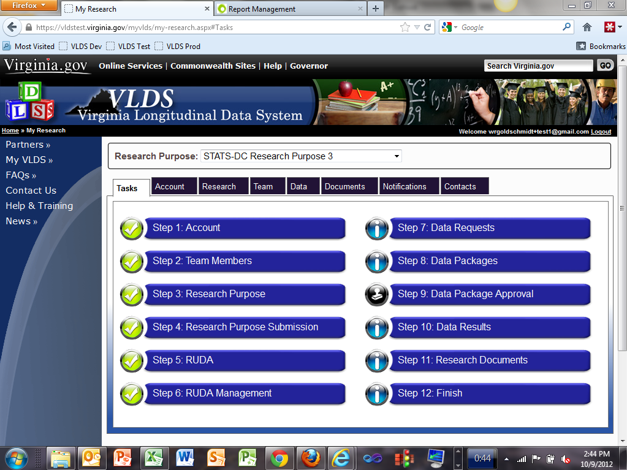
Process Steps

Slide 20
Current Research Projects
College and Career Readiness
SIG Schools Evaluation
Career and Technical Outcomes
Study of successful partnerships in other states
Brainstorming meetings being scheduled

Slide 21
Bridging the Data Divide:
Areas of Analysis
Project to improve state agency-university researcher partnerships
  Facilitated by Virginia Commonwealth University
Case study of state-university partnerships
Study of successful partnerships in other states
Brainstorming meetings being scheduled

Slide 22
Bridging the Data Divide:
Areas of Analysis
Organizational culture, value, and roles
Data governance and access
State agency-researcher perspectives
Lessons and recommendations

Slide 23
Researcher Access to the SLDS
Kentucky

Slide 24

Independent office created through legislation
Board composed of state agency heads
Operates the Kentucky Longitudinal Data System
Provides information to help decisionmakers
Responds to requests for data or information
Research and evaluation functions for the state and staffed accordingly

Slide 25
Current Data Sources
Public K12 students, teachers, staff
Private high school students
Public and independent 2- and 4-year colleges
Private (proprietary) colleges that provide training
Out-of-state colleges
Adult education / GED
Educator Licensure
Kentucky Employment and Wages and Unemployment
Workforce and training program participation
Early Childhood and Preschool
Financial Aid

Slide 26
Data Access and Use
State law prevents KCEWS from releasing identifiable information
KCEWS staff are the only people by law who can access the Kentucky Longitudinal Data System (KLDS)
Data in the KLDS remain the property of the data providers
Data Access and Use Policy governs how KCEWS responds to requests for statistical information and data files

Slide 27
Types of Data Requests / Access
Agency (providers) researchers access the De-Identified Reporting System (DRS) – a report-writing tool linked to de-identified data
Statistical information or reports with redaction
Person-level files for statistical analysis

Slide 28
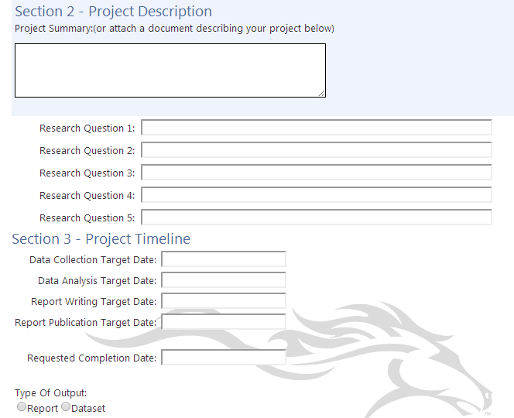
Data requests are received through the website, which triggers an entry in the project management system.
Statistical data requests are always provided if the data are available.
Requests for files are reviewed for their validity as research and must be approved first by KCEWS and then by the data owners.

Slide 29
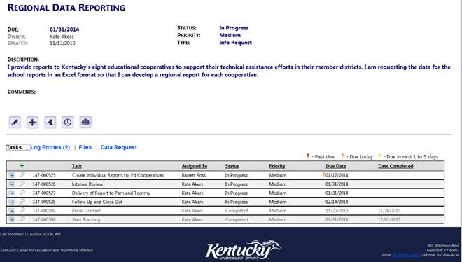
Once the data request is made through the web it automatically goes into the custom Project Management Tool where:
Alerts are sent to the research staff
Tasks are entered into the system with alerts for things that need to be done
The PM Tool tracks progress for each data request and any follow-up or documents collected

Slide 30
Data Access for Researchers
Approved requests for data files must complete an MOU that outlines researcher responsibilities
Data files are provided in a secure manner (developing a virtual machine where they can analyze it in the future without the data “leaving” KCEWS control)
Any reports or publications must be provided in advance to KCEWS for review to ensure the acceptable use guidelines are followed correctly
Data MUST only be used to investigate the research proposed in their proposal
Data files must be destroyed or returned along with all copies at the end of the agreement

Slide 31
Data Access Areas of Concern
All persons or entity level data files are considered confidential whether they have names and SSNs or not
Researchers want to use the data for topics outside the scope of the approved project
Researchers want to allow others (students) to use the data
Researchers may not have the right background to know if they have a truly secure environment for the data or not
Time involved in evaluating research requests, developing the data, assembling the documentation, answering researcher questions, and following up with the agreements

Slide 32
Researcher Access to the SLDS
Questions?

Slide 33
Contacts & Additional Resources
Contact information:
Keith Brown, keith.brown@sst-slds.org
Kathy Gosa, kgosa@ksde.org
Bethann Canada, bethann.canada@doe.virginia.gov
Charles McGrew, charles.mcgrew@ky.gov
Kate Akers, kate.akers@ky.gov
For more information on researcher access to the SLDS:
Data Use Issue Brief 2: Forming Research Partnerships with State and Local Education Agencies: http://nces.ed.gov/programs/slds/pdf/Data-Use-Issue-Brief-2_Research-Partnerships.pdf
Webinar: Using SLDS Data ⎼ Working with Researchers: http://nces.ed.gov/programs/slds/webinars.asp
Forum Publications: Forum Guide to Supporting Data Access for Researchers: https://nces.ed.gov/forum/publications.asp

