Slide 1
Integrating Early Childhood Into SLDS: Planning and Project Management
Thursday, March 15, 2012
Carol Noddings Eichinger, Wisconsin
Michael Rebar, Oregon
Tony Ruggiero, Delaware
Missy Cochenour, State Support Team

Slide 2
Objectives for this Session
Introduce where states currently are in integrating EC into the SLDS
Discuss steps to begin integrating EC into SLDS
Discuss state examples of how to use the tools
Notes:
SST (Missy) will introduce the objectives for the session.(2 mintues)

Slide 3
Identifying the Need
“Growing state momentum; increased federal support, including the State Advisory Councils’ specific focus on data systems development; and nationwide interest in using data for continuous improvement make this the ideal time for states to build and use coordinated state ECE data systems.” —Early Childhood Data Collaborative, 2010
“No state has a fully developed state early childhood data system. All are engaged in some work in building that system.” —Build Initiative, 2009
“While the state collects many types of data related to early childhood, [states] do not have the capacity to connect it, track children’s progress, or use it to assess the system.” —Wisconsin Early Childhood System Assessment Report (UW-Madison LaFollette School of Public Affairs, 2010
The Wisconsin ECAC supports a major goal of data alignment —Create a comprehensive longitudinal data system to be used in planning and decisionmaking.
Notes:
SST will discuss identifying the need (3 minutes)
Susan, anything else you would like to reference? Also, would you mind discussing this slide?

Slide 4
Addressing the Need
To address the need, the State Support Team created a Planning and Project Management Work Group to help create relevant generalizable resources.
Three states of the eleven states are going to help us walk through planning and project management for development and integration of the early childhood SLDS.
Notes:
SST (Missy) will do a quick overview of how the need for this service was established. Then introduce our state panelists for the day. (3 minutes)

Slide 5
Where to Begin…
So were do we begin? ...Planning & Project Management!
EC Self-Assessment Tool
EC Planning Guide
Three steps to begin:
Step 1: Complete Early Childhood Self-Assessment Tool
Step 2: Identify your state’s needs
Step 3: Use the Planning Guide to start conversations
Step 4 (if needed): Request Technical Assistance
Notes:
SST introduce the rest of the converation (1 minute)

Slide 6
The Tools
Both documents have 8 sections focused on the components of planning
EC Self-Assessment Tool
Each section includes questions for a state to address
EC Planning Guide
Each section includes detailed guiding language to help stakeholders start planning
Notes:
Missy will do a quick overview of actual resources and how they were developed (10 minutes total, 5 minutes each resource)
EC SA tool
Purpose and process of creating
Structure
Content
EC Planning Guide
Purpose and process of creating
Structure
Content

Slide 7
Wisconsin’s Example
Step 1: Complete Early Childhood Self-Assessment Tool
How did these tools help Wisconsin in initial project planning and management?
Completion identified gaps in WI’s planning process, such as the need for a communication plan.
Structure provided paradigm for discussion at WI’s pending Data Roundtable.
Created a “road map” for the journey.
Website development of important documents for public consumption also evolved.
Notes:
Carol (5-7 minutes)
Mike and Tony to follow (1-2 minutes each)

Slide 8
Oregon’s Example
Step 2: Based on results of the Self-Assessment Tool, identify your state needs.
How did these tools help Oregon identify its needs?
Coordination of communication: A multitude of committees and workgroups
Body of evidence
From humility to utility
Notes:
Mike (5-7 minutes)
Prevents Groundhog Day: Same communication/conversation over and over and over
Shared understanding of capabilities, needs, priorities
SB909: Complete restructuring of 0-20 education in Oregon
New Early Childhood Agency
New EC ‘Early Learning System’ by 7/1/2012: Requirements coming soon!
Hug your standards!
CEDS isn’t the only lovely standard
Data Governance
DAMA
Body of Evidence: Is it soup yet, whodunnit? to evidence
Humbling to realize how little we know about niches of the EC world
Tony and Carol (1-2 minutes each)

Slide 9
Delaware’s Example
Step 3: Use the Planning Guide to start conversations
How did these tools help Delaware start conversations?
Starts conversations with P-20W Council
Early Childhood Essential Questions
Research or Evaluation Questions
Importance of working collaboratively across Departments
Starts conversations with our own technical department
What data systems are in place and what are the plans for a future system?
Is EC part of the data system or part of plans for a future system?
What is the timeline to incorporate EC data into data system?
Notes:
Tony (5-7 minutes)
Starts conversations with P20W Council
Early Childhood Essential Questions
Research or Evaluation Questions
Importance of working collaboratively across Departments
Starts conversations with our own technical department
What data systems are in place and what are their plans for future system?
Is Early Childhood part of data system or part of plans for future system?
What is the timeline to incorporate EC data into data system?
Starts conversations with other departments and agencies
Helps to think about various stakeholders, particularly data stewards
Provides support to P20 Council
Communication Plan
Agreement Form
What needs to be done with the EC data in order for it to roll into data system?
Carol and Mike (1-2 minutes each)

Slide 10
Delaware’s Example
How did these tools help start conversations? (continued)
Starts conversations with other departments and agencies
Helps to think about various stakeholders, particularly data stewards
Provides support to P20 Council
Communication Plan
Agreement Form
What needs to be done with the EC data in order for them to roll into data system?

Slide 11
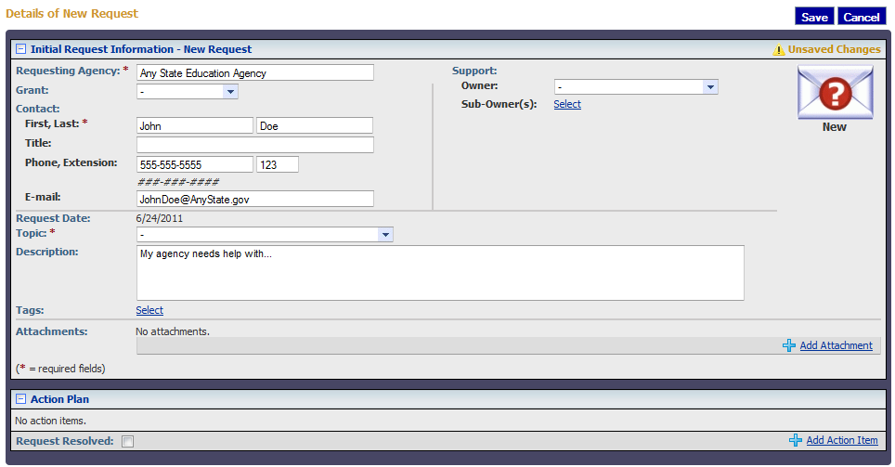
Development of Resources
Step 4: Request free technical assistance.
To Request SST Support:
Fill out a TA Request
Form on GRADS
…or email
support@sst-slds.org
What is the process? State examples
Notes:
SST can talk about ways to do this. (2 minutes)
WI can discuss asking for additional TA. (3-4 minutes)
DE and OR please feel free to jump in, but we realize that we have not worked with you all outside of the work group. You can always request TA before MIS and then if will be fresh in your mind! ☺

Slide 12
Questions & Answers
Thank you!!
Notes:
SST will facilitate questions and hope that each panelist will help answer as appropriate. (10-15 minutes)

Slide 13
For Additional Questions
Resources:
Early Childhood Self-Assessment Tool
Early childhood Planning Guide
To Request SST Support:
Fill out a TA Request
Form on GRADS
or
support@sst-slds.org

