Slide 1
Project Management Tips
Rick Rozzelle – Moderator
Cathy Rinehart–Kansas
Jim McMahon–Louisiana
Deb Holdren - Georgia

Slide 2
Agenda
Is Project Management Essential?
How we manage Projects
Project vs. Program Management

Slide 3
Is Project Management Essential?
Yes!
Silos
Master Data Management
Managing multiple projects
Scope, Cost, Time, and Quality
Risk, Visibility, and Complexity
Grant Management
State Project Management needed even if you have Vendor Project Management!

Slide 4
The Request For Proposal (RFP) sets the standard
Define the Requirements
General & Functional
Technical (Hardware & Software)
Data Specifications
Reporting
Timeline
Budget (optional)
Growth
Performance
Testing
Training
Other Requirements
Needs, Timeline, Deliverables, and Budget

Slide 5
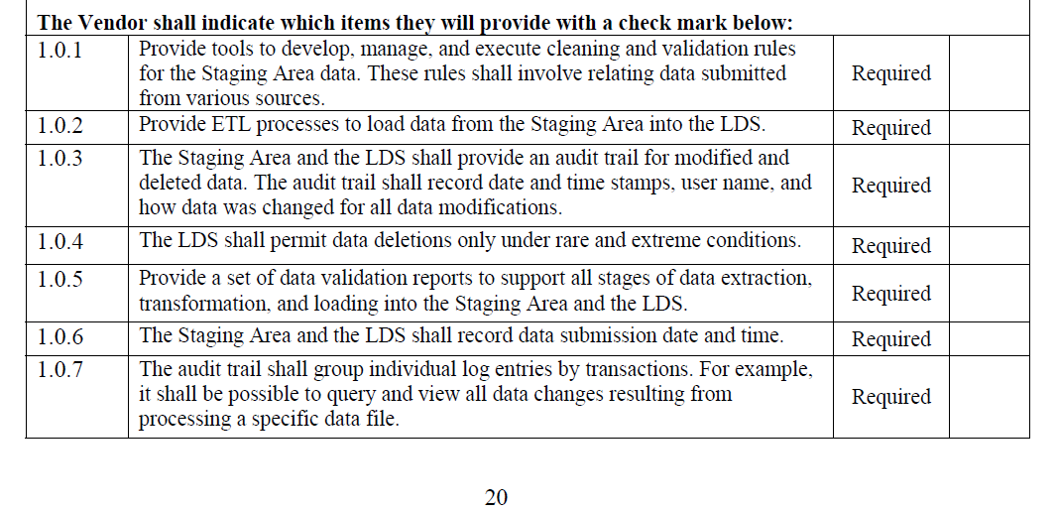
Sample of RFP requirements definition.
Needs, Timeline, Deliverables, and Budget

Slide 6
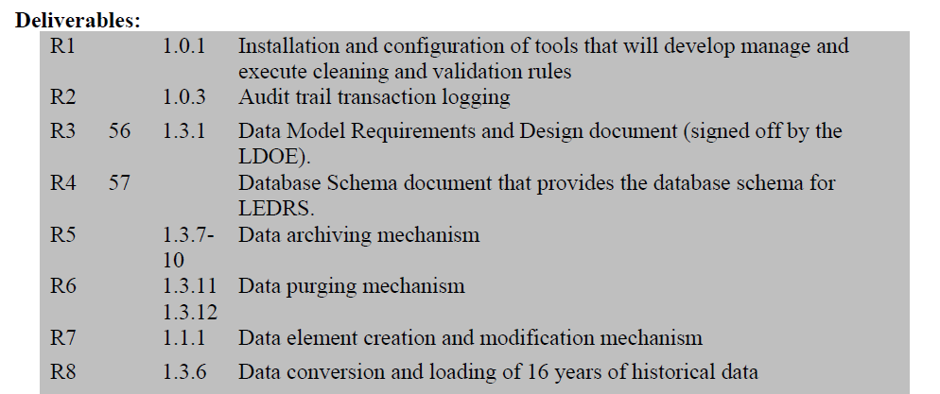
Sample of Contract alignment with RFP (Attachment-A Deliverables).
Needs, Timeline, Deliverables, and Budget

Slide 7
Sample of Contract alignment with RFP (Attachment-D Payment Schedule).
Needs, Timeline, Deliverables, and Budget

Slide 8
Sample of Contract alignment with RFP (Attachment-C High-Level Project Plan).
Needs, Timeline, Deliverables, and Budget

Slide 9
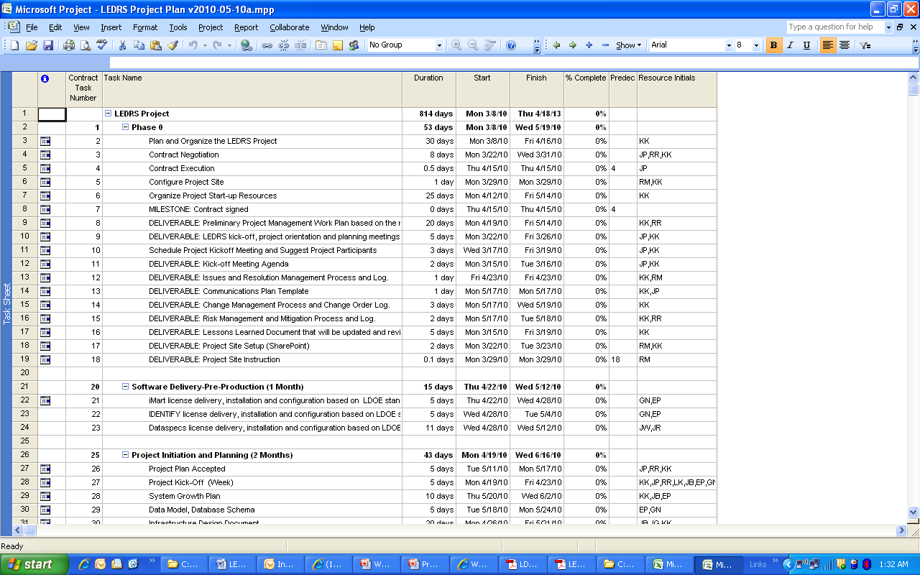
Sample Detailed Project Plan
Managing Resources, Time, and the Budget

Slide 10
Sample Management Status Report
Managing Resources, Time, and the Budget

Slide 11
Day-to-Day Project Management
Daily Team Meetings (Stand-up)
Daily tech meeting
Weekly managers meeting
Weekly sub-contractor meetings
Regular on-site visits by primary contractor executive
SharePoint Team Site
Managing Resources, Time, and the Budget

Slide 12
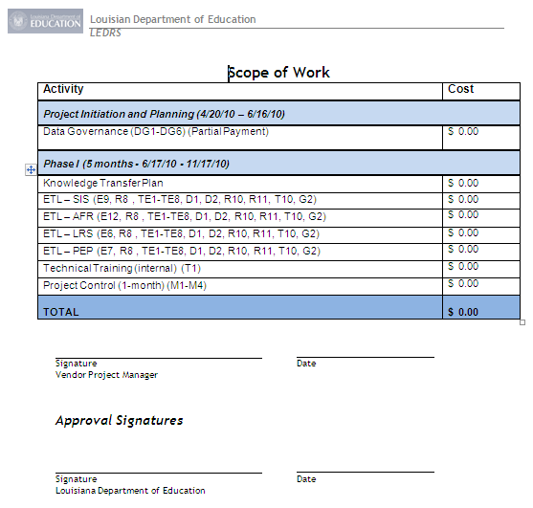
Sample Acceptance Document
Managing Resources, Time, and the Budget

Slide 13
Sample Invoice
Managing Resources, Time, and the Budget

Slide 14
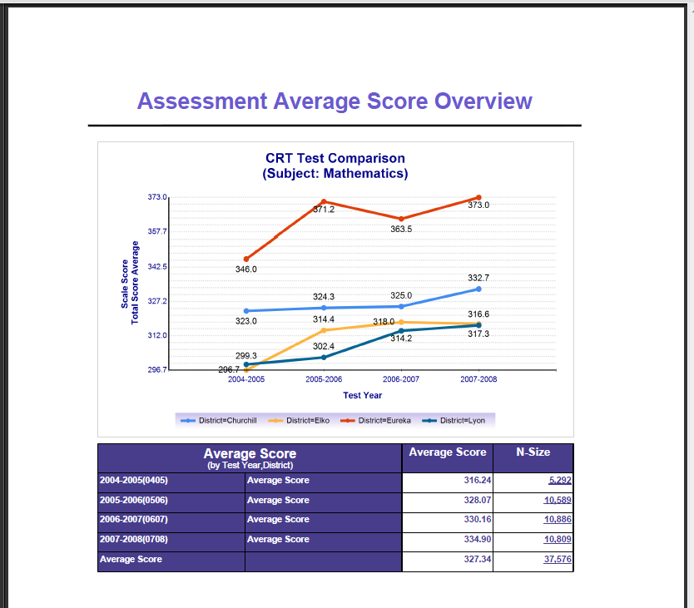
SUCCESS: Win - Win!
Client defines the expectations.
Vendor and Client are clear on expectations.
Deliverables are identified.
Milestones are identified.
Process to manage the project on a daily, weekly and monthly basis.
Process to get acceptance and fulfill contract.

Slide 15
Project / Program Management
Project Management
Size Varies
Can Be A Program
Delivers Program Benefits
May Be Interdependent
Led by Project Managers
Grant Objectives
Feeds Program Mgmt.
Program Management
Coordination of Multiple, Related, Aligned Projects
Plus Grant Mgmt
Communication Critical
SLDS Grant Level
Alignment
Feeds Portfolio Mgmt.

